Slide 1
Tencent iOA
Zero-Trust Security Management System
2023

Slide 2
Zero-Trust concept and evolution
Tencent Zero-Trust security solution
Success stories
Content

Slide 3
PART 1
Zero-Trust Concept and Evolution

Slide 4
Background: Diversified working environments leads to blurred boundaries on corporate network
Internet
Public Cloud
SaaS
On-premise Datacenter
Main office
PC/Laptop
Branch office
Home
Public
Workstation
Mobile
As the cloud service is gaining wider adoption and remote working is increasing, the security boundaries of corporate have blurred over years. This brings an issue that the traditional security solution based on boundary protection may not address the challenge of digital transformation.

Slide 5
New Challenges to Traditional Cybersecurity
Challenges arose from Digital Transformation
High Cost and Complexity
Fragmented Security Management
Lack of Control to Services Deployed in Cloud
The digital transformation of corporate is driving the need to apply new technologies such as cloud computing, big data, and the Internet of Things. The adoption of these new technologies poses new challenges to the traditional network security technology and management methods.
The development of corporate business has been expanding to hybrid cloud and multi-cloud environments. However, the failure to implement security controls on time has resulted in security blind spot, which leads to difficulty conducting unified security management and control.
Endpoint security, identity management, and business application access control are fragmented and disconnected. There is an urgent need for an effective way to integrate these capabilities in providing a holistically defence mechanism.
Corporate access and security management are complex and ever-changing. Traditional technologies are complex and require lots of effort to make changes, resulting in long cycles to make changes that involve hardware and software components. It also incurs additional costs on hardware and operational labour.

Slide 6
What is Zero-Trust?
Traditional Security Mindset
Zero-Trust Mindset
Trust all internal network traffic by default, authorize user based on IP and location
VS.
Do not trust anything by default, authorize based on identity and user behavior
What
is it?
Zero-Trust is a security concept instead of a technology or a product.
Assuming the network environment is already compromised: for every access request and service execution, a holistic, dynamic and smart access control verification is always required based on as many factors as possible (such as human, device, system etc) to lower uncertainty of policy decision. Access to resources is secured with end-to-end encryption.
Continuous Validation, Never Trust

Slide 7
Zero-Trust Concept Evolution and Practices
2010
2013
2019
2020
2021
Zero-Trust brought up by John Kindervag, Chief analyst of Forrester
CSA brought up Software-Defined Perimeter (SDP) and it’s the first technical solution of zero-trust.
Tencent Security initiated zero-trust project under ITU-T, contributed to standardized implementation.
Tencent co-published Whitepaper of Zero-Trust practices and implementation
Tencent led ITU standard, shortlisted by authorities such as Gartner, IDC, CSA.
US officially published NIST SP800-207 Zero-Trust Architecture Standard in Aug
2011
2016
1994
2019
Google launched BeyondCorp project and implementing zero-trust within the company. Published articles about BeyondCorp in 2014
Tencent started implementing zero-trust within the company and apply to the entire organization.
Jericho Forum explored on security architecture and solution for borderless network
Gartner published“Market Guide for Zero Trust Network Access”
2020
Ideation
Development
Implementation

Slide 8
PART 2
Tencent iOA
Zero-Trust Security Solution

Slide 9
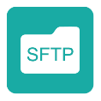
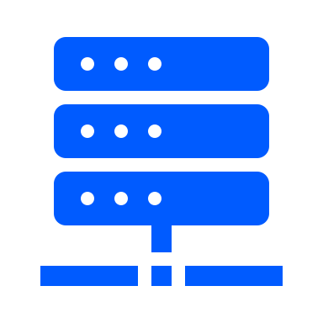
Tencent iOA Security Solution Overview
Data Analysis & External Data Sources
User Access
ID security big data
Device Risk big data
Enterprise App
iOA Client
Security Engine
App risk
big data
Threat Intelligence
IAM
Distribute policy
Zero-Trust Mgmt System
Identity sync
Collect status
AD/LDAP
Endpoint Security & Mgmt
Centralized Policy Mgmt
Browser
Endpoint Credibility
Identity Mgmt
App credibility
Self-adapted MFA
Private Cloud
Application
Encrypted Connection
Public Cloud
Encrypted Connection
Zero-Trust network gateway
Datacenter

Slide 10
Design Principle – Continuous Validation
Based on Tencent’s best practice, build the next-gen security framework on
identity, endpoint, application & access
Trusted Identity
Trusted Device
Trusted Application
Trusted Link
WeCom QR Scan
Anti-Virus
Combine long & Short connection
System hardening
Authorize only trusted app
Fingerprint / Facial recognition
Local identity
Force validation for all access
Compliance Check
Threat response
Network encryption
AD identity
Real-time blocking malicious process
SMS / token
Endpoint access
Invisible service
Network acceleration
Data Protection
Dynamic assessment
Notes:
接下来我介绍一下我们整个体系建设的理念：
1、归纳一下，腾讯iOA整个零信任体系基于4T的可信原则，持续验证，永不信任，来实现整个零信任方案的运转
2、身份可信：我们对接企业的身份管理系统（我们内部叫TOF），以及根据我们配置的授权管理，通过扫码，密码等方式实现员工的身份认证。
3、设备可信：设备可信是安全很重要的一环，依托我们超过20年的基础安全技术积累，通过病毒防护，漏洞修复，安全合规等手段实现设备环境的可信
4、应用可信：历史上chrome，xshell等工具都爆出过严重的安全问题，正规软件也未必是安全的，我们可根据业务情况，指定和控制特定版本的应用对系统的访问权限控制
5、链路可信：互联网接入成为常态，公司敏感数据在互联网上传播是比较敏感的事情，我们通过严格的链路加密，安全校验，保证数据传输不被黑客劫持和嗅探。
6、基于这几大安全原则基础上，整个系统是一个动态监测的系统，持续验证，永不信任，来实现整个职场安全和运营体系的构建。

Slide 11
Core Capabilities - Identity Management
Unified Identity Management
Identity Validation and Binding
Identity-Based Policy
AD/LDAP
Automatic acquisition of identity information （Domain）
Endpoint Compliance and Hardening
WeCom or other enterprise IM
Identity-Device Binding
Access Channel
Integrate existing IAM
Manage different devices on the same platform
Resource Access Control
Notes:
1，2，3，4照着念

Slide 12
Core Capability: Self-adaptive Multi-Factor Authentication (MFA)
Various MFA Mechanism
OTP token, H5 token, hardware token
Support email / SMS OTP
Self-adapted engine, improve user experience
AI password-less login (with device fingerprint capability)
Facial, fingerprint, voice etc.
Trigger MFA based on user behavior
Trigger MFA based on device security status
✓

Slide 13
Core Capability: Unified Endpoint Management
OS Hardening
File & Data Mgmt
Guest account ctl
Password policy
Lock screen policy
Critical process hardening
Disable sharing
Firewall rules
Block critical ports
Deploy custom script
Plug-in device (USD/Drive)
External connection
File access control
File operation audit
Screen/Printing watermark
Device Mgmt
Hardware Inventory
Software Inventory
Windows/Mac/Linux same platform
Compliance
Patching
Process identify
Software identify
OS services
Port detection
Domain detection
3rd party Anti-Virus
iOA Version
OS Version
AD/local account weak pw
Registry
Scheduling
Violation response
Notes:
1，2，3，4照着念

Slide 14
Capability: Trusted Device Assessment
Continuously monitor users’ activities, block/prompt 2FA for abnormal behaviors.
Abnormal Login
Different location in short time
Different device in short time
Abnormal Access
Application access duration
Frequent login & logout
Suspicious Timing
Outside of regular hours
Outside of defined timing
Abnormal Changes
Abnormal permission change
Change in authentication method
Abnormal Path
Change in critical app paths
Sudden change in activities
Others
Customized rules

Slide 15
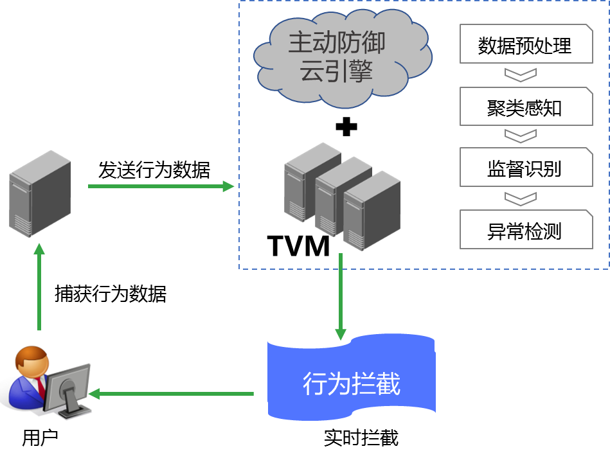
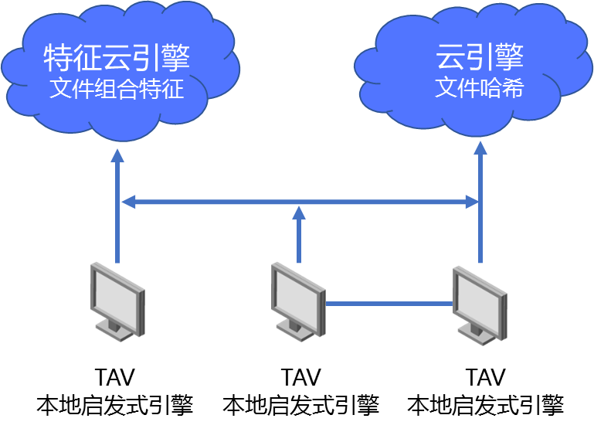
Core Capability: Device Security
Anti-Virus
Intrusion Protection
Vulnerabilities Patching
Dual Cloud + TAV
Multi engines for different scenarios
Smart categorization based on criticality and emergency
P2P patch distribution to increase patching efficiency
Efficient Operation patch filter, sort, search and quick patching
Visualized by endpoints or by patches
Multiple ways of patching
Windows Patching
Patching speed limit
Virus Definition
Samples: 70b+
Whitelists: 10b+
Blacklists: 4b+
Update Frequency
Hourly
Pro Ops Team
More Proactive Defense Capability
Use an international-patented AI-heuristic engine TVM and proactive defense engine.
Identify abnormalities quickly and auto-triggering defense mechanisms.
Cloud Engine Massive samples, fast response
TAV Engine
Low CPU/Mem, accurate, platform-agnostic
Notes:
1，2，3，4照着念

Slide 16
Core Capability: Application Security
Trusted Applications Identification
Office
SAP
Software Inventory
Software information collection
Whitelisting allowed software
Remote software distribution & uninstall
Putty
Various Apps
…
WeCom
Mail
App Access Control & Audit
Granular app & process identification, name/version/Hash/Signature
Remote blacklisting to stop malicious process
Whitelisted-apps-only mode
Dev Tools
Chrome
AV
Notes:
1，2，3，4照着念

Slide 17
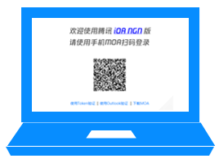
Core Capability: Fast & Secure Network
Self-developed QTCP protocol to accelerate TCP transfer
Self-developed algorithm to optimize network routing
Encrypted communication between terminal client and iOA gateway
Short connections mode. No need to maintain long connection tunnel.
Comprehensive identification: device, user, application and target
Trusted Application Access
SSL Encryption
Zero Trust Gateway
Credential Login
Invisible Service
Notes:
1，2，3，4照着念

Slide 18
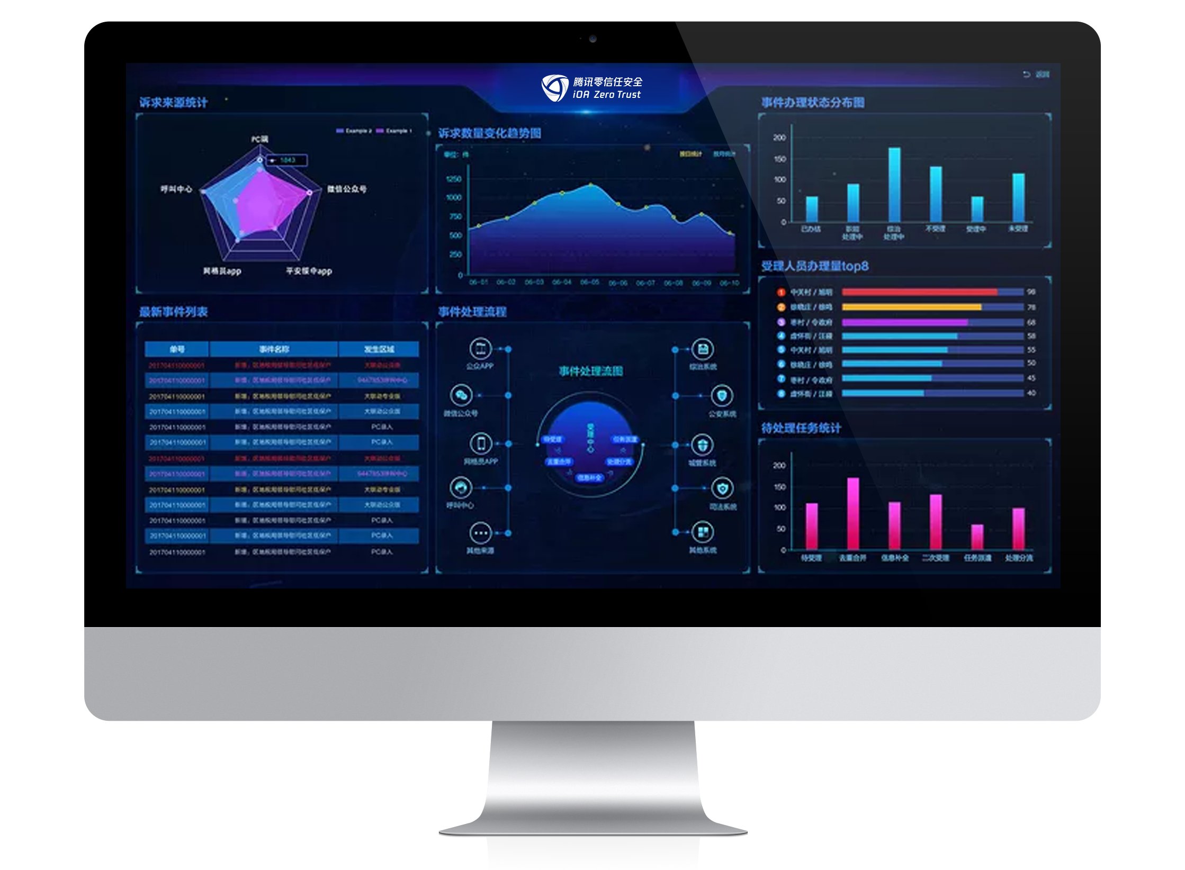
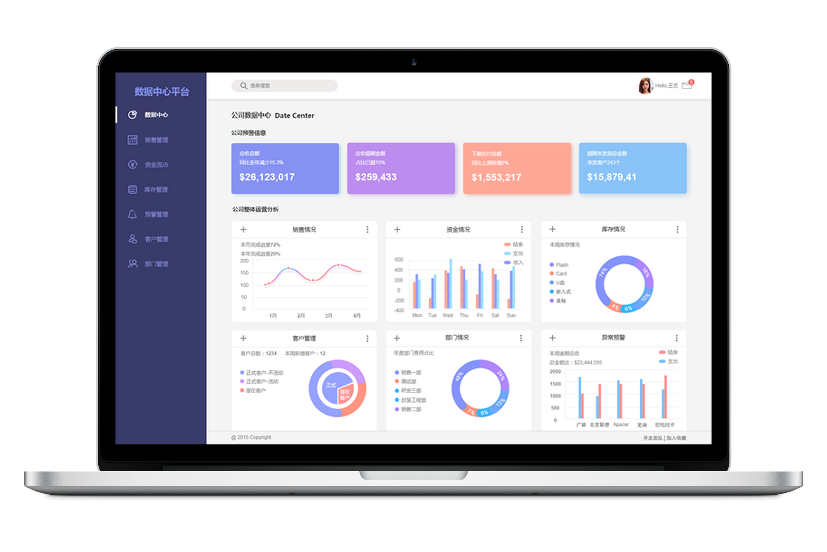
Core Capability – Application-Level Access Control
Central and unified authorization management & control for intranet application.
Protecting information leakage through iOA solution.
iOA Gateway
Enterprise App
Remote Debugging
X
Process Validation
X
DB query
Device Regconition
Ticket Approval
Authentication
X
HR Mgmt
Notes:
1，2，3，4照着念

Slide 19
PART 3
Success Stories

Slide 20
Base on Tencent’s Best Practices
Challenges of Corporate IT
Endpoint Device Access：120k+ /day
Large number of endpoint devices：Security baseline configuration for each device varies, resulting in huge maintenance work.
Laptop/Desktop Device： Windows 70k+, MacOS 18k+
Mobile Device： iPhone 10k+, Android 4k+
Various operating systems ： A large number of MacOS developers, but lack of corresponding security management.
Uncertain working location： Company, outdoor, home office, etc., Both internal and external networks need to be managed.
Excessive use of public internet：Risk of sensitive information leakage.
Solution
BJ
SH
Tencent iOA is Tencent IT self-designed and self-developed product, based on Tencent’s network security management practice for more than ten years.
The development was started in 2016, and it has been practiced and verified in internal production and office environments.
At the beginning of the Covid-19 epidemic in 2020, the iOA successfully supported the company of 60k+ employees, 100k+ devices across different cities and overseas.
The iOA network equipment were quickly expanded to 140 units which supported hundreds of application systems, carried an average of 20G network traffic, and fully supported various office scenarios.
SZ
Overseas Branches
CD
GZ
Offices in China
*There are special security requirements, such as mergers and acquisitions, investment companies, workplaces of temporary cooperative companies, department handling payment business , information security departments, etc.
Notes:
接下来跟大家分享一下今年疫情期间我们的整个系统的运营状态：
1、20年初开始的新冠疫情让整个中国有些措手不及，人员不能流动，很多企业因基础建设不足，企业的复工，运转面临巨大的困难。
2、疫情期间腾讯最高峰iOA支撑了6万员工，10万+设备的同时在线工作，包括国内外员工的接入
3、期间我们上线了腾讯健康，健康码，腾讯会议等诸多产品，助力国家抗疫工作，以及企业的复工，复产

Slide 21
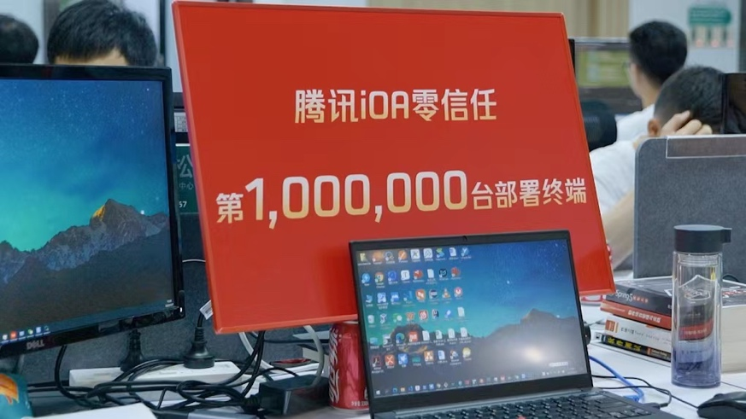
Success Stories in China Mainland
Notes:
接下来跟大家分享一下今年疫情期间我们的整个系统的运营状态：
1、20年初开始的新冠疫情让整个中国有些措手不及，人员不能流动，很多企业因基础建设不足，企业的复工，运转面临巨大的困难。
2、疫情期间腾讯最高峰iOA支撑了6万员工，10万+设备的同时在线工作，包括国内外员工的接入
3、期间我们上线了腾讯健康，健康码，腾讯会议等诸多产品，助力国家抗疫工作，以及企业的复工，复产

Slide 22
Success Story in HK
Customer | A licensed digital banking and insurance company in HK
Product | iOA 零信任安全解决方案
Use case | About 1000 endpoints, covering endpoint management, anti-virus and software center. Deployment model includes main control center and secondary cache server.
Deployment & Support model | Remote deployment with screen-sharing between HK IT team and our engineers located in Shenzhen. A dedicated WeChat support group is created between customers and our engineers for support and maintenance discussion.
Current status | The system has been deployed and running for more that 10 months and zero major incidents reported.
Tencent in HK
Tencent is rapidly extending its ToB presence internationally.
Tencent cloud provides 3 availability zones with multiple data centers located in HK. Tencent has delivered services including IT infrastructure (Private cloud data center) and self-developed (信创) platform/softwares to customers at HK and Macao.
Meanwhile, we are actively developing, providing training and certification process to local partners and support teams in HK/Macao to support our customer in both region.
Notes:
接下来跟大家分享一下今年疫情期间我们的整个系统的运营状态：
1、20年初开始的新冠疫情让整个中国有些措手不及，人员不能流动，很多企业因基础建设不足，企业的复工，运转面临巨大的困难。
2、疫情期间腾讯最高峰iOA支撑了6万员工，10万+设备的同时在线工作，包括国内外员工的接入
3、期间我们上线了腾讯健康，健康码，腾讯会议等诸多产品，助力国家抗疫工作，以及企业的复工，复产

Slide 23
Thank you!

