Slide 1
Tencent Meeting
Enterprise
2022.07

Slide 2
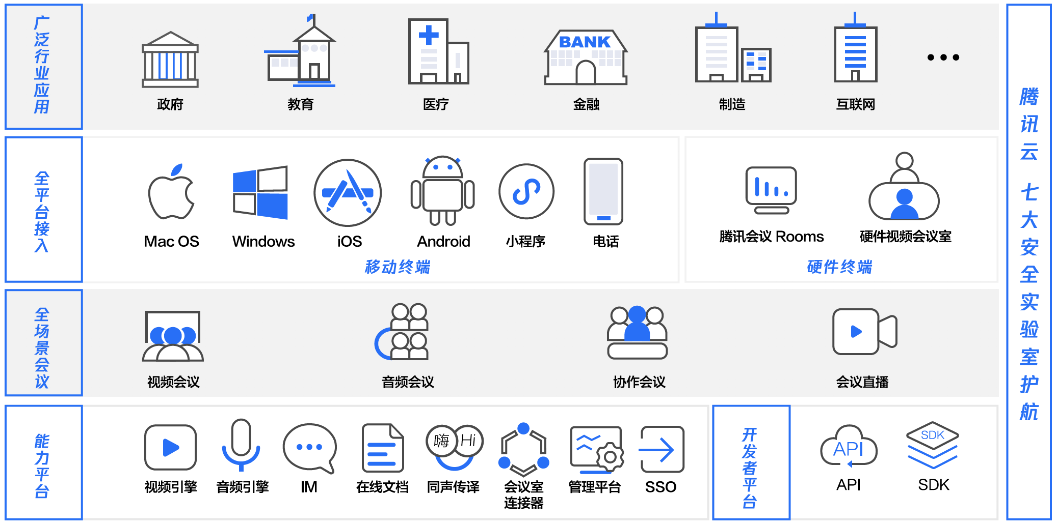
Application Scenarios
Wide Industry Applications
Government
Education
Medicine
Finance
Manufacturing
Internet
Full-platform Integration
WeChat Mini Programs
Tencent Meeting’s Rooms Feature
Video Conference Room Hardware
Phones
Mobile End
Security Protection Provided By Tencent Cloud’s 7 World-class Security Labs
Hardware End
Multiple Meeting Scenarios
Video Meetings
Audio Meetings
Collaborative Meetings
Live Broadcasting
Capabilities
Developer Platform
Capabilities
Video Engine
Audio Engine
Online Docs
Simultaneous Interpretation
Conference Room Connector
Management Platform

Slide 3
Product Capabilities
Large Meeting Rooms
Custom Layouts
Sharing and Annotations
1080P HD Image Quality
Dual Monitors and Dual Display
Simultaneous Interpretation
Cloud Recording
Live Streaming Push
Automatic Meeting Notes
Efficient Control
Integration Security
Ops Management
Fore more capabilities, please visit meeting.tencent.com

Slide 4
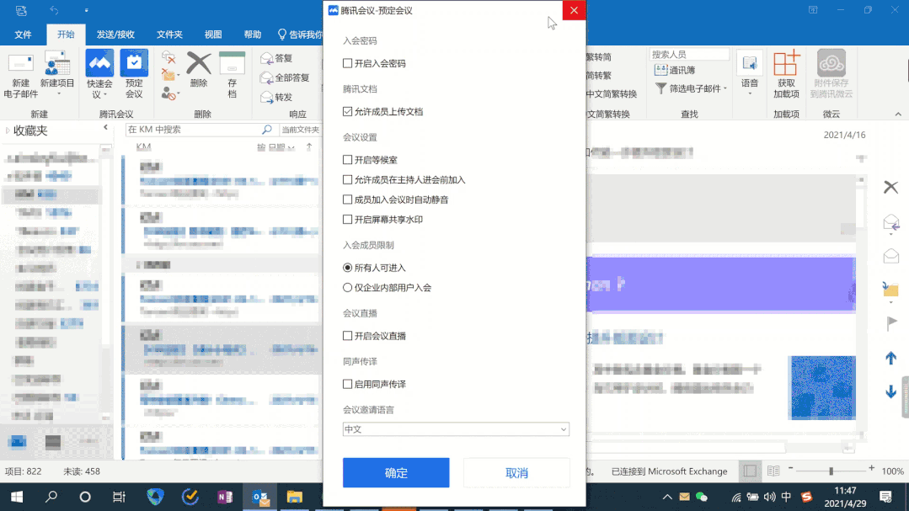
Multiple Integration Methods
Schedule Tencent Meetings via Outlook
Outlook can be used to book a Tencent Meeting with coworkers and access the user's address book and calendar, making scheduling meetings more convenient
Supports meeting passwords, waiting rooms, screenshare watermarks, meeting participant restrictions, and other settings
After an appointment is made, an invitation e-mail will be automatically generated. After the recipients are set, the meeting invitation can be sent with one click
The meeting schedule is automatically synchronized to users’ Tencent Meeting lists
Currently supported on Windows

Slide 5
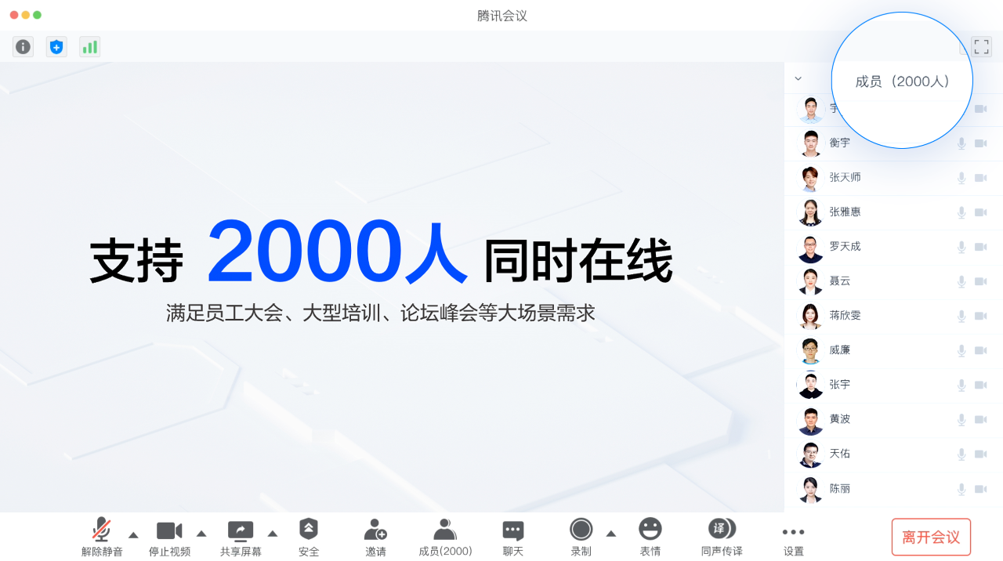
Support for Up to 2,000 People in 1 Meeting Room
2,000-person Meeting Rooms
Tencent Meeting's Enterprise Version supports virtual meeting rooms for 50, 100, 300, 500, 1,000, and 2,000 people
Enterprise staff meetings, training meetings, summits, and other use cases
Physical meetings can be easily moved to the cloud to simplify event planning

Slide 6
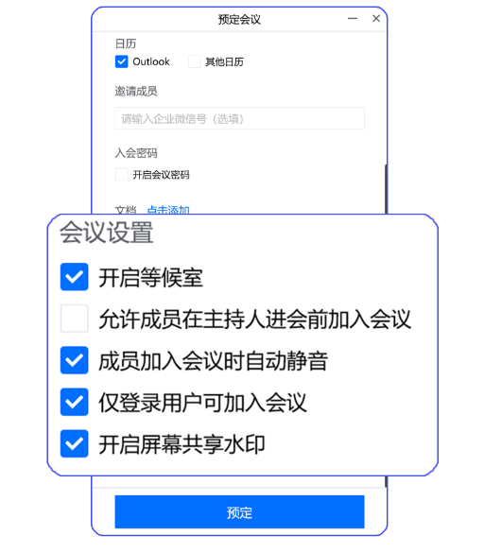
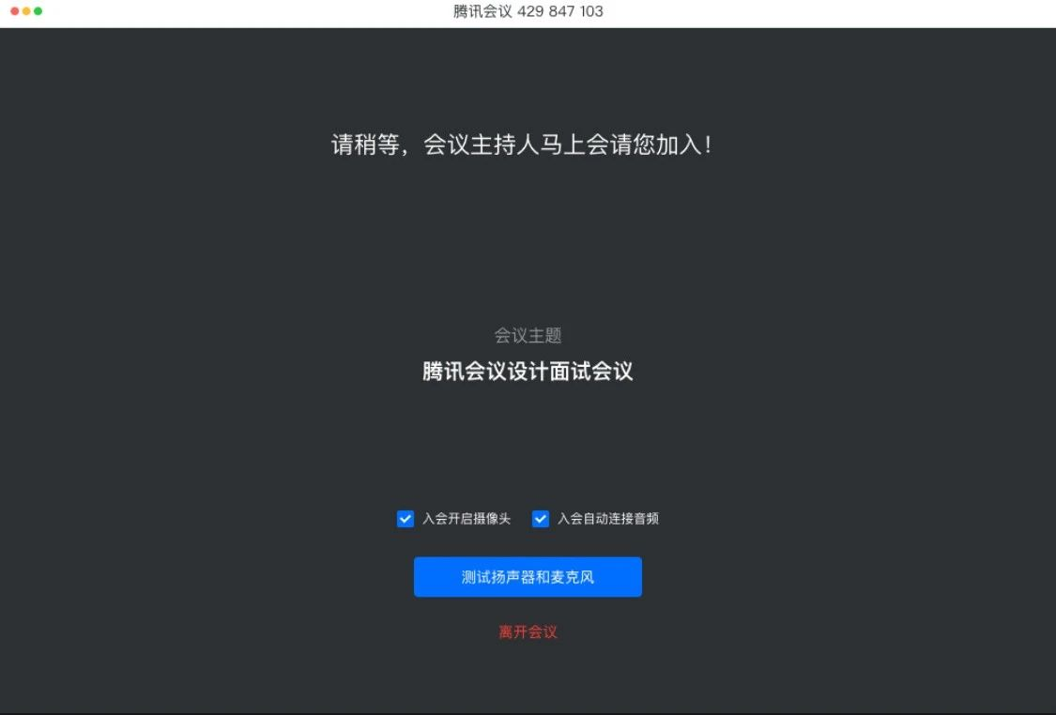
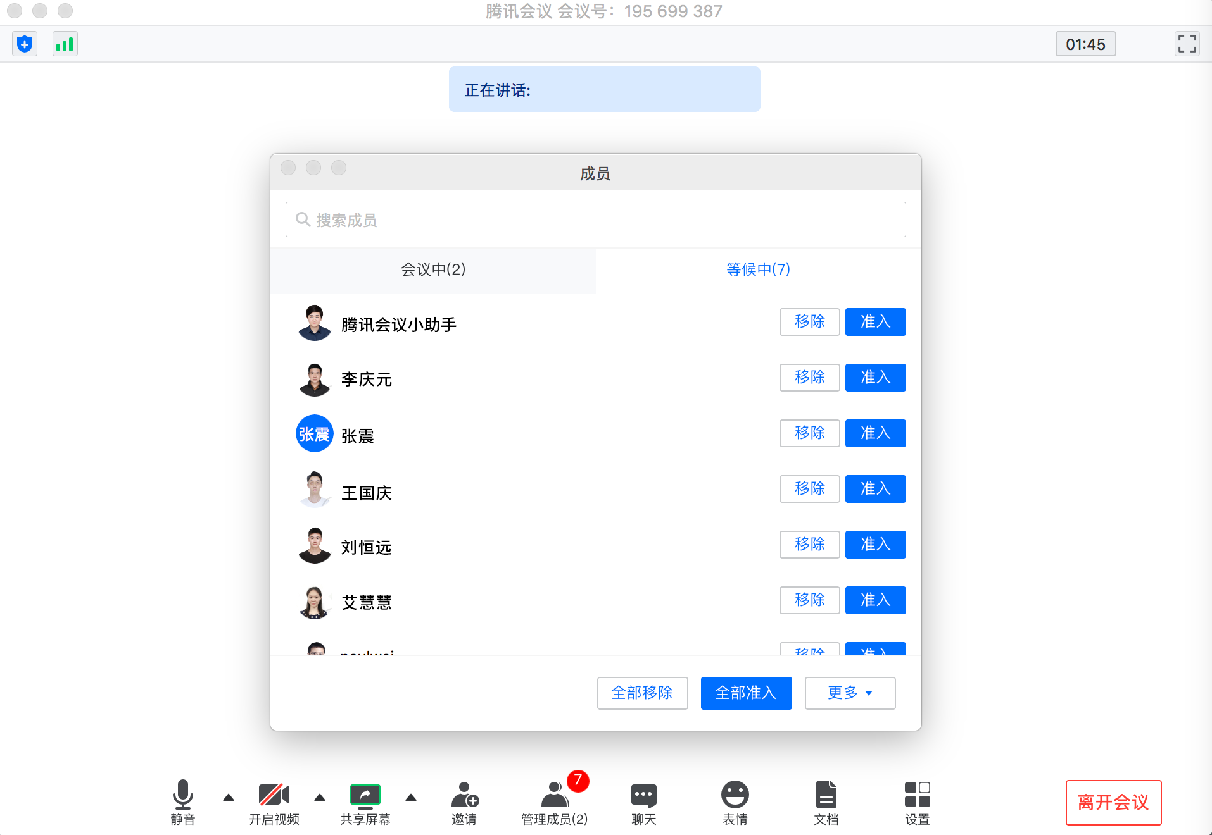
Waiting Rooms for Increased Security and Organization
The host enables the waiting room
Participants enter the waiting room
The host allows people in from the waiting room
Suitable for high security use cases such as trainings, interviews, and Q&As
All participants need to be approved by the host before they can join the meeting, allowing the host to maintain control even when the meeting number is leaked to the public
When certain members in the room need to discuss important matters, the host can move other members to the waiting room to ensure the information security of the meeting

Slide 7
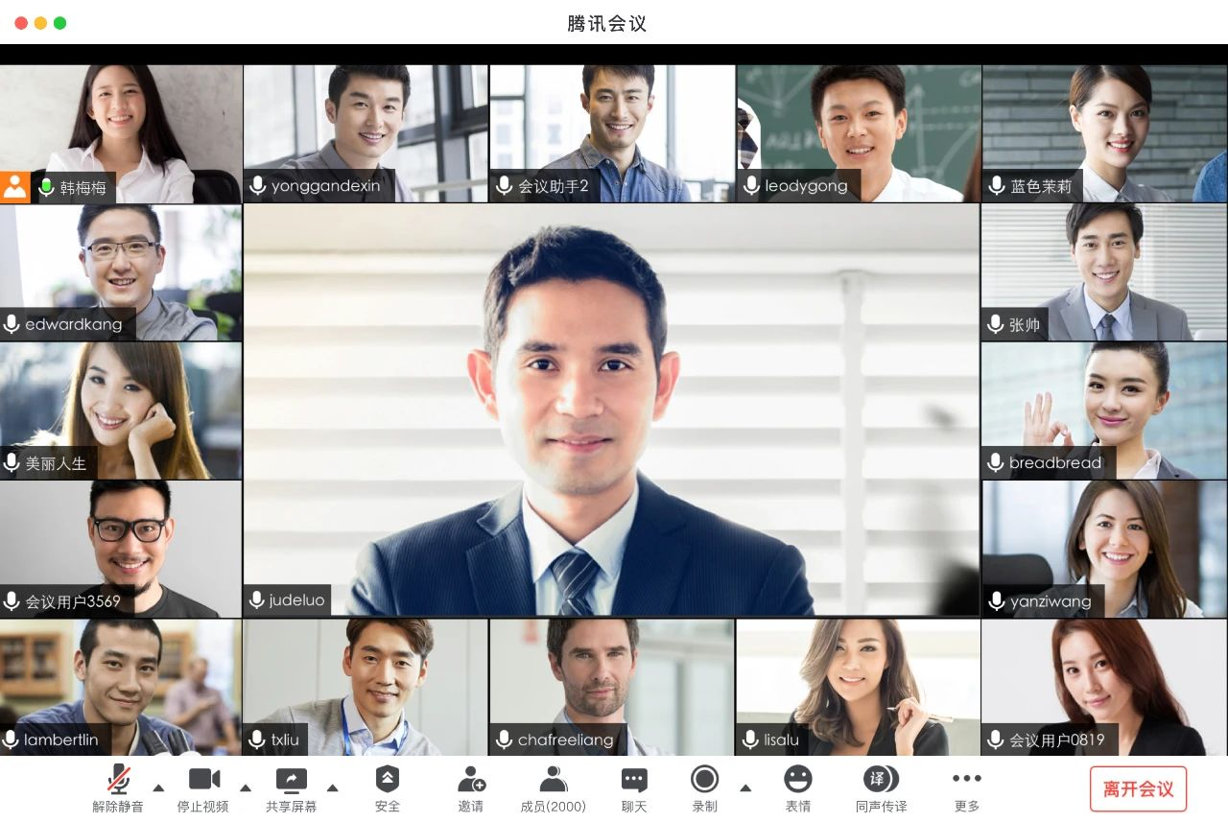
Flexible Video Layouts
18 Video Layout Types
Grid view:
9/25 people on one screen
Speaker view:
The list of members can be on the right or on the top
Supports switching between the grid view and the speaker view
The full-screen mode supports floating member lists
Custom layouts:
18 different types of video layouts
Supports changing the virtual background
You can select the “meeting mode,” the “signing mode,” or the “group photo mode” based on your needs

Slide 8
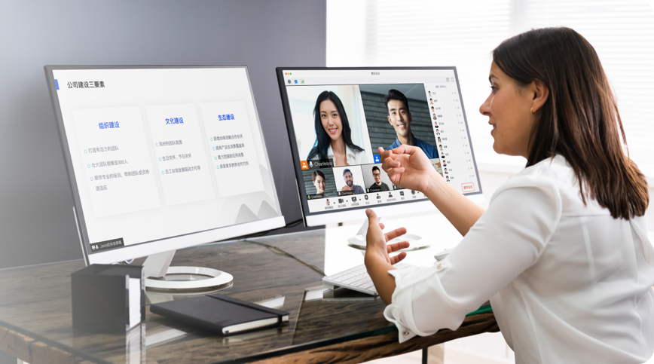
Support for Dual Monitors
One Monitor For Videos and Another Monitor For Presenting
For enterprise trainings, summary reports, telehealth, and remote learning. One screen displays videos, and another screen displays PPTs, allowing participants to better engage with each other during video conferences
During meetings, presenters often need to adjust their communication strategies in real-time according to the expressions or body language of participants. The Windows client supports the dual-screen mode, allowing presenters to reference their screenshared PPTs while paying attention to the feedback of other participants

Slide 9
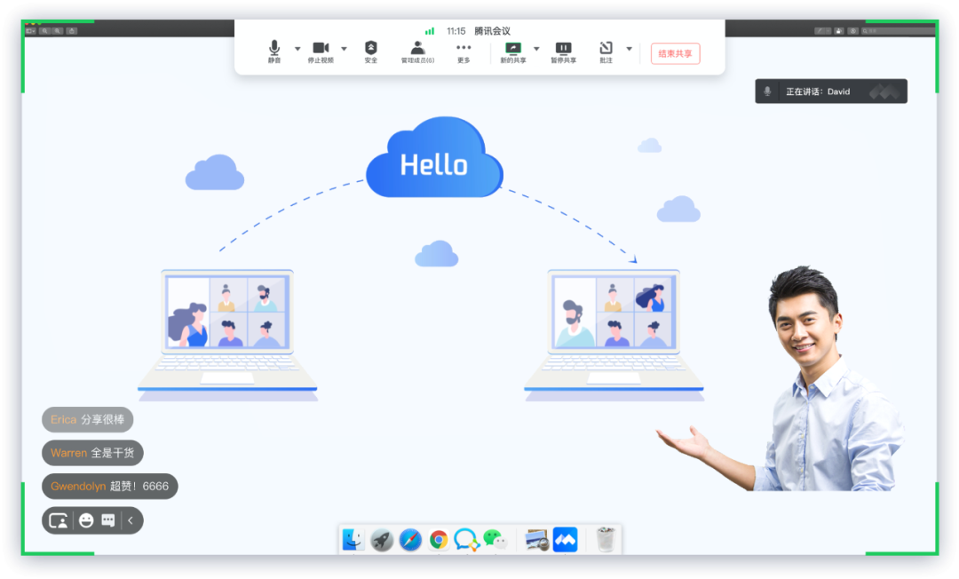
Video and PPT Overlay
Video and PPT Overlay Mode
Allows desktop (Windows & Mac) users to overlay their own video on their shared screens, windows, or whiteboards
Thanks to the video and PPT overlay mode, students can say goodbye to boring PPTs and say hello to engaging, and lively teachers on their screens
During internal reporting sessions and staff meetings, speakers can use the video and PPT overlay mode to better connect with the audience

Slide 10
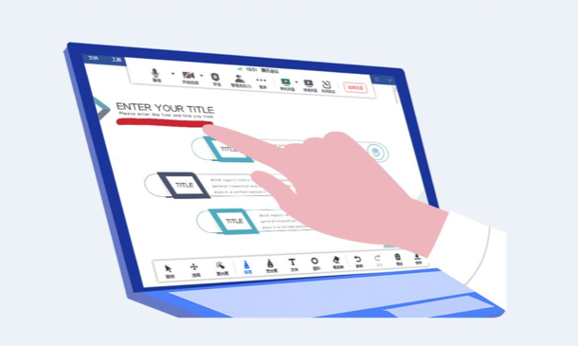
Interactive Collaboration
Whiteboard Interactions and Content Sharing
Electronic Whiteboard
Whiteboard sharing
Interactive writing
Various brush tools
Windows supports touchscreen whiteboards and annotations
Screensharing and Interactive Annotations
The maximum resolution supported is 1080p
Screensharing watermarks
Smooth sharing mode
Support for multi-party interactive annotations
Tencent Meeting supports features such as document creation and import, text and image messages, on-screen emoji comments, and online voting that make meetings more fun and efficient

Slide 11
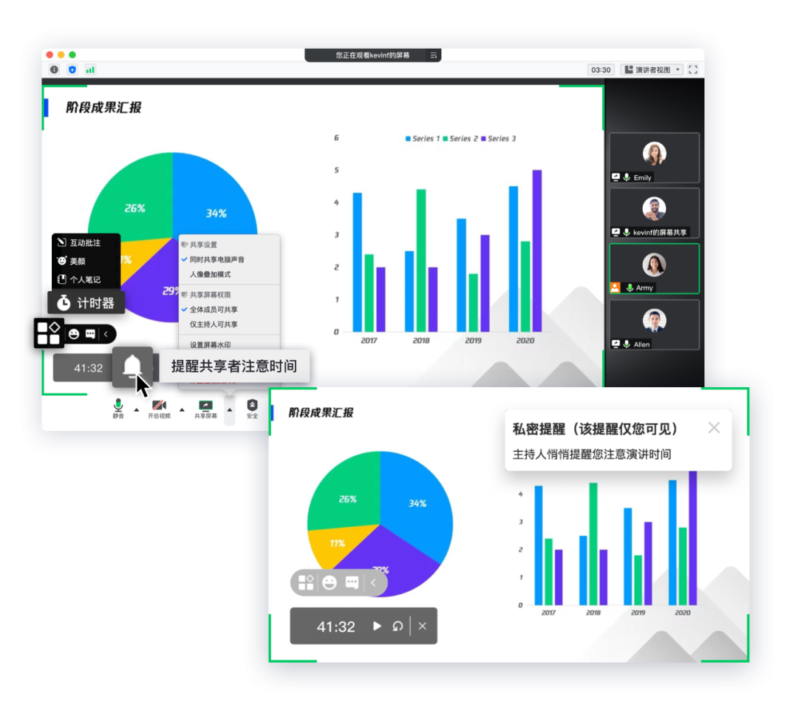
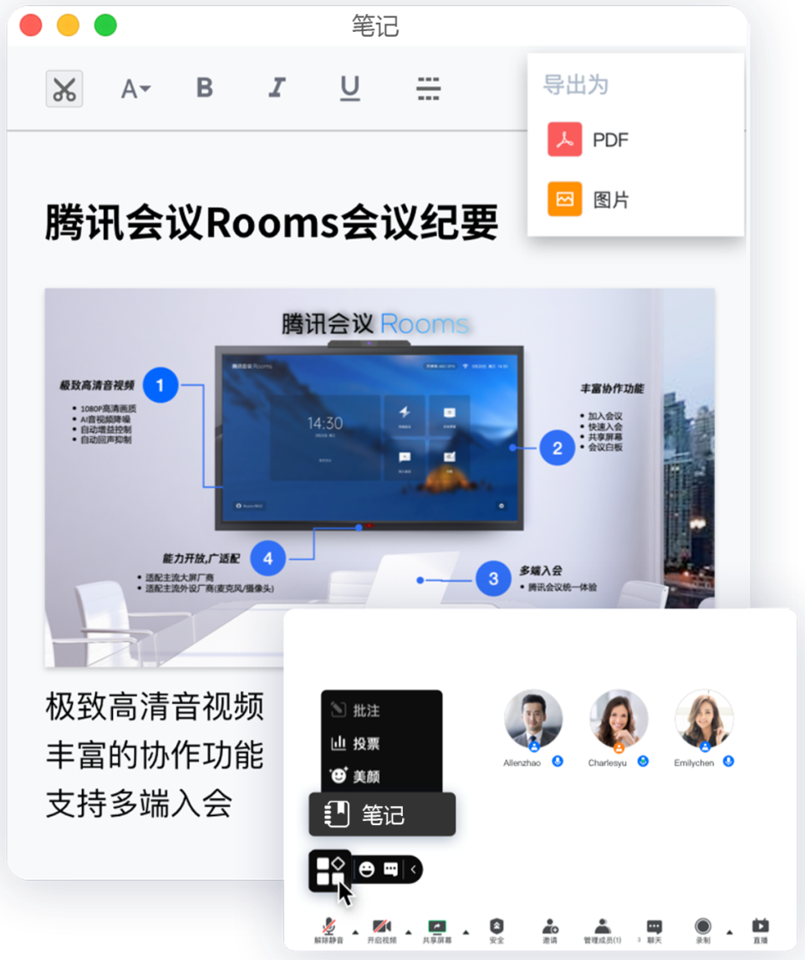
Helpful Presentation Features
Screensharing Timer
Meeting Notes
For briefings and training sessions
For training sessions and interactive conversations
Accessed by clicking on the mini-tool icon
Speaker reminders
Private reminders
Exclusive draft box
Stores important meeting content
The note window can be moved around freely to avoid blocking the meeting screen
Instant notes
Great ideas can be recorded and stored immediately, and the notes can be exported to PDF or image formats to be easily shared with others
On-cloud notes
Simple typesetting and rich tools allow you to directly share notes so that you do not have to reformat them after the meeting
Meeting notes can be saved and stored in the cloud in real time and can be searched at any time on mobile and PC devices

Slide 12
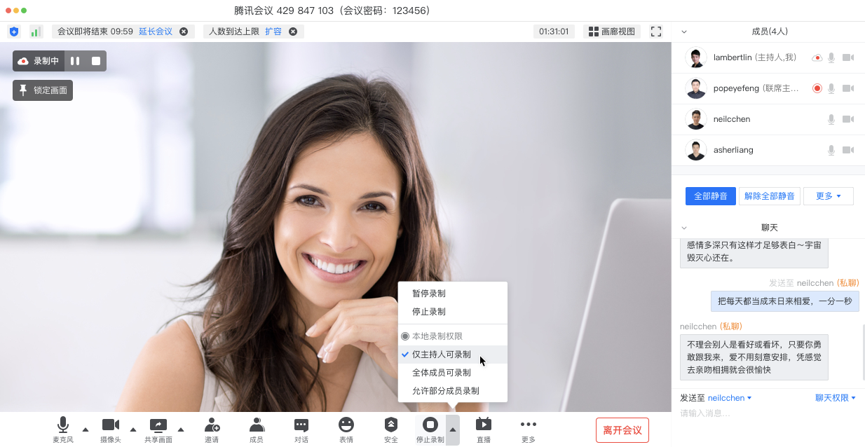
Meeting Recording
Local and Cloud Recording
For meetings, trainings, and sharing sessions
Controllable recording permissions
Recording status
Simultaneous audio, video, and screensharing recording
Local Recording
Stores recordings locally
Records the speaker and the screen being shared at the same time
Cloud Recording
Unlimited cloud storage
Online playback and convenient sharing
Support for cloud clipping
Visible to all users or visible only to specific users invited via WeChat
Records the screen as formatted by the host

Slide 13
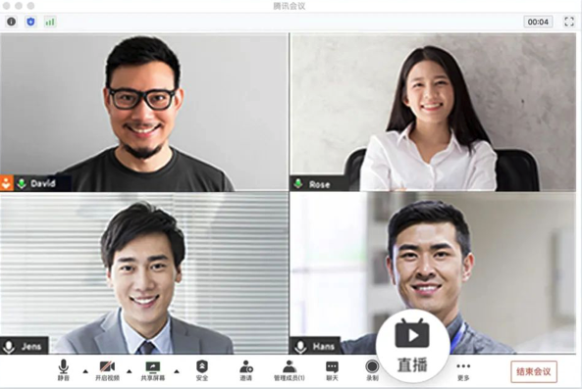
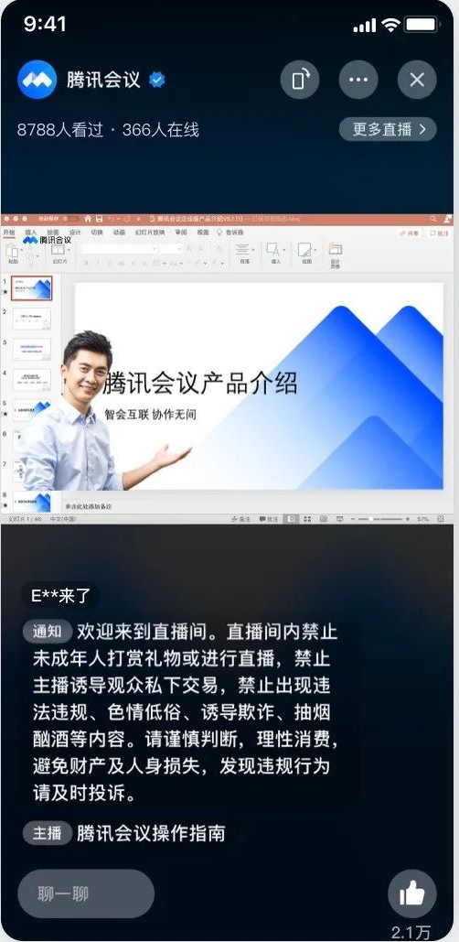
Live Broadcasting
Live Broadcasting and Meetings
For public enterprise trainings, employee meetings, roundtable discussions, and online classes
The meeting can be live broadcasted simultaneously
View on mobile/PC via the live broadcasting link
Custom live broadcasting topics and descriptions
Text-based interactions among the live audience
Ultra-low live broadcasting latency
Support for live playback
Custom RTMP stream push
Supports pushing streams to WeChat Channels
Stream push to WeChat Channels (the portrait overlay mode is enabled)

Slide 14
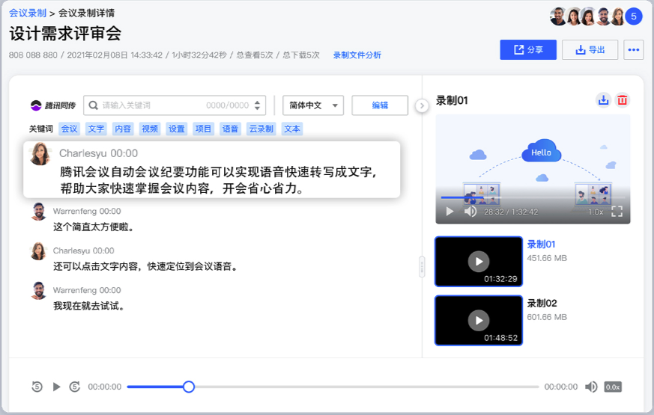
Automatic Meeting Notes
Machine-generated Meeting Notes
For trainings, classes, and solution reviews
Automatic transcription
After the meeting starts to be recorded on the cloud, the transcription of the meeting will be outputted immediately. The typesetting will be neat, and the participants will be automatically distinguished. Even if they speak at the same time, they can be identified individually
High accuracy
Supports Mandarin/English speech transcription. The Mandarin speech recognition accuracy can reach 97% or higher and the English speech recognition accuracy can reach 93% or higher
Intelligent punctuation prediction
A super large-scale language model is used to intelligently predict the dialogue context of the recognition result sentence and provide intelligent sentence segmentation and punctuation prediction
Intelligent transformation
The transcript automatically converts speech containing numbers, dates, and phone numbers to their respective stylistic formats that are more convenient to read
Automatic filtering
The transcript automatically excludes filler words such as "um," "ah," and "ehr" to improve readability

Slide 15
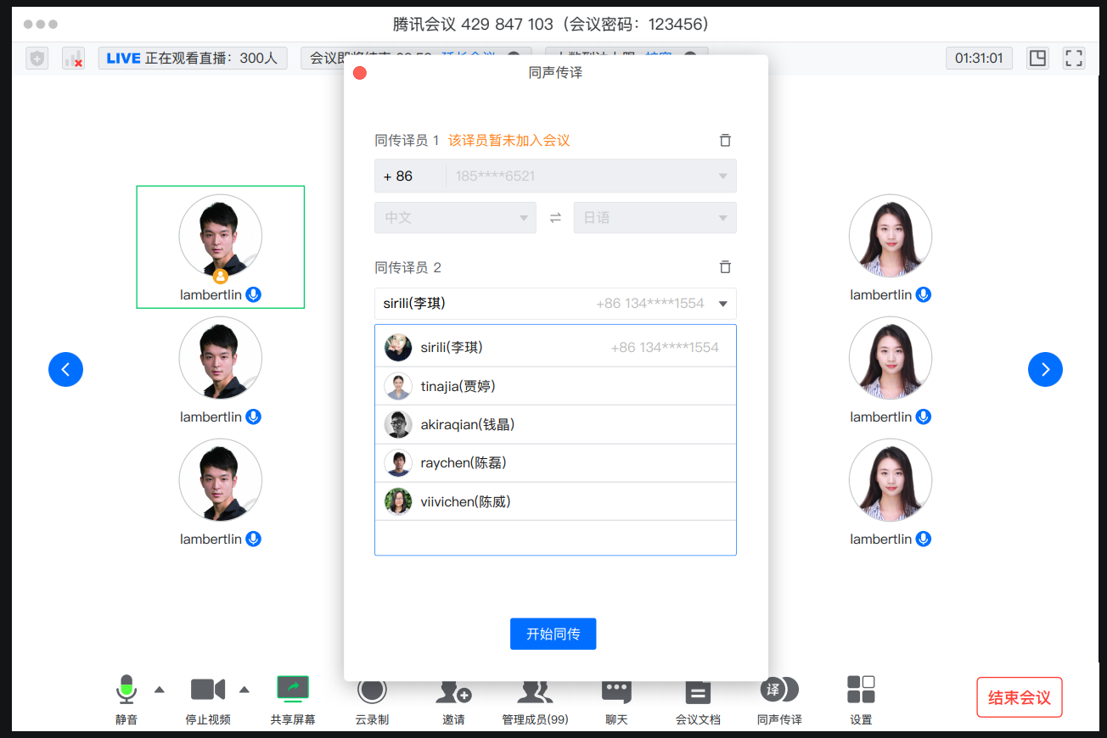
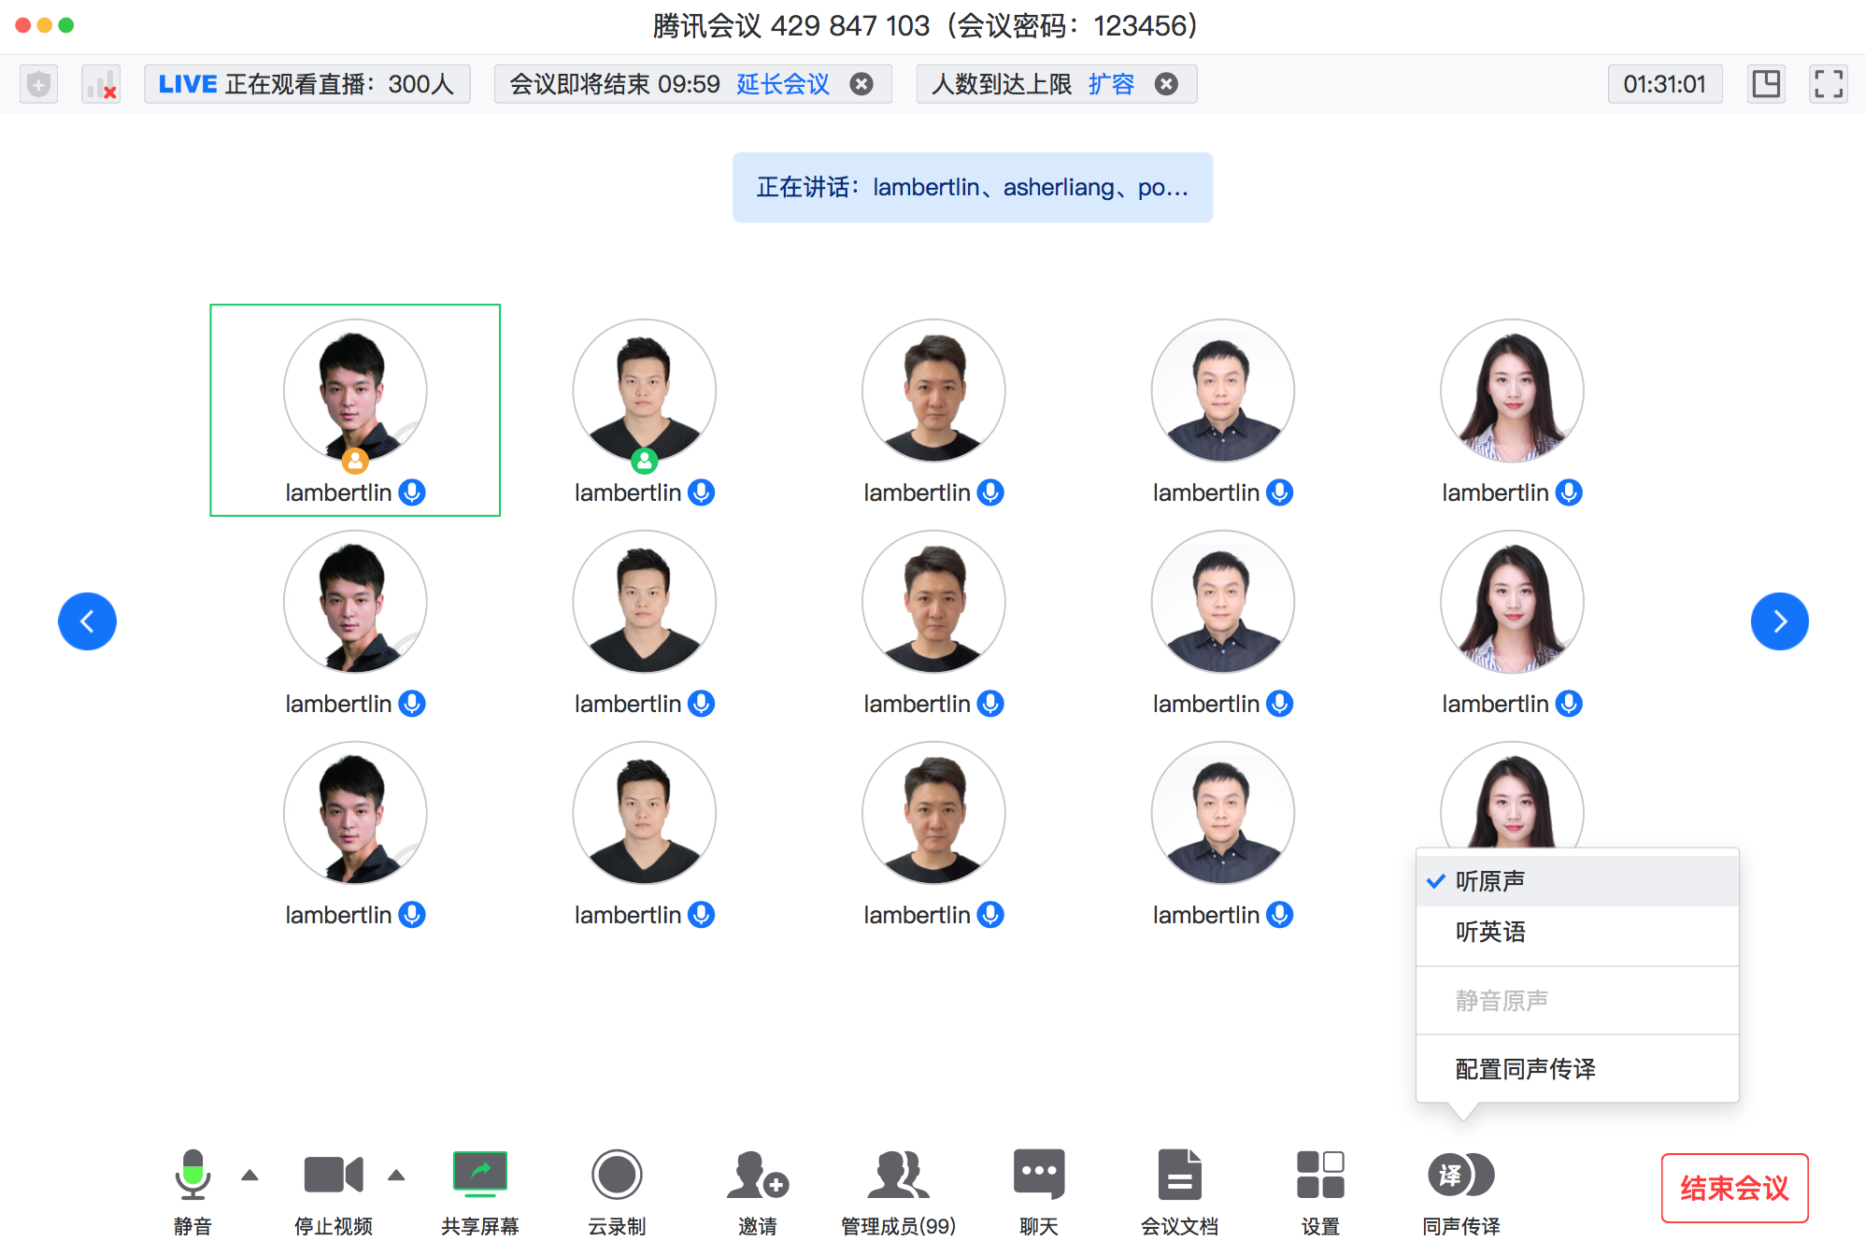
人工同传 跨语言会议轻松开
添加传译员
与会者自由选听
支持设置英语、德语、法语等17个传译员；与会人可以选择“原声”或“同传声音”
腾讯会议企业版支持设置同声传译员，还能同时多语言传译，辅助与会者更好地理解会议内容，不同的传译模式彼此互不干扰，不打断会议进程。支持手机端、电脑端担任传译员

Slide 16
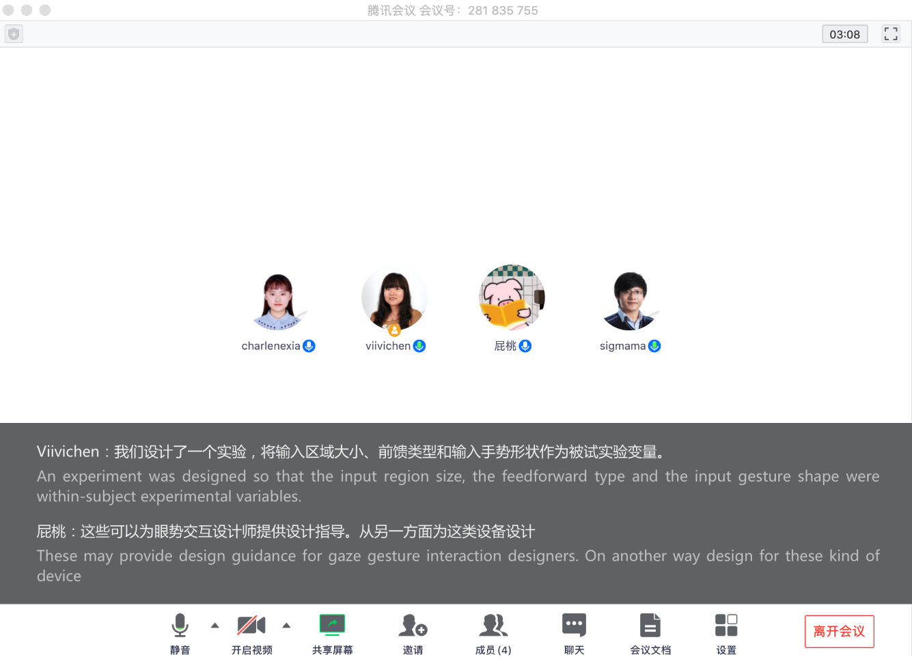
AI同传-在线视频会议应用
场景
在线会议同传
会议内容可回看
效果
视频会议增加字幕
会后纪要输出
示意图

Slide 17
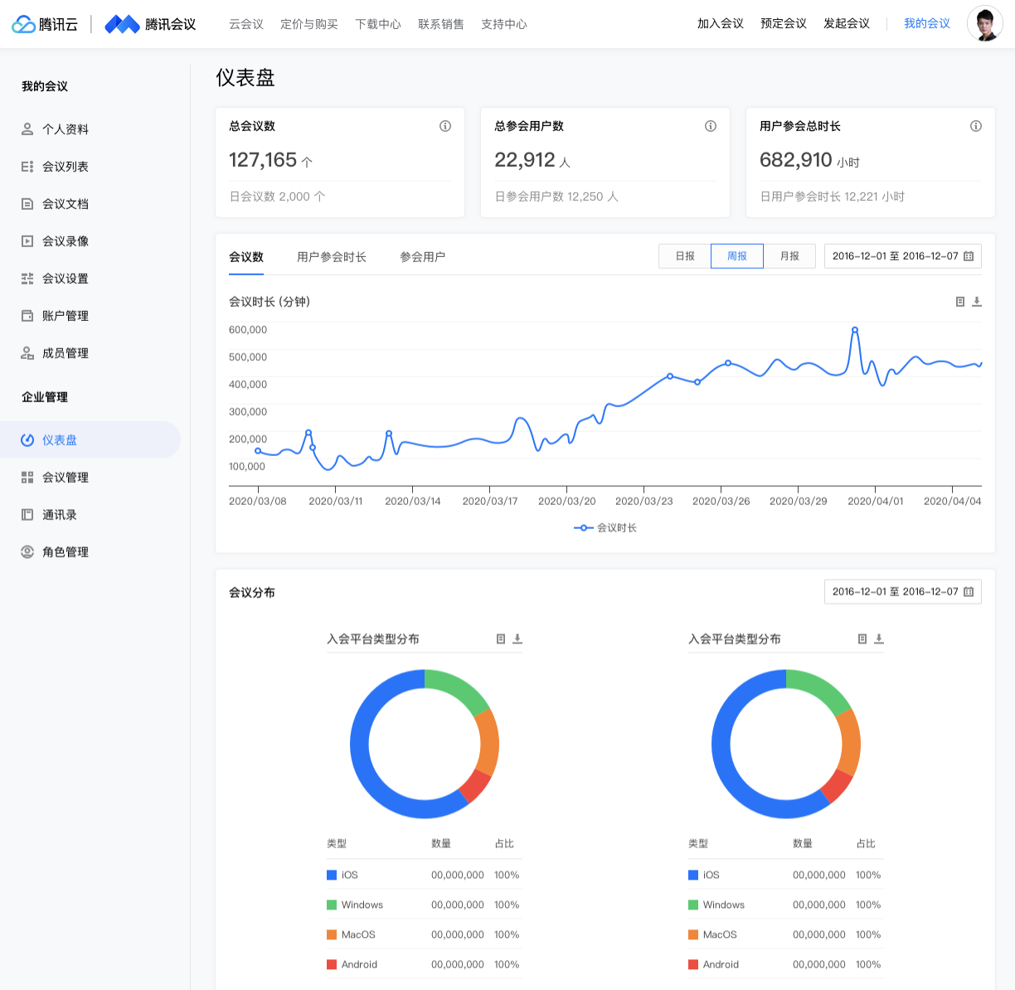
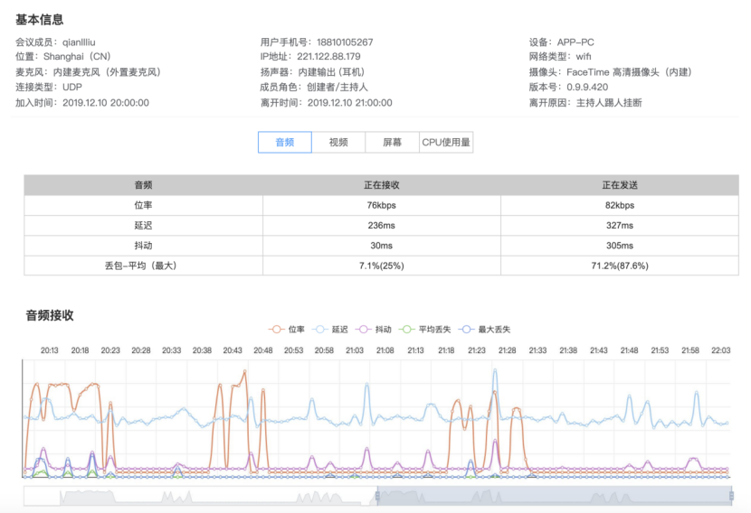
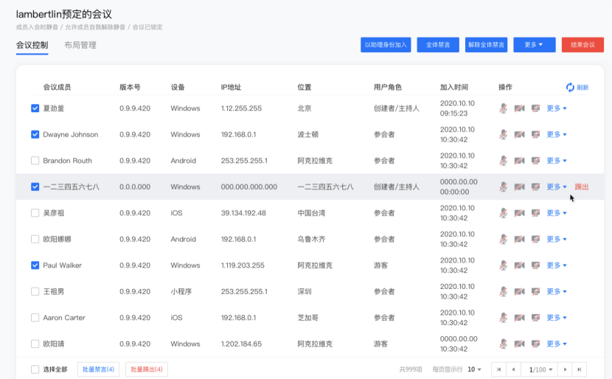
Enterprise Ops Management Platform
The Ops management platform helps IT staff and managers monitor the enterprise’s resource consumption and operation data, and implements solution previews and remote support for important meetings
Dashboard
Data monitoring
Remote management
displays the enterprise's overall meeting list, presents the enterprise user's overall meeting usage data, and the enterprise's overall consumption of purchased resources
real-time conference quality monitoring, conference support, and troubleshooting
remote meeting control (even when not participating in the meeting) and layout management

Slide 18
Integrated Meetings

Slide 19
Ecosystem Partners
Personal Edition
Education
Software Partners
Business Edition
Enterprise Edition
Medicine
Tencent MeetingRooms
Finance
Conference Room
Connector
Enterprise Services
Hardware Partners
API
Retail
SDK
ISV
Manufacturing

Slide 20
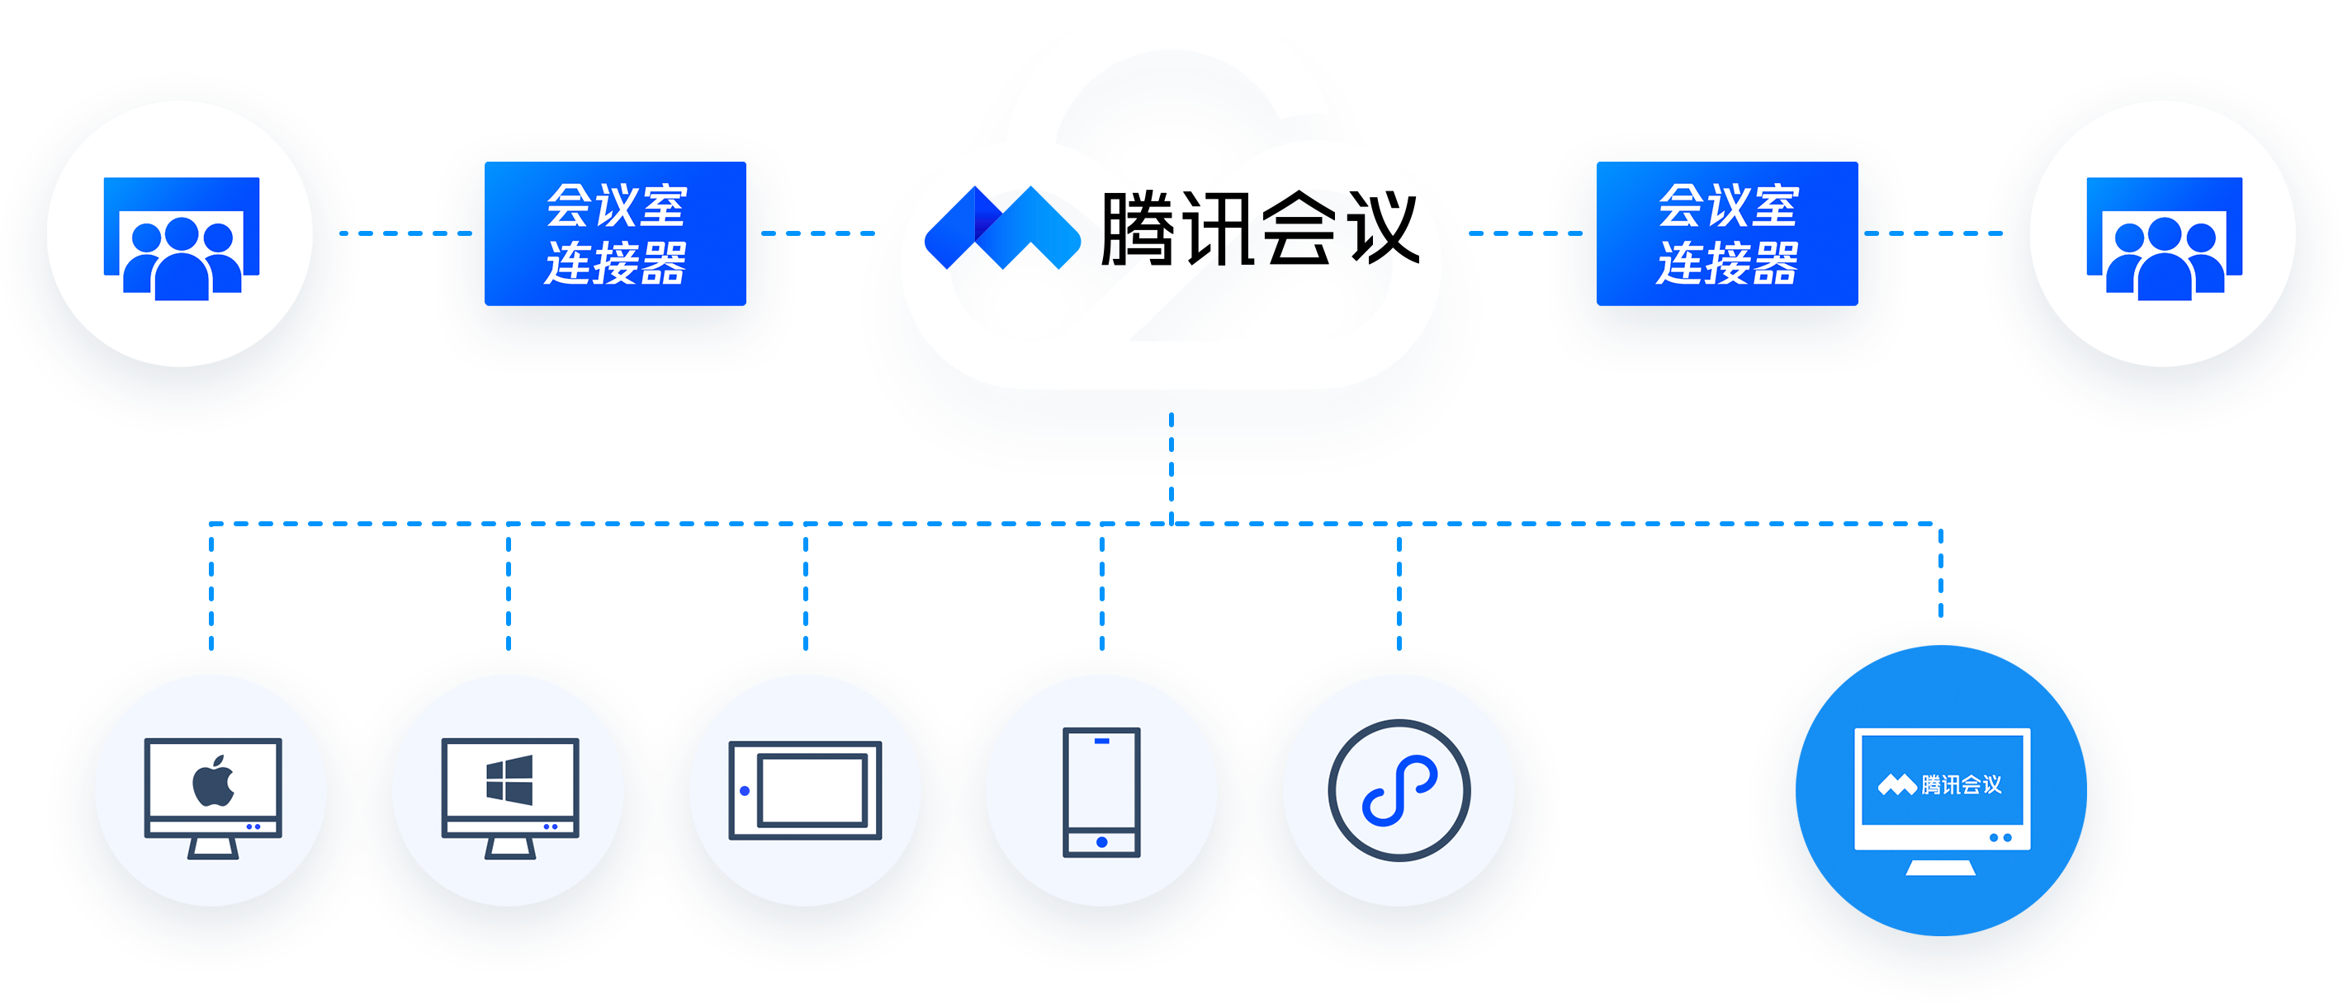
The Meeting Room Connector Links Traditional Video Conference Hardware with Tencent Meeting
Conference Room Connector
Conference Room Connector
H.323/Sip Video Meeting System
H.323/Sip Video Meeting System
Tencent Meeting expands cross-enterprise and cross-terminal conference capabilities for conference rooms
Thanks to the conference room connector, conference rooms of different enterprises that previously could not be interconnected can join the same Tencent Meeting to communicate efficiently

Slide 21
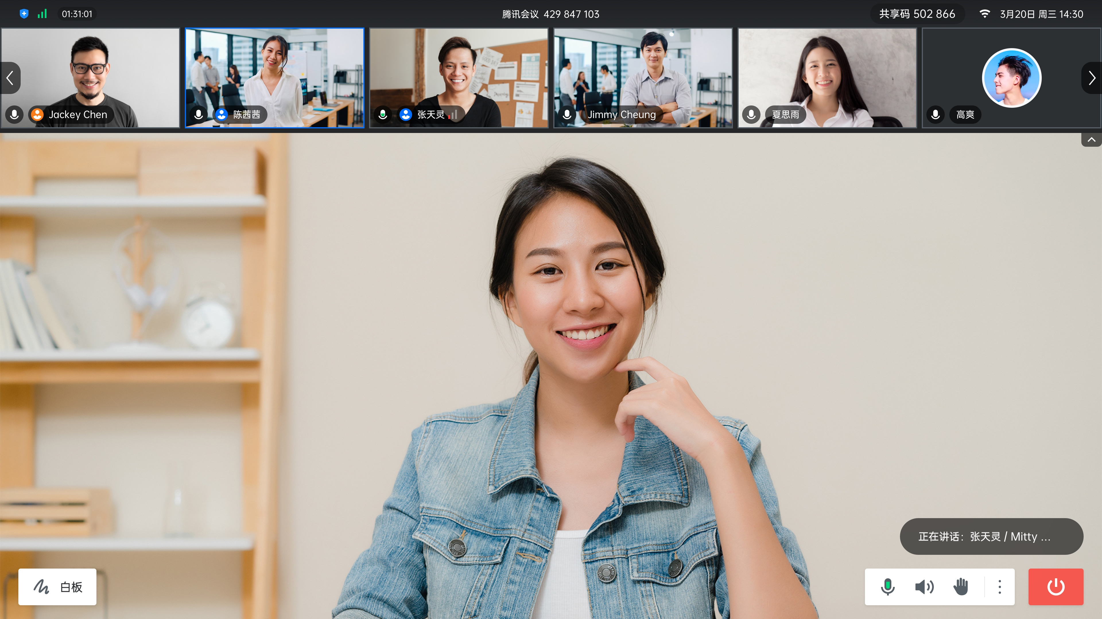
Tencent Meeting’s Rooms Feature
Cloud Meetings
Multi-end interconnection
Meeting room scheduling
Initiate meetings via address book
Wireless Projectors
Dual monitors for videos and for PPTs
Electronic Whiteboards
Preparatory writing before meetings
Interactive annotations during meetings
Centralized Management
Status overview
Remote batch software upgrades
Tencent Meeting's Rooms feature is a software system specially designed for physical conference rooms, providing an integrated conference experience that consists of audio and video communication, screensharing, and touch-screen whiteboards
Rooms features open audio and video certification standards and works with hardware partners to provide modern conference room solutions for enterprises

Slide 22
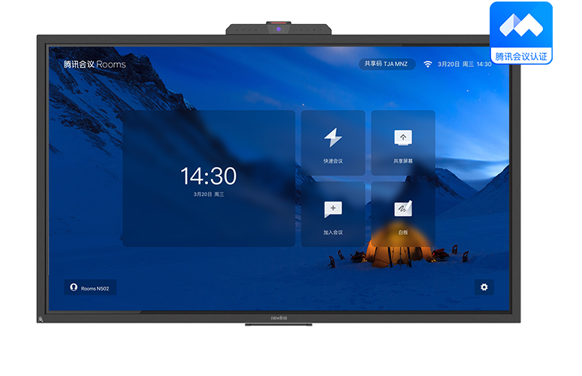
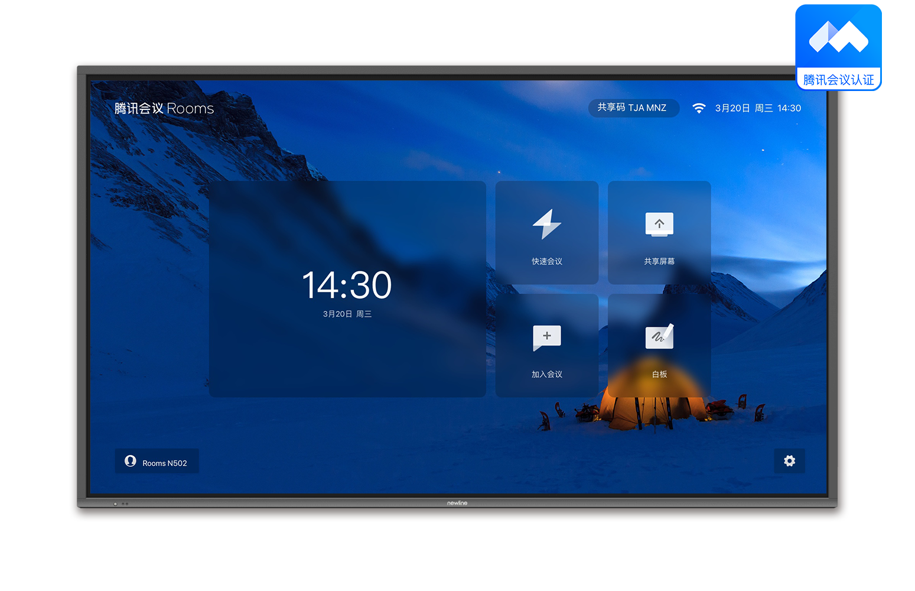
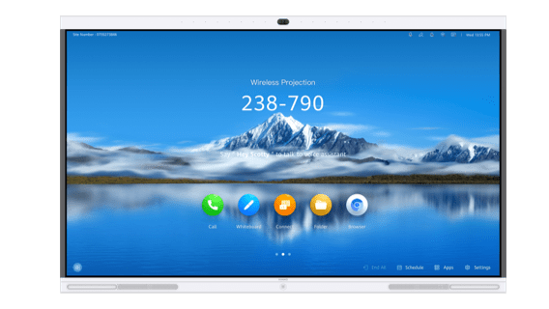
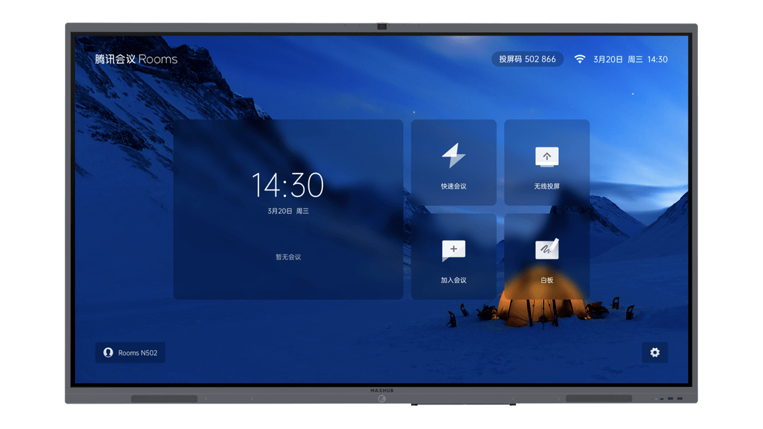
Certified Rooms-compatible Touchscreen Devices
Newline TC65/75/86
Integrated Video Meeting System
Newline IP86 Touchscreen (needs to be integrated with external audio and video devices)
Huawei Idea Hub Pro65
Integrated Video Meeting System
MAXHUB CC Series (55/65/75/86)
Integrated Video Meeting System

Slide 23
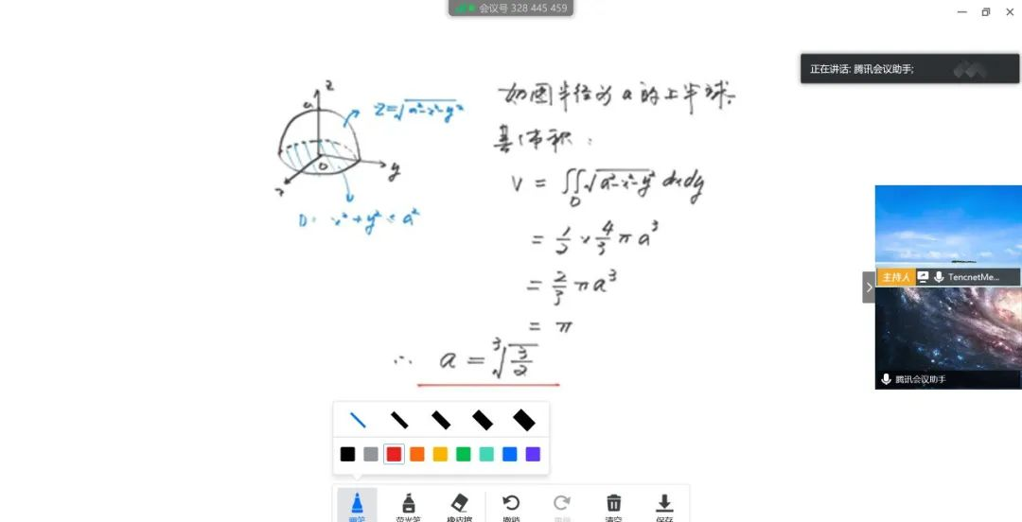
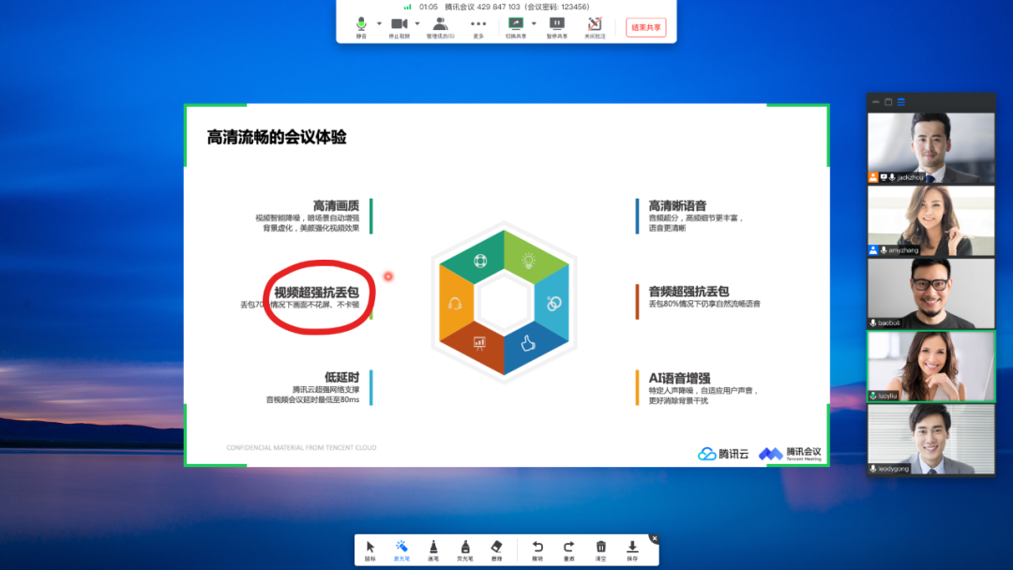
Tencent Meeting API/SDK Use Cases
On-cloud Interviews
Online Classes
Enterprise Collaboration
Tencent Meeting can integrate with enterprises' recruiting systems to interconnect interview invitations and communication processes, eliminating the need for interviewers to invite candidates manually and improving the interview efficiency. It allows interviewers to enter meeting rooms anonymously and utilize a special interview webcam mode to protect their privacy
Tencent Meeting can integrate with enterprises' course and training systems to enable real-time class schedule synchronization, automatic Tencent Meeting reservations, one-click class schedule access, and convenient class schedule management
Tencent Meeting can integrate with enterprises' meeting scheduling systems to enable one-click batch online meeting scheduling for enterprise employees, designate meeting hosts, and efficiently manage meetings
Tencent Meeting provides API calls for enterprises' IT staff, system integrators, and SaaS service providers to interconnect industry applications, enterprise office platforms, and Tencent Meeting's audio and video

Slide 24
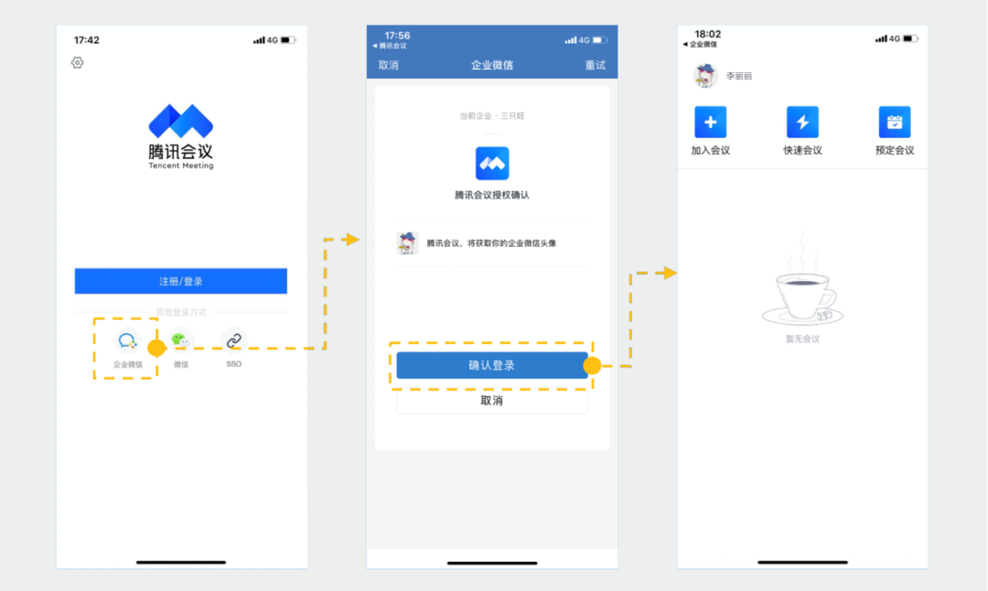
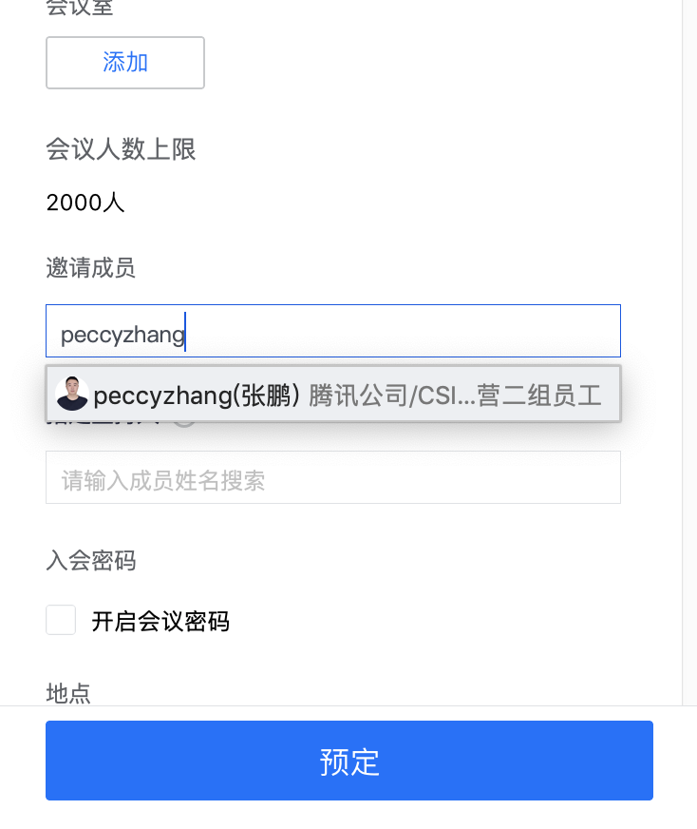
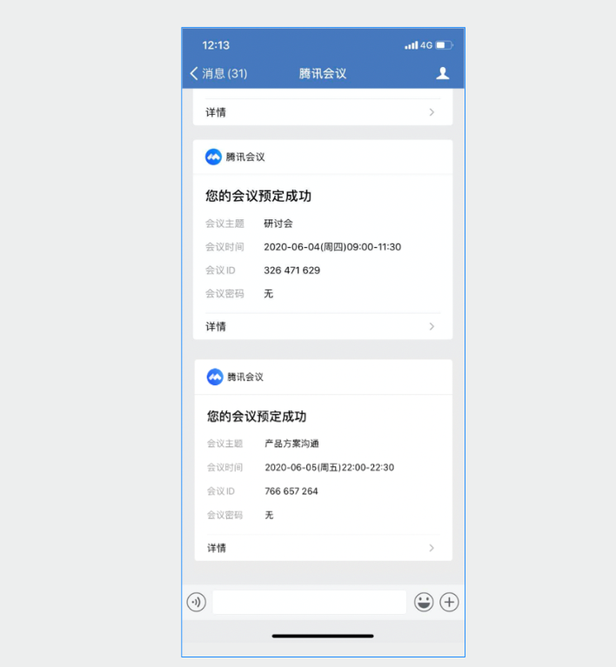
Integration with WeCom
Unified Verification and One-click Login
Meeting Invitations and Unified IDs for More Secure Meetings
Real-time Notifications and Quick Meeting Entry
Enterprise users can log in to Tencent Meeting in one click to enjoy efficient audio and video collaboration experiences without having to memorize account credentials
The Tencent Meeting accounts of enterprise users will use the users' WeChat avatars and nicknames to maintain ID consistency, help users recognize each other, and make meetings more secure
In addition to being able to check their meeting schedules on Tencent Meeting, all invited members can receive real-time successful appointment notifications, meeting modification notifications, and meeting start notifications on WeCom

Slide 25
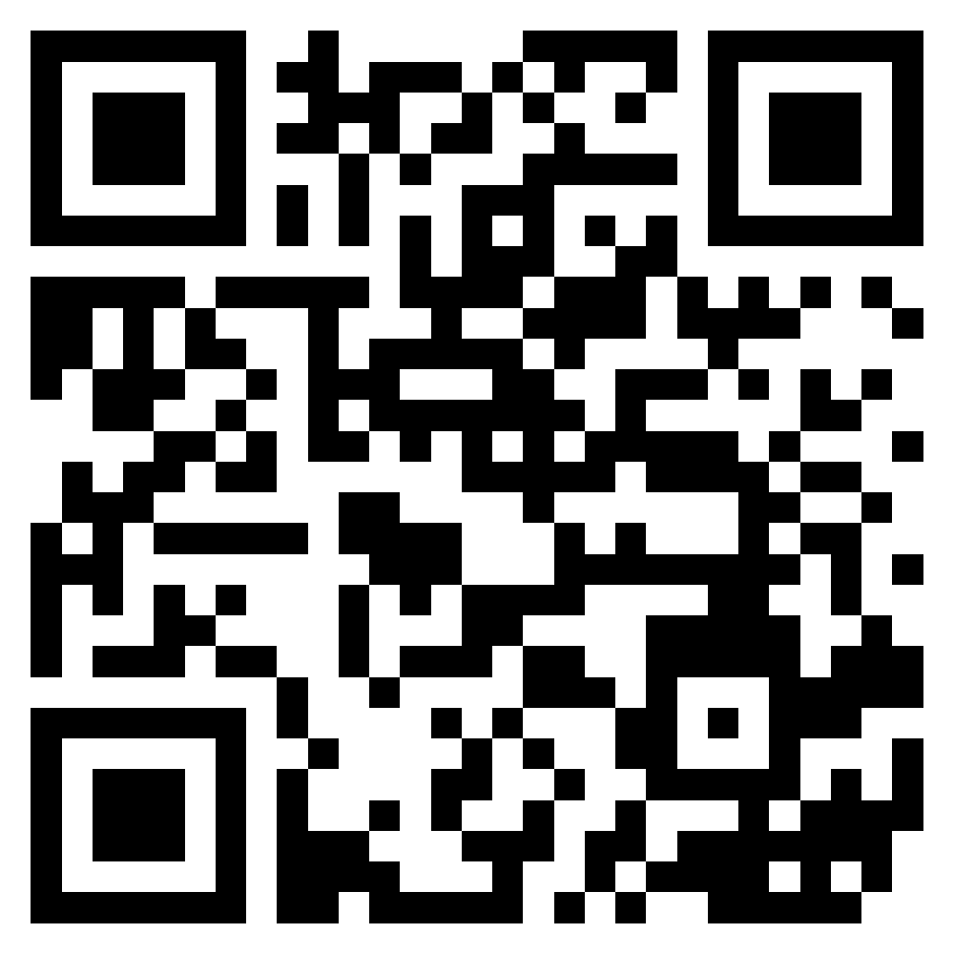
THANK YOU
Website
Facebook
LinkedIn

