Slide 1



WeCom企业微信
2022.07

Slide 2

1. Ecosystem and History of WeCom
2. Communication and Collaboration Capabilities
Content

Slide 3
01
Overview of WeCom

Slide 4



企业微信系统演进
企业微信
（SaaS）
政务微信/企业微信
（私有化部署）
微信
2
3
个人（2C）
目前对企业客户主推的版本，丰富的协同办公类应用，代替传统OA的功能；
一些大型集团把其用于移动类轻应用的入口平台进行推广
面向政府客户推出的智慧移动协同办公平台；
构建统一的政企移动门户主架构；
丰富内外协作类的场景应用；
构建政府、企业、个人的新型沟通渠道，移动办公、音视频会议、助力政企移动业务创新；
重点加强移动信息安全保护能力
包括：手机端APP，桌面客户端。
订阅号
企业（2B）
服务号
企业号
1
过渡版本，未来官方会逐步不再支持
简单的功能界面和功能扩展性

Slide 5
企业微信应用生态能力
外部服务对接
供应链管理
关联企业管理
知识库
项目
公司用车
文档
管理
供应链
合作伙伴管理
物资采购
协作
合同
审批
生态企业管理
合同
名片
B2B
支付
报销审批
位置
电话
人员
语音会议
提醒
项目
管理
回执
关联企业
订阅号
客户关系管理
费用管控
组织架构
聊天
工作
汇报
行业信息共享
B2C
视频会议
邮件
企业号
服务号
群聊
支付
HR
管理
图片
分享
人员管理
员工
考勤
融合使用体验
审批
市场营销
文档
分享
移动接入
业务监控
B2G
审批
企业会议
论坛
企业
支付
办公
消息沟通
企业微信
投票
督办
经营报表
核心能力
办文
工单分派
生产运营监控
培训
客户服务
日程管理
扩展移动办公能力
办会
关联政府
扩展企业运营能力

Slide 6



Ecosystem Synergies: WeChat - unlimited toC & toB Capacities
Native WeChat Ecosystem Integration
Chat, Group Chat, Time line
Users
Internal
HR, Product, Sales…
Apps, mini Game
Mini Program
Associated Organization
Distributor, agency
Consumer
WeChat
WeCom
Content, Service
Official account
Field Systems
Factory, Logistics
Streaming, VOD
Video account
Industry
Ecosystem, Chains
Transaction
WeChat Pay
Customer
Employee
20 million +
1.2 billion
Over 800 million
Over 800 billion
440 million
5.5 million
130 million
400 million
5.5 million
WeChat
The official account
WeChat
Monthly active users
WeChat Pay
Monthly Active Users
Mini program
Transaction total
Mini Program
Daily Active Users
Mini Program
WeCom
Active Users
WeCom
WeChat Users
Connected
WeCom
Enterprises-
80% of China top 500
Statistics as of Mar. 2020
Statistics as of Mar. 2020
Statistics as of Dec. 2019
Statistics as of Mar. 2020
Statistics as of Jun. 2020
Statistics as of Jun. 2020
Statistics as of Dec. 2020
Statistics as of Dec. 2020
Statistics as of Dec. 2020

Slide 7
Communication and
Collaboration Capabilities
02

Slide 8
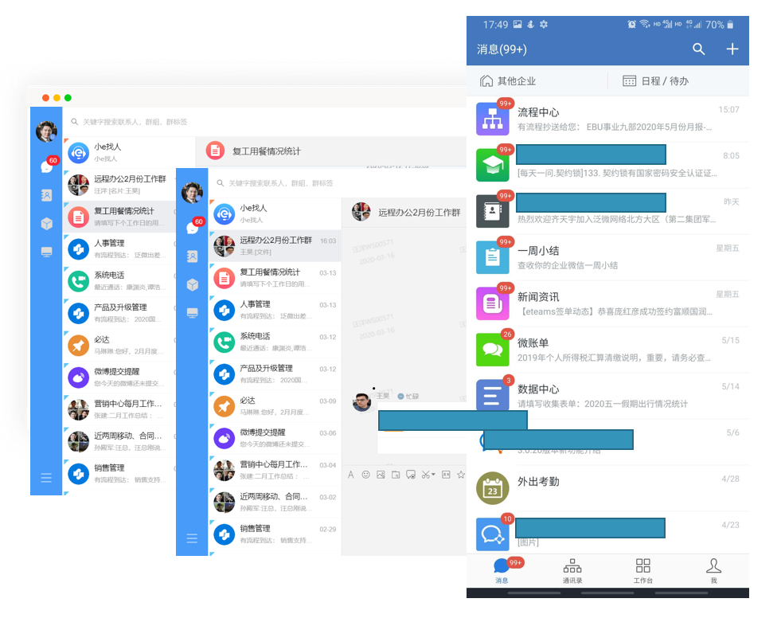




Efficient Collaboration
Multiple
Communication
Methods:
Chat
Voice
Email
Bonus
Video
Featured office
Functions:
Message
reply
To-do
Markup
break
Check In
Meet multiple types of work collaboration scenarios
One platform for all types of Communications
Communication of all organizations, person on one platform.
Integration of internal staff, external suppliers, customers, distributors， agents.
not only video and audio - all application notifications and warnings can be pushed messages and consumed directly
Communication can be associated with data, processes, customers etc.
Task collaboration tool
Online audio/video meeting
Document store and collaboration
Authorization of rights

Slide 9





Efficient Collaboration
Instant Messaging
Contact, work group chat, Voice/Video
Chat management, WeChat interoperability
HR
E-Badge,, Business Travel, OKR, Payroll
Organization Culture
Questionnaire, Poll, Team building, Meetings & gifts
Collaboration
Built-In E-mail & Meeting , Calendar, Log, Smart ToDos
Social
BBS, gamification, redemption
Training
Knowledge share & management LVB & VOD Course, Quitz

Slide 10

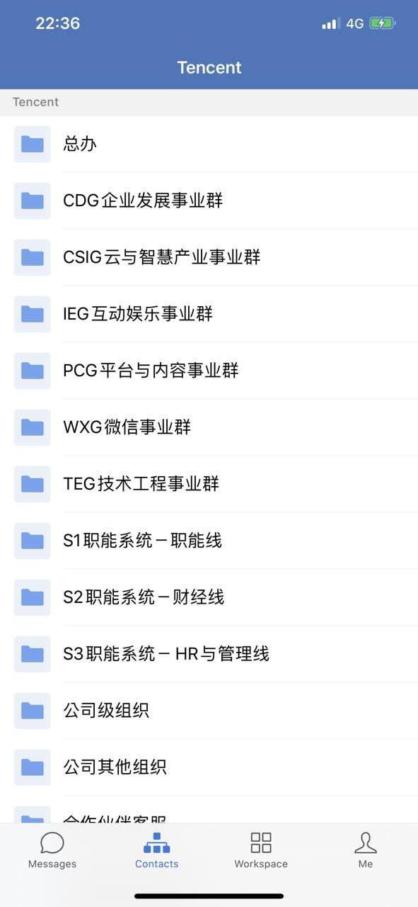
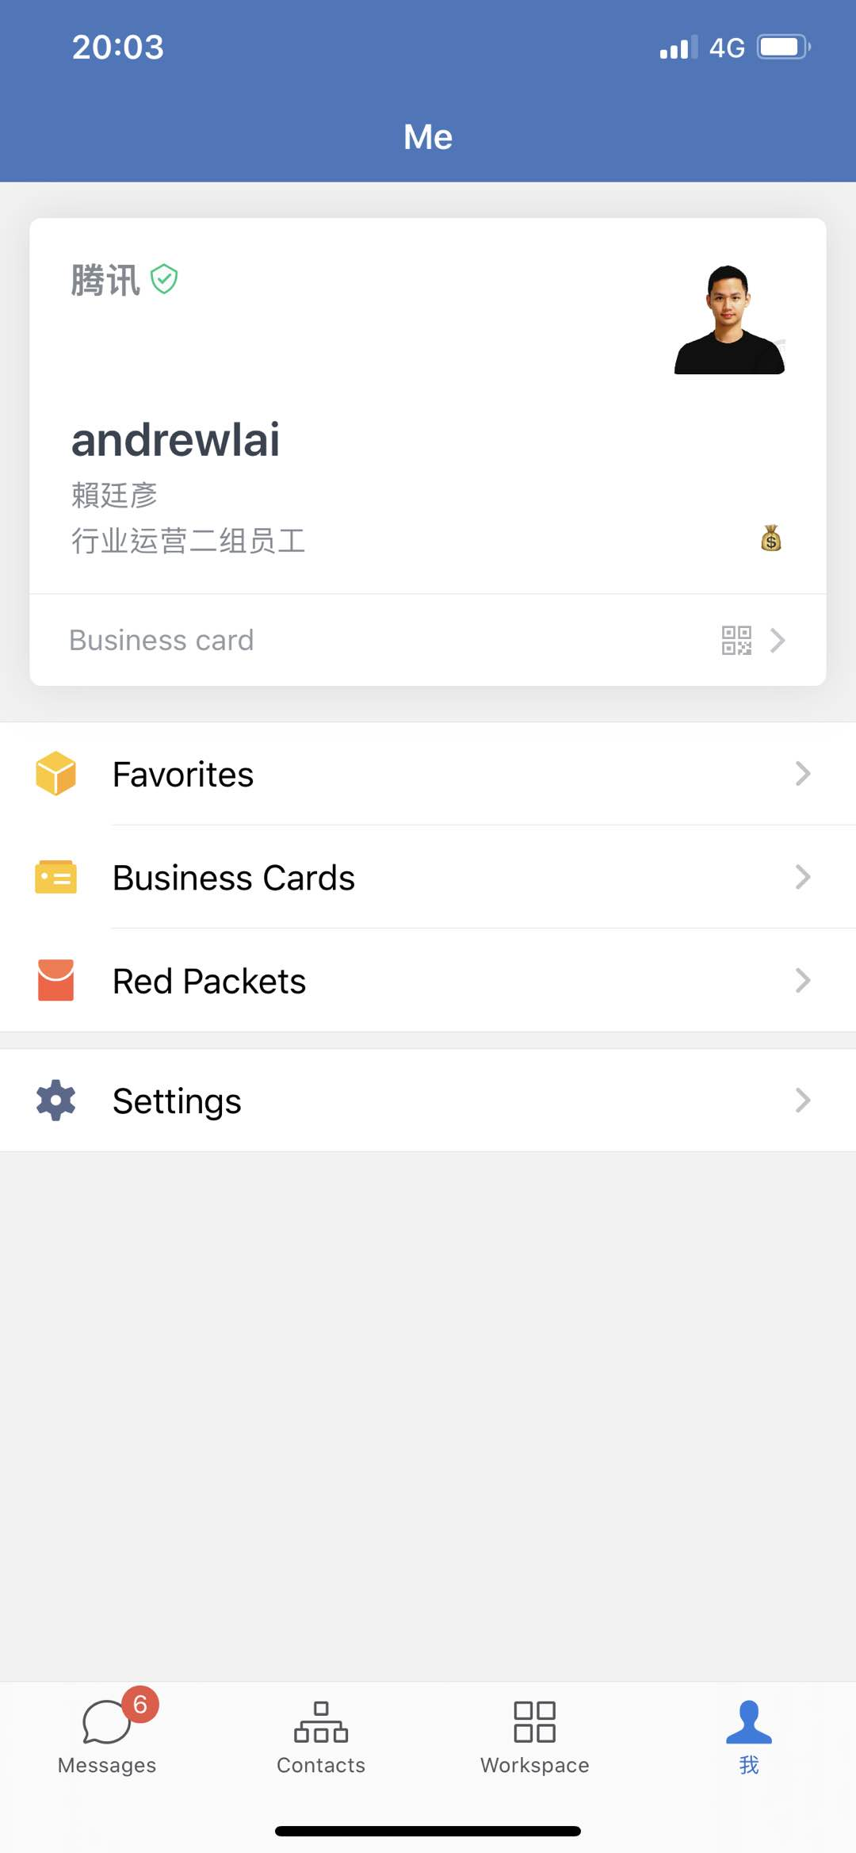
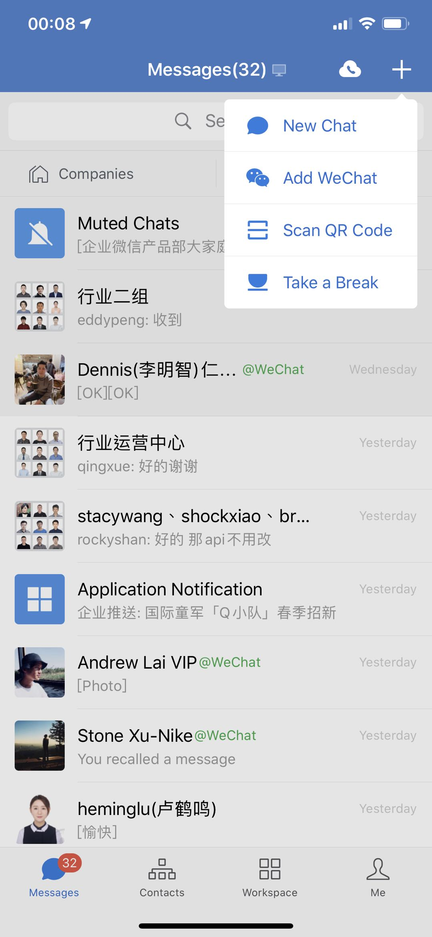
WeCom Interface
Similar experience with WeChat
Organization Directory
Corporate Identity

Slide 11
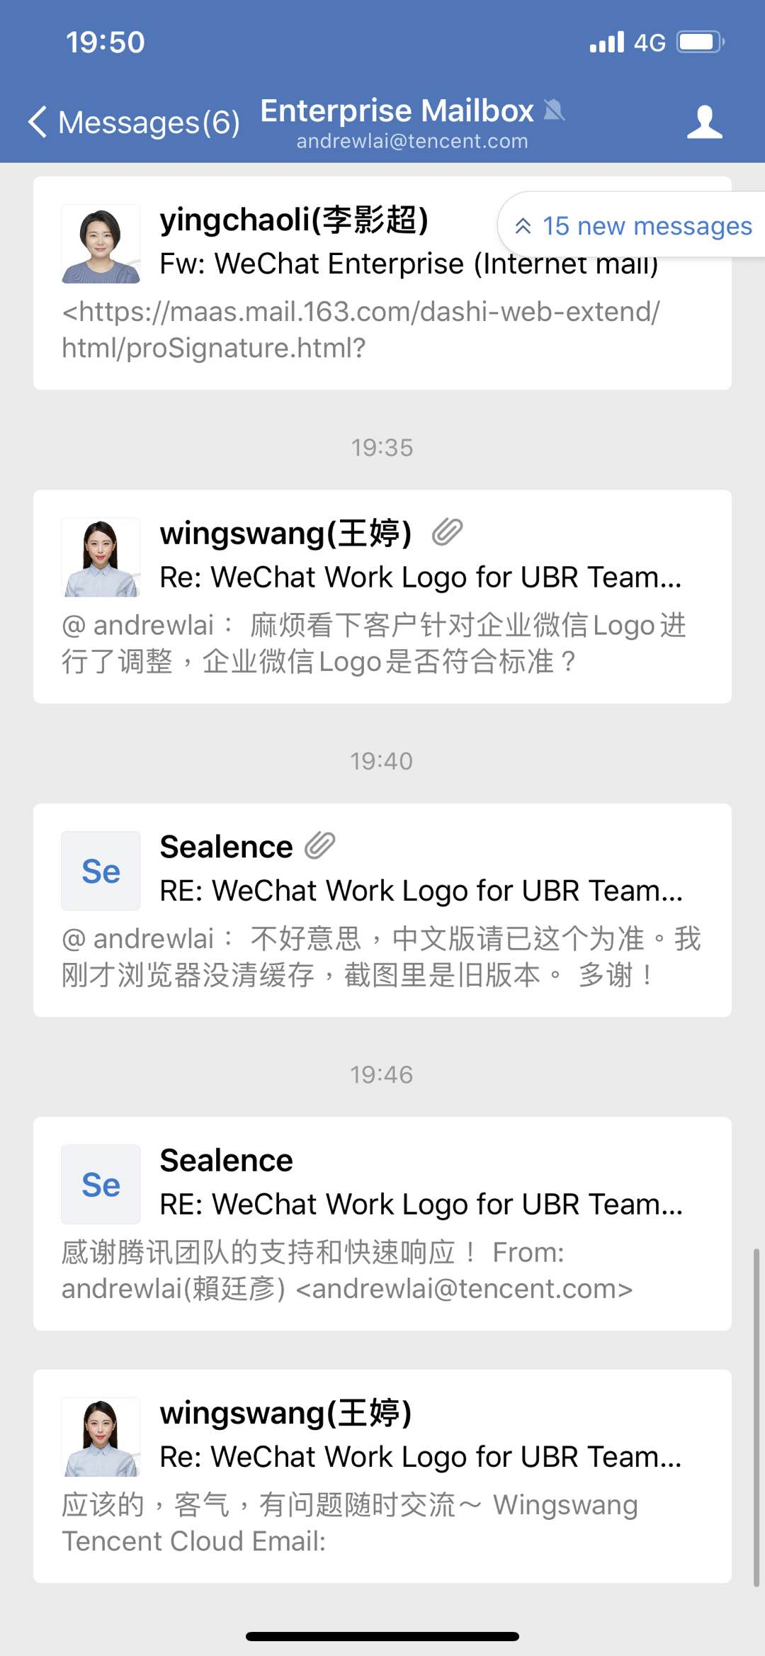
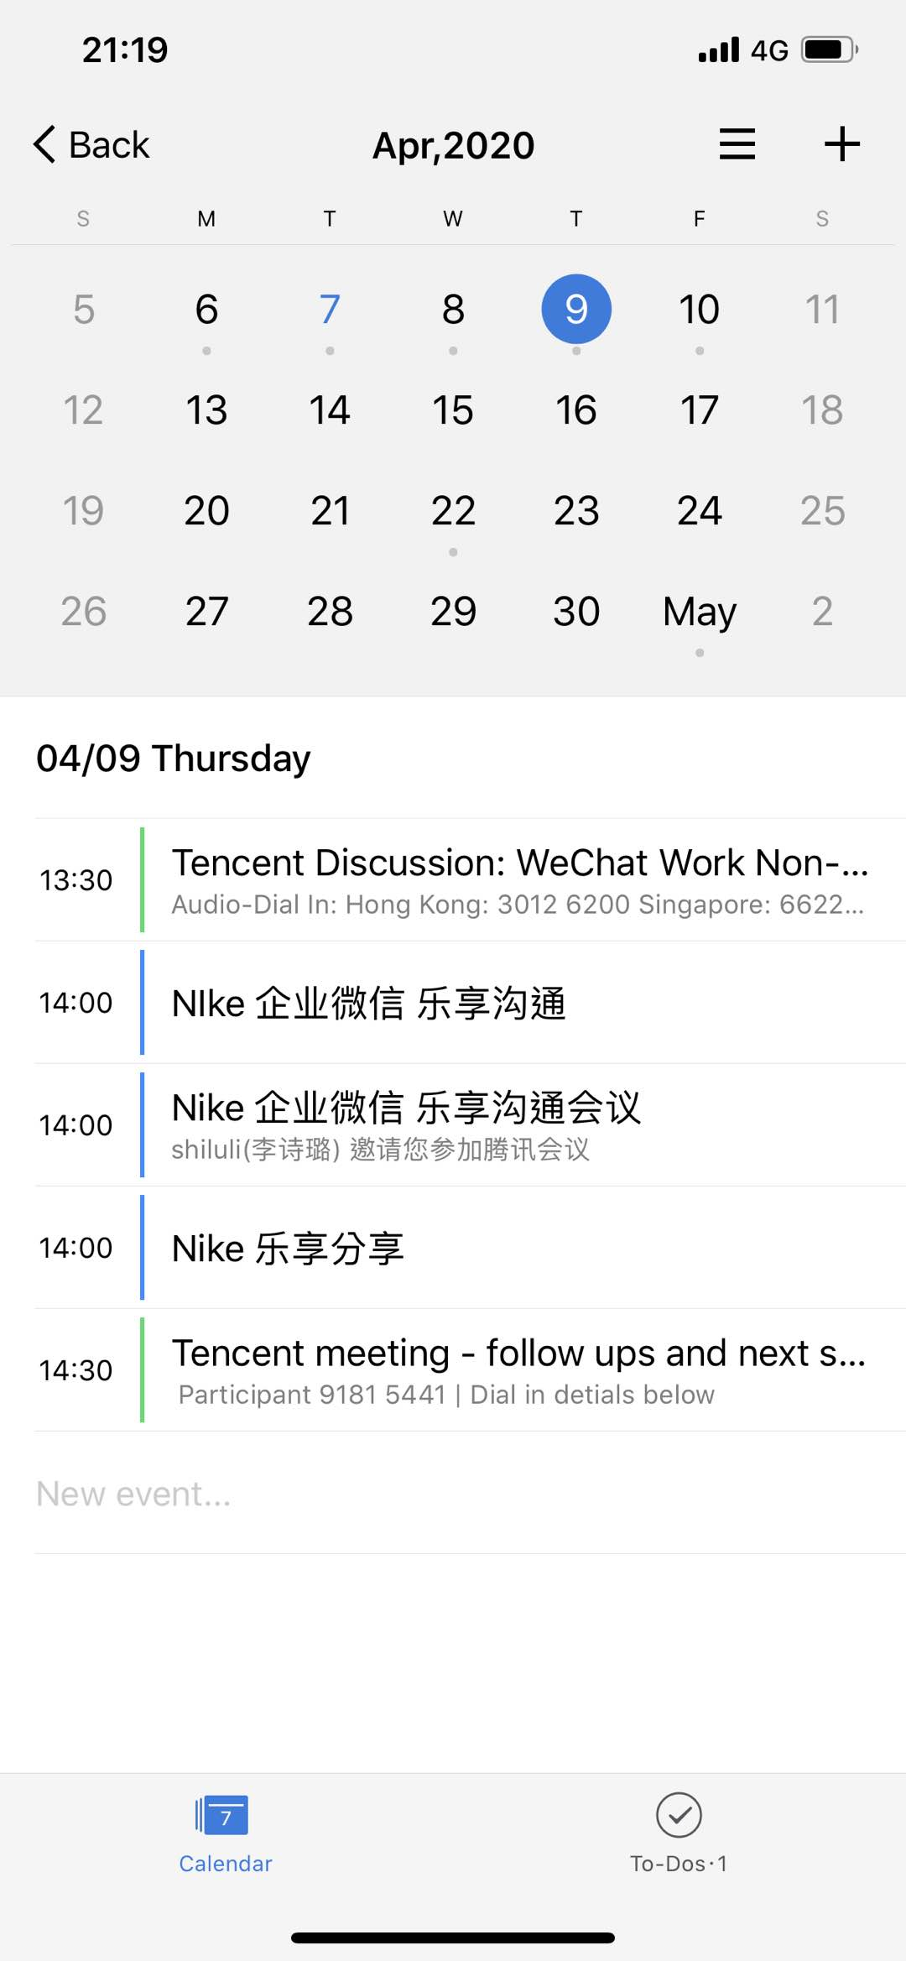
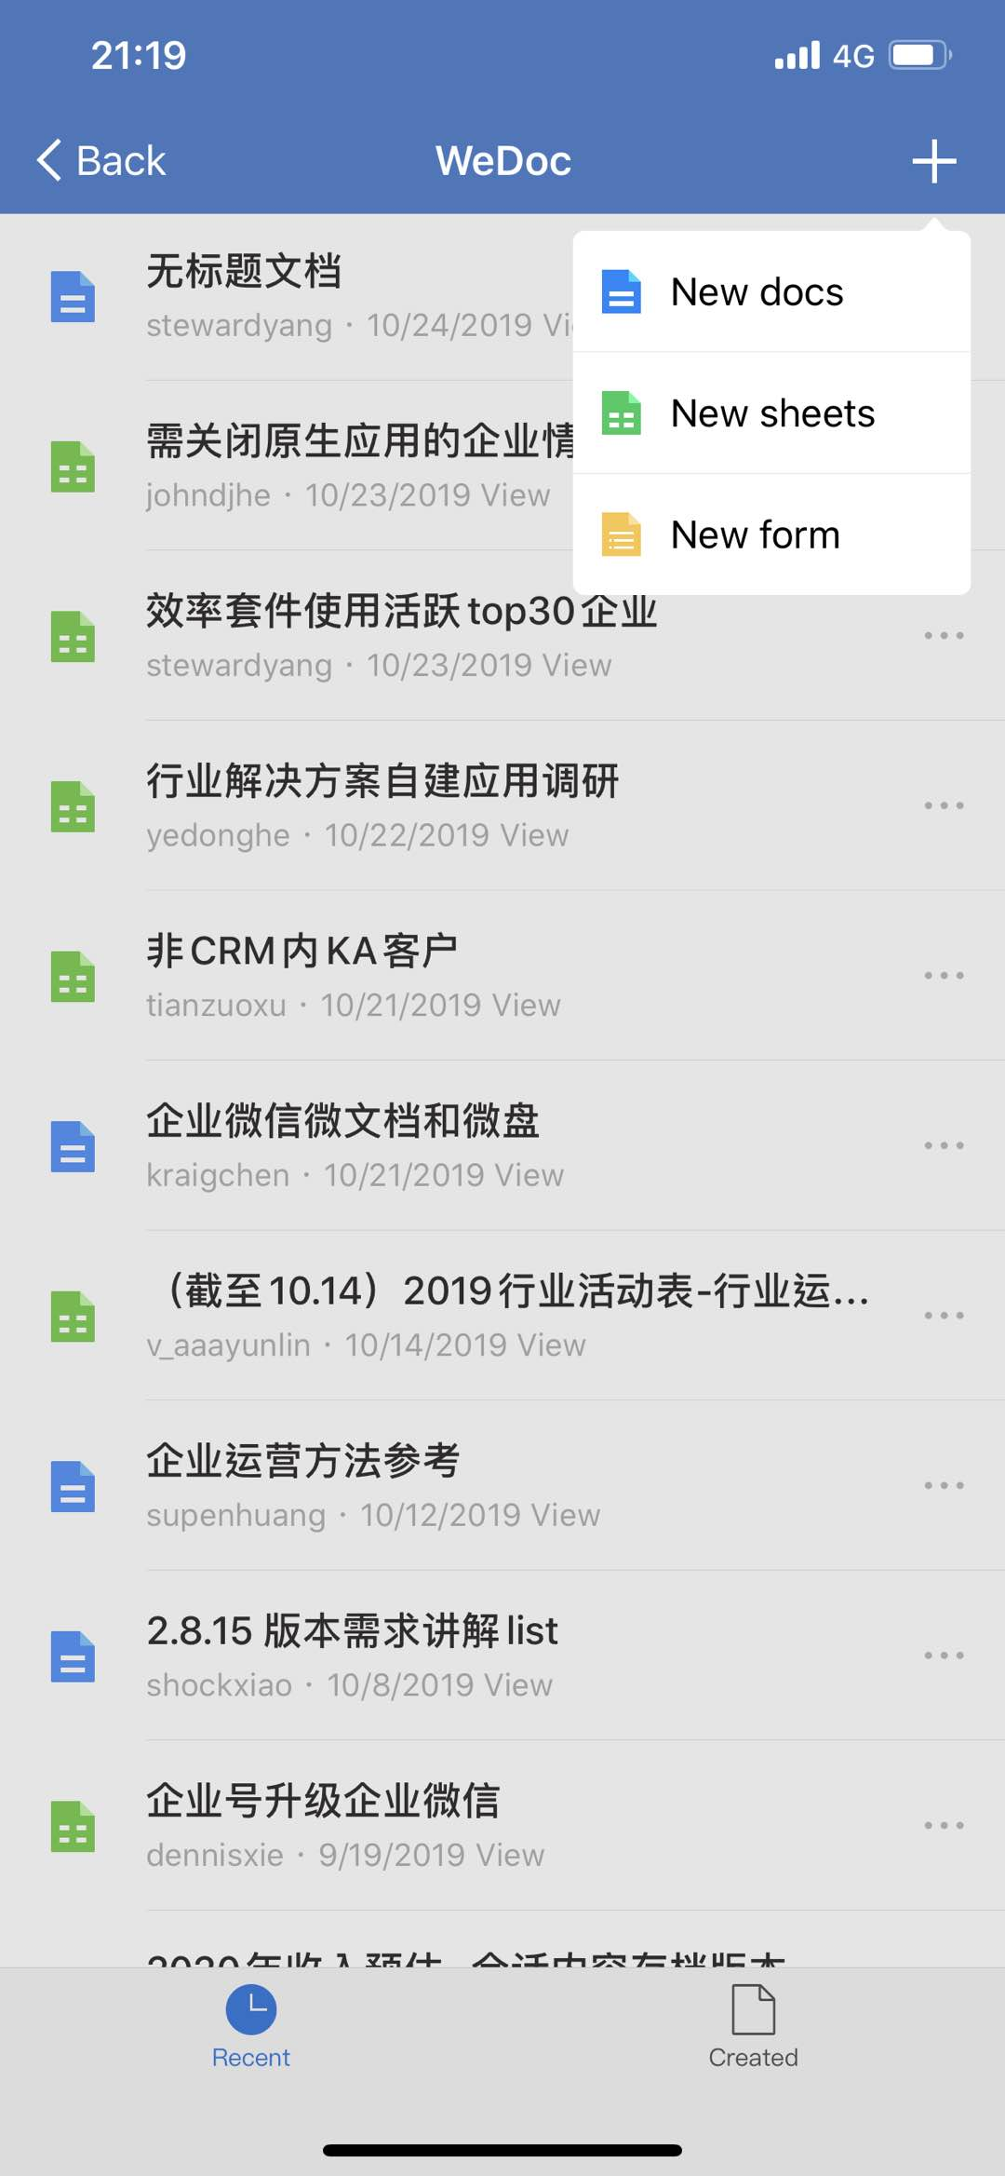
WeCom
Default Function
Mailbox integration
Calendar synchronization
Online document
Approval process
Clock-in tool
Cloud drive
Notes:
我们做了一些基础的内部办公应用。是内置的，包括打卡、审批、文件盘、汇报等。可以满足大多数企业的基础办公需求。

Slide 12
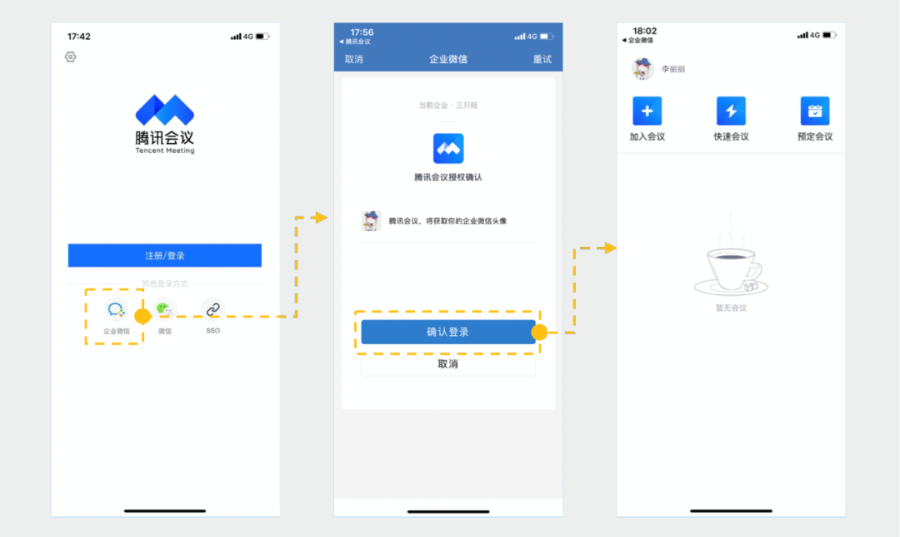
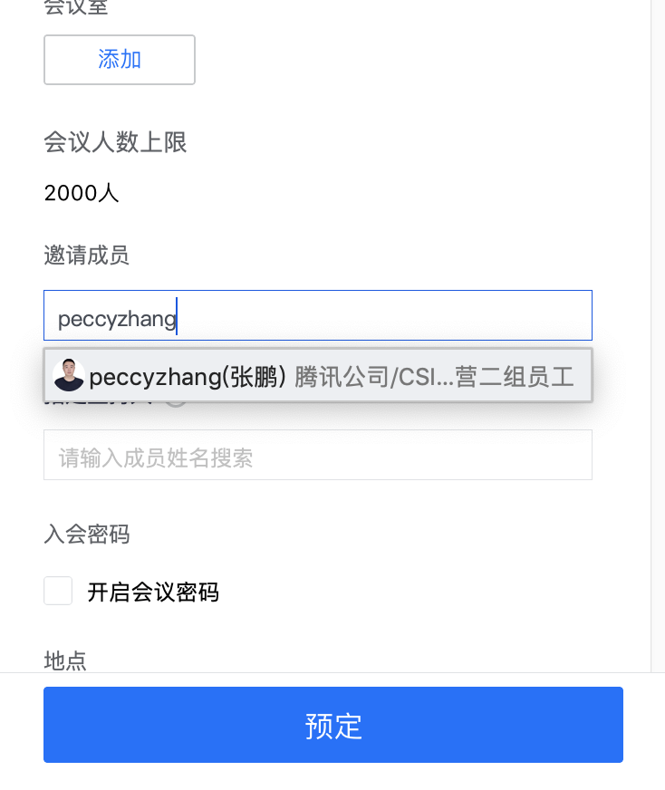
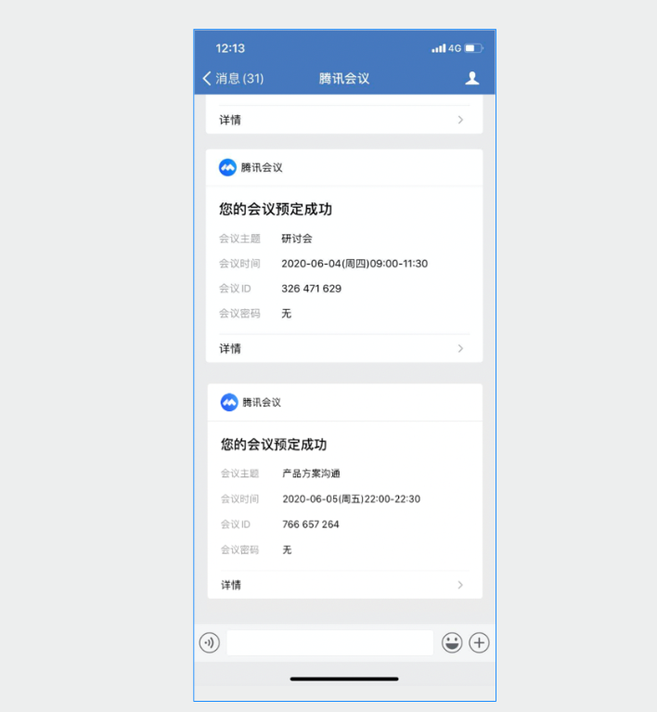
Integration with Tencent Meeting
Unified Verification and One-click Login
Meeting Invitations and Unified IDs for More Secure Meetings
Real-time Notifications and Quick Meeting Entry
Enterprise users can log in to Tencent Meeting in one click to enjoy efficient audio and video collaboration experiences without having to memorize account credentials
The Tencent Meeting accounts of enterprise users will use the users' WeChat avatars and nicknames to maintain ID consistency, help users recognize each other, and make meetings more secure
In addition to being able to check their meeting schedules on Tencent Meeting, all invited members can receive real-time successful appointment notifications, meeting modification notifications, and meeting start notifications on WeCom

Slide 13
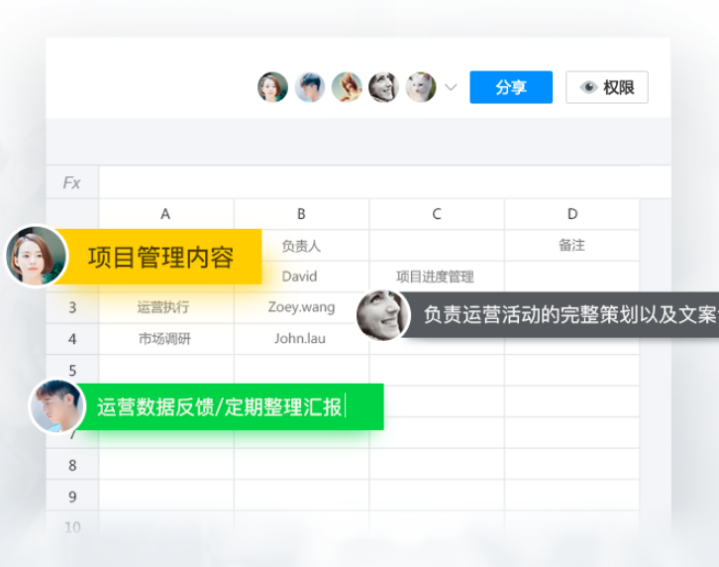
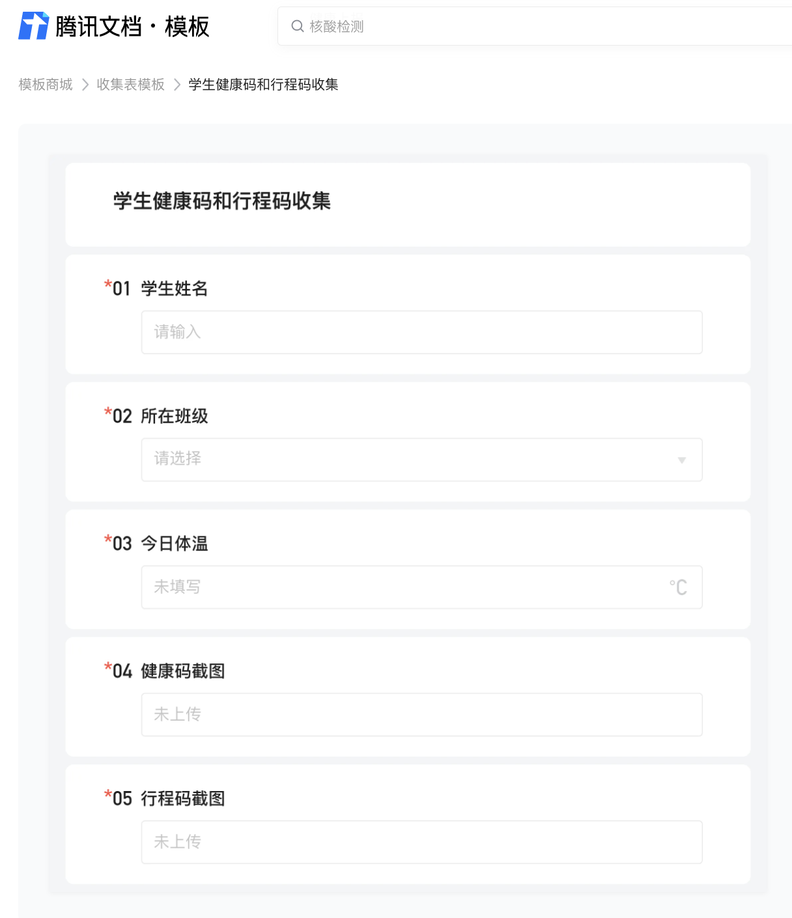
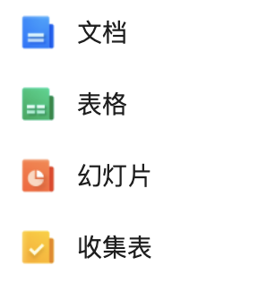
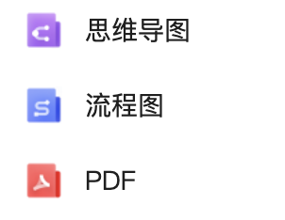

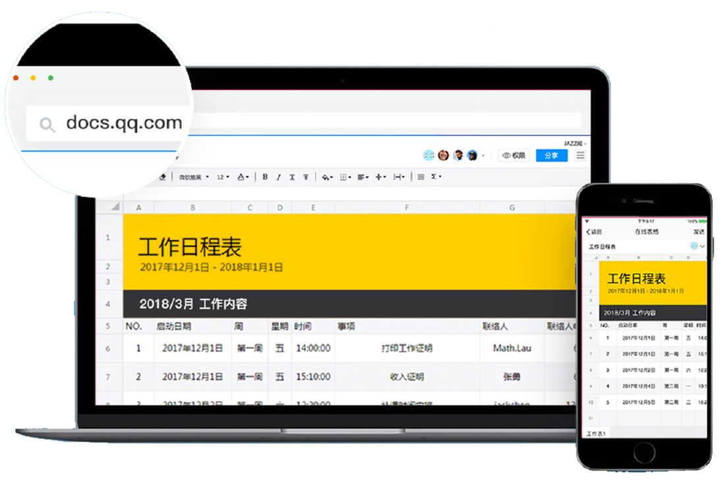
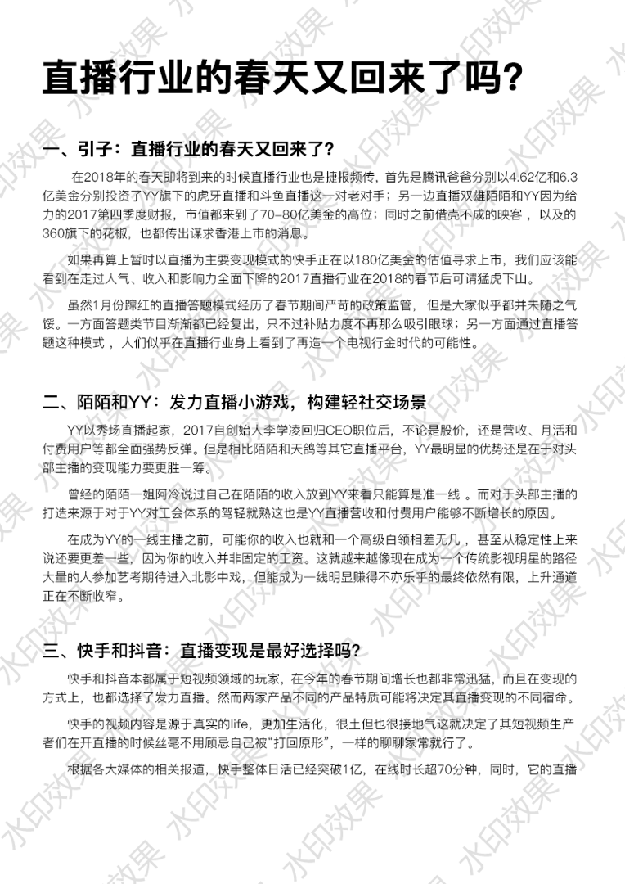
Tencent Docs
多人协作，实时查看协作者的创作内容,多人协作时高亮显示名字
网页版
APP
微信小程序
文档上添加自定义的文字水印
丰富多场景模板

Slide 14
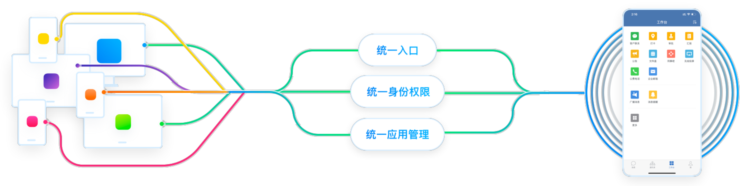
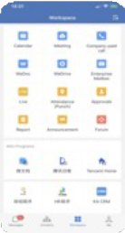
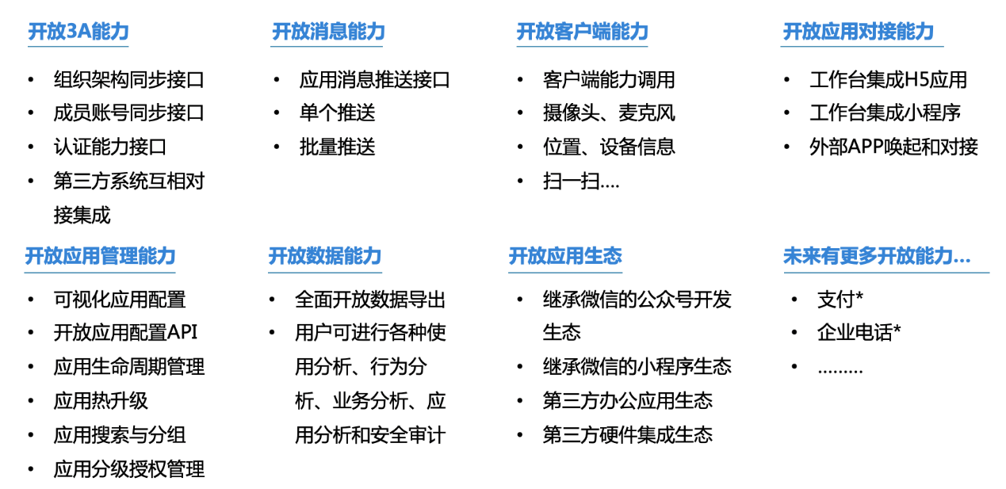
Enterprise Applications
iDaaS
Identity
Integration
iPaaS
Data
Integration
aPaaS
+ RPA
Process
Integration
Built-in Office applications [Default]
Build-in Office applications [Addon]
Messaging, Video Conferencing, Location Services, Phone calls, Calendars, Mail, BBS
Document Sharing, Image Sharing, Business Card Receipt, Approval, Poll
Operation Report, Employee Timecard, Expenses Office Stationary, Knowledge Management, Contract Approval
HR Management, Payment, Reimbursement, Company Car, Document Management, Project Management
3rd party/External applications
Ecosystem-Enterprise
ERP, CRM, External Services
Marketing, Supply Chain, Affiliates, Industry Sharing
Self-built applications
Open API & SDKs
[Till Dec.23 2020]
540 Open APIs 80000 Partners 11,9 Million Connected systems

Slide 15
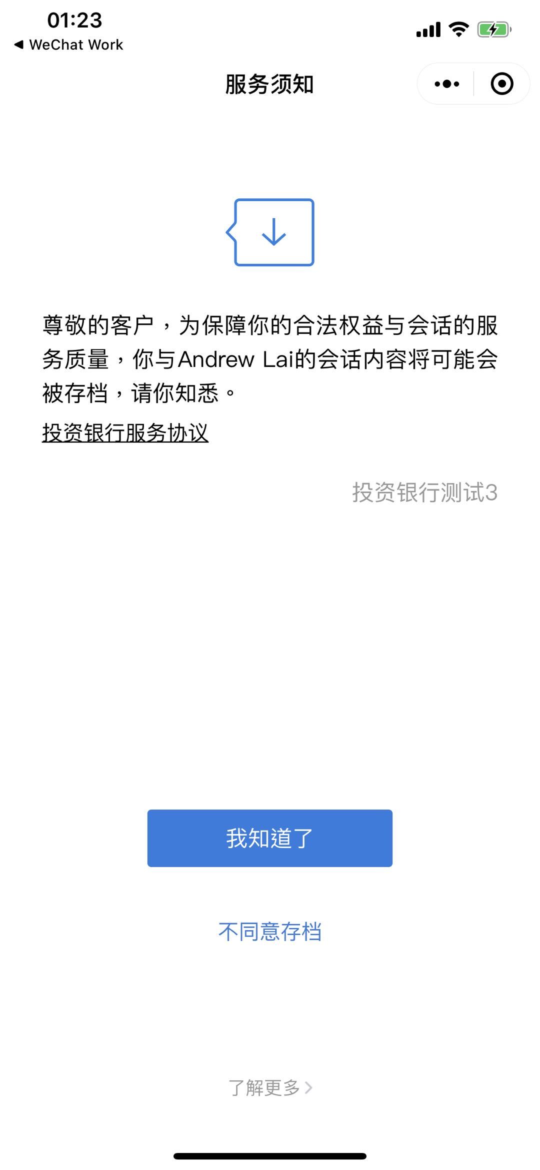

Archive Disclaimer
WeCom
T~T-3
WeCom
Message Archiving
JSON
#
Public Key
Media
Obtain chat context & log
Corporate public key
Audio/Video disable option
Annual charge per headcount
Request Freq:
600 calls/min
Private Key
Notes:
We have the capability to archive the messages history internal and external，this capability is premium.
This is like when we call the customer service, the operator will tell you that for better service, the next call will be recorded.
So we will send a mini program as the reminder in order to archive the message histroy legally.
Enterprise can download the history by coportate key.

Slide 16




WeCom Values
Efficient Collaboration
Ecosystem Synergies
Enterprise Applications
Comprehensive Security
  WeChat UE without learning curve
  Instant Messaging, work Group
  Self service
  Office Automation, Tooling
  WeChat customer message in single chat or group chat, share content to the customers moments. PGC & UGC via Video Channels, official account.
  Mini-Program Internet & Intranet
  Enterprise Payment Out of box
  Open Ecosystems and API Economy
  Built-in Tencent productivity tools (Meeting & Calendar, on boarding & off boarding, Approvals, etc.)
  3rd-party apps
  User-developed system integration via APIs.
  Low code rapid dev studios.
Robust cybersecurity system to secure private user information and enterprise data
the first to receive certifications for all major international information security standards
A Wide Array of OA Apps,
App Builder & Integrations
Ensured Security
& Full Compliance
  As easy to use as WeChat
WeChat & qCloud Ecosystem
Deployment - Standard SaaS or Private deployment
Industry Solutions - Custom industry solutions & applications
Smart Hardware - ioT hardware & software smart office
Business Innovation - WeCom Enterprise API and developers*
* WeChat API compatible and extensions, mini-program inter-runnable

Slide 17

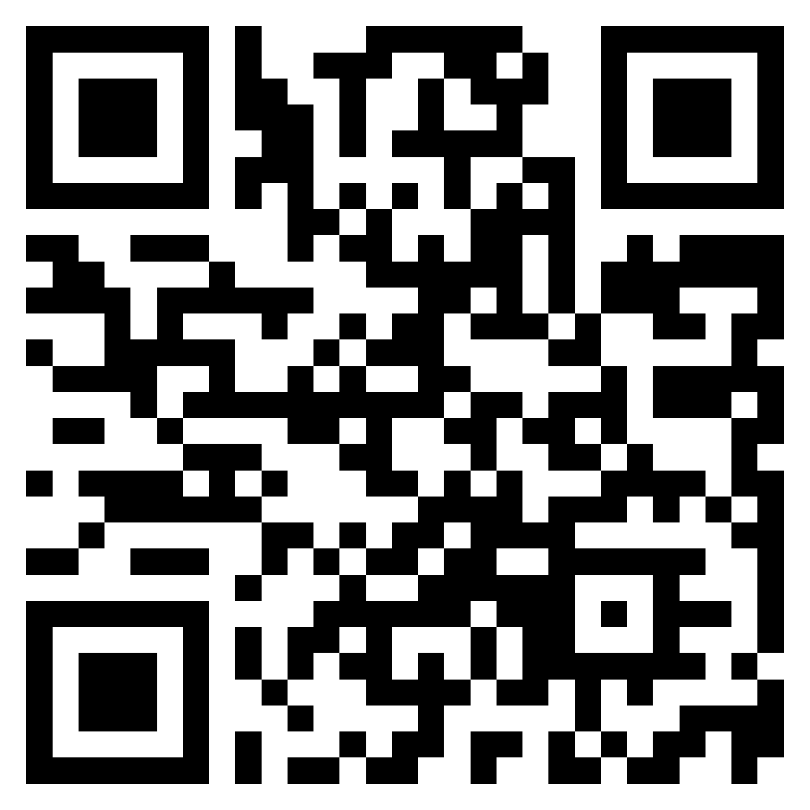
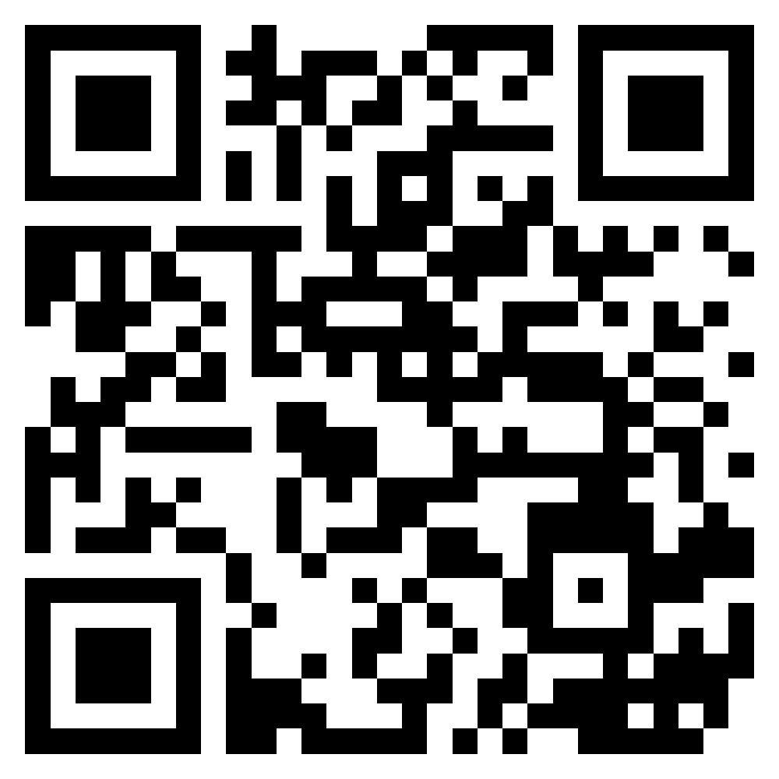
THANK YOU
Website
Facebook
LinkedIn

