Slide 1
TDSQL briefing
By：ivyyuehu
Date:Oct.2020
Notes:
1. 面向的行业/客户/适应场景，客户处于什么状态下适合引入TDSQL
2. Tdsql的优势介绍，最好有和【传统常用DB、主要分布式DB竞品】的对比优势
3. Tdsql项目的典型流程
4 经典案例
5. Tdsql的售卖方式（私有化、公有化）

Slide 2
Agenda
01
Basic Information
Product family
Position of TDSQL
02
Some Typical industry and scenario
Users cases
When do we Choose TDSQL
03
Advantages and characteristics
Characteristics
Competitors
Notes:
面向的行业/客户/适应场景，客户处于什么状态下适合引入TDSQL
4. 经典案例
3. Tdsql项目的典型流程
5. Tdsql的售卖方式（私有化、公有化）
Tdsql的优势介绍，最好有和【传统常用DB、主要分布式DB竞品】的对比优势

Slide 3
Overall view
User Industry
e-commercial
financial
retail
gaming
industry
education
……
Database SaaS
DTS
DMC
DBBrain
Cloud Visualization
Expert Service
Audit
Service module
Database PaaS
Scheduler
RDBMS
Distributed DB
NoSQL
AP
With Hardware
Others
Disaster recovery
Migration
MySQL
SQLServer
PostgreSQL
MariaDB
TDSQL
TBase
CynosDB
Redis
MongoDB
CTSDB
Tcaaplus
Memcached
Gbase(external)
CStore(stand-alone)
TData
TDSQL Rack
Easygraph
(doing)
YottaDB(doing)
Failover
Log
Backup.
Task deployment..
Alarm
High Availability
Cloud Nest（ Platform ）
Liaoning Platform
Physical Machine（Tencent Linux）
Domestic
UOS
CVM
database Appliance
Route switch.
Statistics
Operation
Notes:
CynosDB 为新整合分类，将该分类有两个条件： 这个分类是我们后续长期竞争力的优势所在，也是投入的重点。 1 自研比例大的关系或者MPP分析数据库，长期可以按照自研口径推广
2 需要时分布式的，不管是share nothing，share storage 。
若不是这两个条件同时存在，就会让分类上出现混乱。 例如，没有自研比例，则当前的 mongodb 可以进入，mongo也有事务，或者说ES也支持SQL，也有分布式。若分布式，则cstore可以进入，从而让现在的mysql陷入分类上的尴尬位置。 所以从分类上做了这样的规定。
ASQL说明：后面会有TBASEV3，自研产品。Clickhouse，开源生态的AP数据库。同时，若是小规模的数据分析，有公有云上的cstore列存直接挂在主实例上。

Slide 4
Basic Architecture of Database
Red:share
Blue:not share
MPP
MPP
Share-Nothing
Share-Storage
Share-Everthing
MPP
VIP/DNS
W
R
DB-Server
DB-Server
Proxy
Proxy
Proxy
Client 1#
Client 2#
Client 3#
Client 4#
W
DB-Server
DB-Server
DB-Server
DB-Server
DB-Master
replica
replica
replica
Storage
Storage
Storage
Storage
Storage
Storage
Storage
Oceanbase/Spanner/Cosmos/Redshift
TDSQL/Tbase
Oracle RAC/PolarDB/Aurora
In Public Cloud
CynosDB
Notes:
前面我们描述了分布式的几种架构，在数据库体系中，由于数据库的实时性要求，基本上所有分布式数据库的架构都是在MPP架构上进行的演进。
Mycat/DRDS与TDSQL/Tbase的区别：Tbase与TDSQL的模式比中间件模式的好处是：1.业务层不需要关注数据分到了哪里，只要选择合适的分布方式，db会自动分配数据到底层节点，对于业务层使用分布式数据库就像使用单机一样便利。2.原生分布式架构的好处是在计算和存储的分离处理能力上要强大很多。中间件模式仅是做一个sql语句的路由转发，但是tbase的cn/dn的组合会在计划的算子下推，并行处理方面优越很多。而且有gtm的全局事务保障，对分布式事务的全局一致性是有强保障的。

Slide 5
Two Modes of TDSQL
Both of the modes enable financial-level disaster recovery and data consistency.
The Noshard mode is completely compatible with MySQL, while the Shard mode has some limitations on the capabilities of SQL.
NoShard
Shard
Complete compatibility
High consistency
Automatic disaster recovery
Horizontal scaling
Complete compatibility
High consistency
Automatic disaster recovery
Horizontal scaling

Slide 6
What is TDSQL
Financial-level high availability
Highlights of a distributed system
TDSQL ensures 99.999% availability, cross-region disaster recovery, intra-region active-active capability, and automatic failure recovery.
Read/write separation; distributed transaction; introduction to the basic features of a distributed system
Strong data consistency
High security
It should be introduced from the perspectives of both cases and technical principles in combination with the test data from the Intel team.
TDSQL can lower the risks of user errors and hacking.
The capabilities of enterprise-level MySQL/ MariaDB
Convenient OPS
Chitu Console (you can demonstrate how to use the Console if necessary)
You must introduce that not only is TDSQL a distributed database, but it has the capabilities of enterprise-level MySQL/MariaDB.
The independently controllable features that target at governments/financial companies must be included

Slide 7
Core Architecture of TDSQL V2
Ops Console
Scheduler
Scheduler
Backup
Manage System
Manage System
Monitoring and collection
Manage System
Set 1
SQL engine
Master
Slave 1
Slave N
load balancer
SQL engine
Set 1
SQL engine
Master
Slave 1
Slave N
TDSQL is mainly designed for handling online transactions in the OLTP environment.
It is not suitable for handling complex analytical SQL statements in the OLAP environment.

Slide 8
The architecture of TDSQL V3.0
client
SQL
TDSQL3.0
Threads pool coroutines
Based on MySQL 8.0
Share nothing
Separate the computing layer and storage layer
Not just grammer ,but also function Stored procedure and trigger
SQLEngine
Control
GTM
Control
Range hash
P0
P0
P0
PA0
PB0
PB1
P1
P1
P1
PA1
PA2
PB2
P2
P2
P2
P3
PA3
PB3
P3
P3
P4
P4
PA4
PB4
P4
Notes:
Proxy的线程池模型需要优化成协程模型
Proxy的SQL兼容性工作量还非常大，需要寻找更好的方案
基于shard key的对于开发人员来说存在一些负担，而且不利于olap的场景
在去IOE的形势下，经过几年的培育，客户已经对分布式数据库产品形态非常认可，在具体的数据扩容方面会觉得能自动的数据迁移看起来更cool一点，而咱们的设计看起来更为保守，噱头不够。
3.0架构的目标
因此接下来一方面需要继续对2.0的进行投入，以巩固我们目前的优势，另外为了提高产品竞争力，需要开启新一轮架构优化3.0，以解决上述问题，更好地服务好我们的客户。对于3.0，希望咱们的产品特色如下：
分布式share nothing的架构，计算层和存储层分离，每层可以独自伸缩
数据高一致性，健壮的分布式事务处理机制
单个集群规模的容量可以做到PB,EB级别
所有的节点支持多写，提供更好的性能
100%兼容MySQL的SQL语法功能，包括存储过程，函数，触发器等高级特性，降低从Oracle等传统数据库迁移到分布式数据库的门槛
普通的硬件配置，物理机，虚拟机，公有云，专有云都支持
两地三中心，跨中心多活等
行列混存，除了oltp之外，更好地支持ap场景
适用场景广泛，核心的交易场景，如支付，交易，订单等；hbase的场景；时序数据库的场景等
冷热数据分离
多租户支持
3.0的架构
为了解决2.0的不足，但是又保持良好的扩展性，所以会继续坚定地走Google Spanner这种技术架构，只是将各层的技术实现做一些改造，核心的架构图如下所示，外观看起来跟2.0是比较类似的。
具体的实现层面会有不少差异，主要体现在以下的方面：
Proxy层升级为SQLEngine层，基于MySQL8.0的SQL层进行改造，将原来的多线程框架换成协程框架，将底层的InnoDB引擎层换成分布式的存储引擎，移除各种有状态的信息，如锁，binlog性能优化，本地的表结构等信息。需要持续优化的是分布式的查询计划处理，下推逻辑，路由逻辑，与分布式引擎交互的逻辑等。
调度模块新增一个GTM功能，负责提供全局时钟服务，目前基本开发完成，在32逻辑cpu的情况下，通过raft构成的3节点组能提供200w/s的tps.
分布式引擎不再采用基于hash的多实例的MySQL+Innodb，而是去掉事务和SQL信息，用基于rocksdb实现一个自动range分裂的纯分布式的存储引擎。在这里需要实现基于raft协议的数据一致性同步，基于版本号的并发读写，增减节点自动进行容量伸缩，流量调度等特性。

Slide 9
User cases of

Slide 10
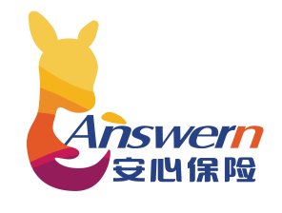
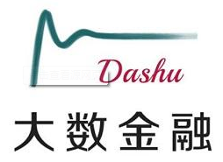
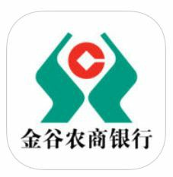
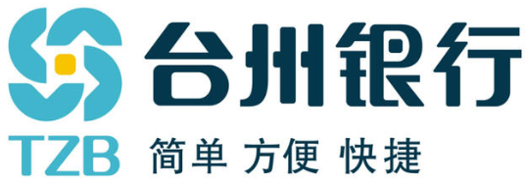
Some of our typical users
Notes:
英杰华 伦敦 500强28

Slide 11
About BYB Digital Banking Project
BYB Highlights
BYB is an Indonesian bank acquired by Akulaku, a Chinese company that has gone global. As the largest online virtual financial loan platform in the Southeast Asia market
About BYB
Strategy：Transfer to bank customer based on Akulaku e-commerce、P2P scenarios；Fast Payment；open to all indonesia
Customer Category：Individual & SME
Product：Fast Payment、Neo Prima、Consumer Loan
Project Highlights
Core Banking Type: Digital Core Banking System
Init Users: 1M
Main Modules
Digital Core Banking
Open Banking
Customer Center
Unified Payment
ODS
ESB
11

Slide 12
DB Challenge for BYB Digital Banking Project
Virtual Banking Platform is needed for online business development
Challenge for VB Core System
Distributed Database is Needed
Performance
DB Splitting
Data Recovery
OR
Extension
Operation
Alakulaku, a leading consumer financing firm , acquired BYB, aims to transform BYB into an all-digital banking platform to realize the closed-loop of financial services.
Massive data , high-frequency transactions , business in internet banking makes a big challenge for BYB new digital banking project.
Benefits
TDSQL can integrate with Sunline iCORE seamlessly, ensures the project be delivered in time;
As a distributed database, TDSQL’s flexibility can meet the expansion of user scale in the future.
End to end verification, ensures project’s success and accelerate the digital transformation of customers

Slide 13
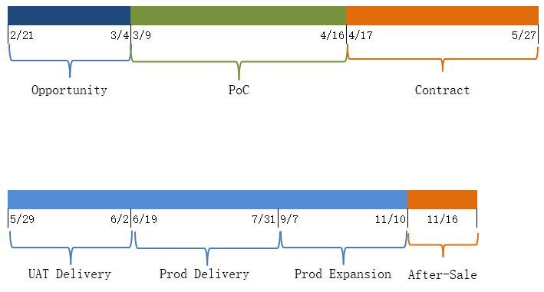
Milestones of Alakulaku TDSQL Project
POC Results (vs hotDB)
SQL Functions
Both DBs can fulfill the requests
Distribution Features
Both DBs can fulfill the requests
Get project members ready!
IaaS Config clarifying & Perf benching before setting up !!
Performance
Query SQL: TDSQL is better
Update SQL: TDSQL is better
Easy-using
TDSQL is better
POC Interpretation
Experts and customers , face to face
Analysis of corresponding Scenarios
Close connection with Sunline
Sale(BD & SA)
TDSQL Team (Production & SA)
Finance Team (PM&SA)
Delivery Team
Notes:
tdsql支持的业务： 新核心：icore,营销服务(marketing services)，流程编排 外围(Peripheral)业务系统：统一支付，营销系统，贷款作业(loan operations)，快捷支付(quick payment)，扫码支付(scan code payment ) 通用服务：短信服务（short message service），手机服务，地址服务，企业网银服务，积分服务 风控服务（Credit service Risk control service ） 达到的效果： 非分布式实例100%兼容原生mysql（100% compatible with native mysql），数据迁移无压力 分布式实例支持水平扩容，以较低的成本地突破磁盘、CPU和内存等单机瓶颈，满足海量数据存储的需求，同时提高了整体的吞吐 tdsql满足银行业务对数据一致性，高可用的要（overall throughput is improved. tdsql meets the requirements of banking business for data consistency and high availability） tdsql的日常运维工作都集成在了赤兔管理平台，提升了运维效率
（of tdsql is integrated into the Chitu management platform, which improves the efficiency of operation and maintenance）
Achieved effects: Non-distributed instances are 100% compatible with native mysql, and data migration is stress-free. Distributed instances support horizontal expansion, breaking through the bottleneck of single machines such as disk, CPU and memory at a lower cost, and satisfying massive data storage At the same time, the. The daily operation and maintenance of tdsql is integrated into the Chitu management platform, which improves the efficiency of operation and maintenance

Slide 14
Tencent Payment Business
Inner request
Outer request
Outer request
Inner request
Shenzhen
Shanghai
GSLB
nginx
nginx
nginx
nginx
Route of different business
TSM
Midas门户
nginx/cgi
nginx/cgi
Access Layer
Configure
NCS
boss
portal
mp
boss
portal
mp
Logic Layer
drm
drm
Ncs services
account
channel
account
channel
NCS
tdsql API
hold API
tdsql API
hold API
More than 100 billion orders a day
Billions of payment
More than 2000 node
Across the AZ and Region
tdsql proxy
hold agent
tdsql proxy
hold agent
storage layer
Account
Order
Account
Order
S
M
M
S
sync

Slide 15
The first internet bank –webank
800+ sets
2000+ instance
PB level storage
Hundreds of kernel system
Peak TPS 100 thousand
360 million trading volume
INTERNET
CDN
CDN
CDN
Intercity
DZ
IDC
Online Network
DZ IDC
DMZ
DMZ
Dev
IDC
Test
IDC
Tencent network
Office network
Business system
deposit business
Clearing system
Facce recognition
Credit card
loan business
business platform
…
safety control & big data
traditional financial module
New financial module
Notes:
demilitarized zone

Slide 16
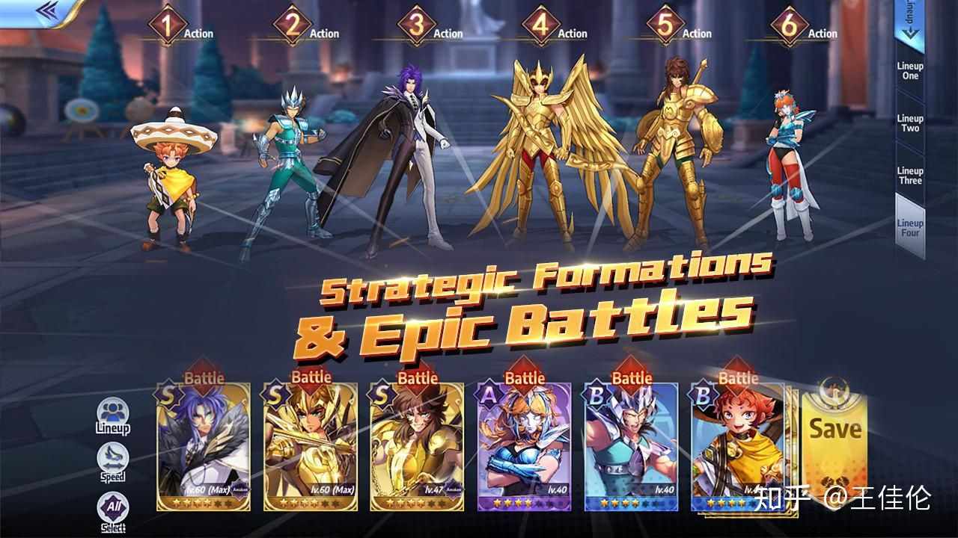
YOOZOO

Slide 17
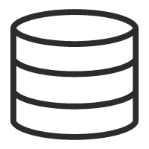
The Architecture2
DCN Master
DCN Master
DCN Master
APP
APP
APP
APP
LB
LB
LB
LB
1 Master 3 Slaves
Sync to 2 slaves and async to 1 slave
inner city IDC ,RPO=0,RTO in several seconds
More than 99.99% availability
Access
Access
Access
Access
SLAVE1
MASTER
SLAVE2
MASTER
SLAVE
TDSQL
SET1
sync
sync
async
MASTER
SLAVE1
sync
SLAVE2
MASTER
SLAVE
TDSQL
SET2
sync
async
Inner city IDC1
Inner city IDC2
Inner city IDC3
Intercity IDC

Slide 18
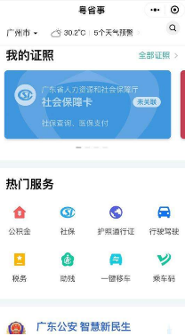
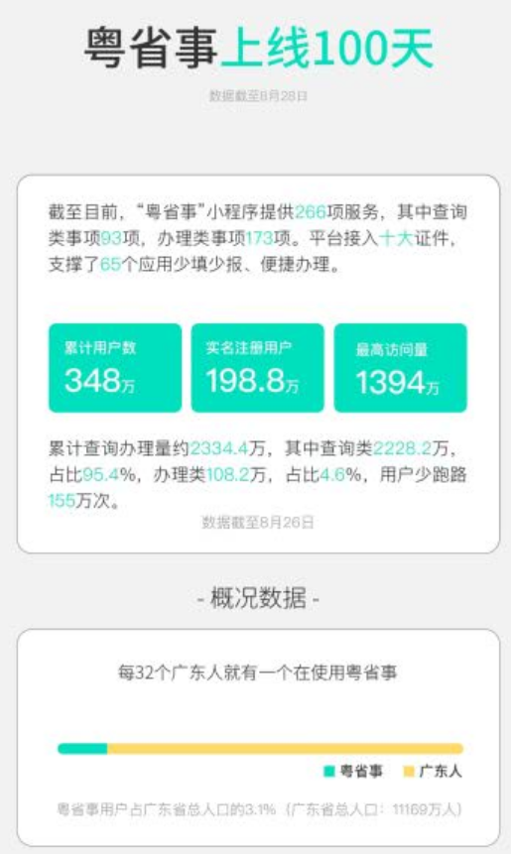
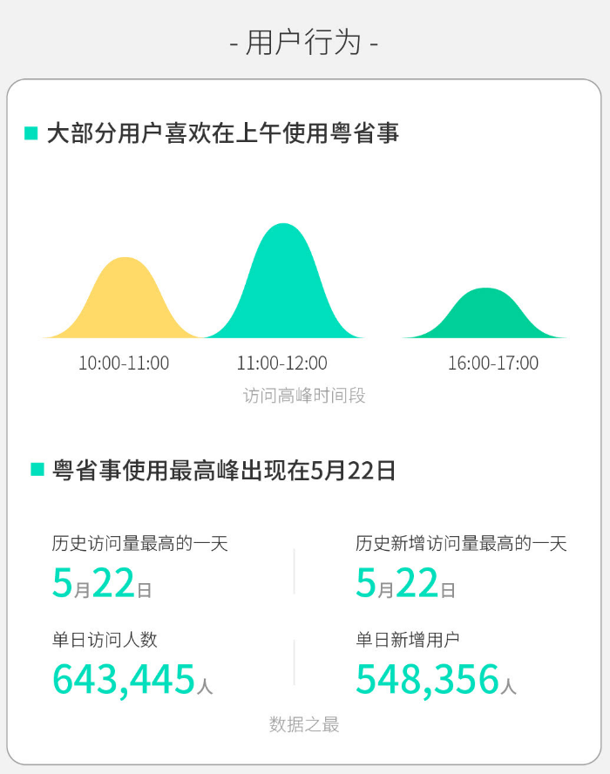
Digital Guangdong
Mini program on WeChat
The First 100 days after released
6000+ encryption tables
266 kind of services
3.48 million users
100 kinds of certifications
Ana
LB
Online office
personal
corporation
public
Handicap service
Data
synchronization
Tax
ETL
certification
…
…
Trade and Industry
Internet
Multi source data)
Government network
Office platform

Slide 19
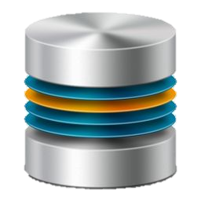
When do we Choose TDSQL
Open-source MySQL ecosystem
Commercial Oracle migration
Backed by tech giants
High reliability
Better performance
Enhanced OPS efficiency
Gradually replacing Oracle
Old devices to be out of service
Performance to be improved
Capacity to be expanded
Inexpensive license
Financial-level
Cloud-based
Distributed expansion
More affordable
Easier to manage
Better performance
1 Financial ：bank，Securities，Insurance
2 Government：statistical bureau, Tax department，
3 Game
4 E-commerce

Slide 20
3
Key Points in Pre-sales

Slide 21
The entire pre-sales process
Business opportunity
Close several deals with customers under the guidance of salesperson
Make technical reports to customers and high-level managers as a technical expert
Write technical proposals and assist customers to develop a technical solution based on Tencent proposals
POC testing
Guide customers to use the parameters provided by Tencent without taking a POC test
Ensure that the results of the POC test, if taken, is in favor of Tencent and improve the substandard metrics in a timely manner
Technical communication
Tendering and bidding
Contract
Delivery and
Acceptance
Help determine the parameters for a given tender/bid
Help write the documents for a given tender/bid
Guide customers to use a test scheme that is beneficial to Tencent
Learn about the designated solution in the pre-sales phase and develop a standard deployment solution
Deploy the product
Check if the features of the product work as expected
Take part in the training for sales team and learn about the product features and use cases of TDSQL
Sign a contract
After-sale service
sign a contract or not ， discount

Slide 22
Introduction to the Tencent teams and contacts
External Partners
Major Liaisons of the Product R&D Team at the Database Product Center:
Current Liaisons: vitosu/coollychen
Database R&D Team: harlylei/andelwu
TCE Team
Independent
TStack Team
Database Product Center
Pre-sales support
Sales support
After-sales support
Beijing: crabyu (primary liaison)
Shanghai: dicksontian
Shenzhen: bernieli
Chengdu: mozzizhang
Tencent Delivery Team
Technical Service Team
talmacschen
Tencent After-Sales Technical Service Team
denniewang
The primary liaison for pre-sales support is crabyu. If you have any special requirements, please contact vitosu/lindalhuang/amyleali/coolly.

Slide 23
How to operate in the TCB system (TDSQL)
Recommended charging scheme:
Software fee =
Option1 Management system fee (product ID: 697) + Physical machine license fee (product ID: 696)
Option2 Charged according to the number of CPU cores (product ID: 1092)
OPS fee [scheme 1] = 22% of the software fee (LTC system ID: 698)

Slide 24
Pricing scheme
1. Is discount rate negotiable? Yes
2. Enter the number of physical nodes/ physical CPU cores according to the deployment requirements.
4. The purchase quantity is set to "1" by default in the Console unless the customer claims to purchase more.
5. It is a business strategy to decide if a customer can enjoy free service for the first year. The product team does not interfere in it. In any cases, the service fee is included in the project cost by default, or the Tencent After-Sales Technical Service Team will include it later.
6. The published price for annual rental = Buyout price/5

Slide 25
How to apply for a license(just in private cloud)
Customer name/number of test devices/test duration/application scenarios/Contact information
Test requirements
Business team/ Architect sends an email
Product manager
makes a record
[Private cloud] The application flow of TDSQL-License (including internal team, POC testing for external customers, official use) http://km.oa.com/group/29336/articles/show/376703
Implementation team
provides an installer package
Make a contract
Business team/ Architect sends an email
Operate on the TCB system
Customer name/UIN/application scenarios/actual licensing scheme/ number of licenses/service fee/ delivery requirements
Deliver to the deployment team
Business team/Architect
Product manager
makes a record
Formal License

Slide 26
Modules used in the deployment of a private cloud
Module Name | Description | Features | Quantity | Recommended Configuration (CPU/memory/ disk) | Network Bandwidth | Operating system | Required | Physical Machine
LVS TGW/VPC/F5… | Virtual load balancing network | LVS (DR mode), which enables access to the load balancer and provides a unique virtual IP for each database instance. It can be replaced by TGW. | 0-3 | 16-32-500 | 20 Gb | Centos 7.0 64-bit | NO | Yes
Chitu ZooKeeper/Monitor Scheduler/Manager | OPS management platform Decision-making cluster Scheduling cluster | Chitu Console is a Web-based platform for managing the entire cluster. With high availability and consistency, zookeeper/monitor collects the monitoring data to judge the risk of faults. Scheduler/Manager provides the capabilities of master/slave switch, capacity expansion/reduction, and resource management. | 1, 3, 5 | 16-32-500 | 10 Gb | Centos 7.0 64-bit | Yes | Virtual machine
DB | Database module | A DB consists of Proxy, agent, MySQL, storage nodes, and compute nodes. | 3*N 2*N | 64-256-6000 | 20 Gb | Centos 7.0 64-bit | Yes | Yes
HDFS/COS | Cold backup data storage module | HDFS stores binlogs (instance backup files) and provides data services for disaster recovery. | 1*N 3*N | 16-32-50000 | 10 Gb | Centos 7.0 64-bit | NO | Yes
This is for reference only.
See the attached file for more information.

Slide 27
Advantages and characteristics

Slide 28
TencentDB For TDSQL Core Features
数据强一致
金融级高可用
确保多副本架构下数据强一致，避免故障后导致集群数据错乱和丢失。
确保99.999%以上高可用；跨区容灾；同城双活；故障自动恢复。
高性能低成本
企业级安全性
软硬结合；支持读写分离、秒杀、红包、全球同服等超高性能场景。
数据库防火墙；透明加密；自动脱敏等；减少用户误操作/黑客入侵带来的安全风险。
线性水平扩展
便捷的运维
无论是资源，还是功能，均提供良好的扩展性。
完善配套设施，包括智能DBA、自助化运营管理台。
Notes:
Regulatory audit requirements

Slide 29
Distributed database limitations
Traits
Limitations
It supports global order by, group by, and limit operations;
It supports aggregate functions, including sum, count, avg, min, and max (but not other aggregate functions)
It supports cross-set joins and subqueries
It supports global unique fields and sequence
It supports distributed transactions
It supports two-level partitioning
It provides specific SQL statements for querying configuration and status of the entire cluster
Custom functions, events, and table spaces
Views, stored procedures, triggers, and cursors
Foreign keys, self-built partitions, and temporary tables
Compound statements such as BEGIN END, LOOP, and UNION
SQL statements related to master/slave synchronization
SQL statements related to authorization(do it on the web console)
Notes:
As a distributed datebase which has capabilities of enterprise-level MySQL/MariaDB，we highly compatible with MySQL protocol and syntax
But because of Architectural differences，we also have some limitations，for ex，

Slide 30
Advantages （compare open source database）
 | By Tencent | By Customers
High availability | High availability architecture | Need to do it by the customers.
reliability | Automatic master-slave replication, data backup, hot backup | Need to do it by the customers.
Security | Anti-DDOS, traffic cleaning, and timely repair of loopholes | buy a security device or Software.
Backup | Automatic backup. | Need to do it by the customers.
Hardware | Pay as you need, no hardware and software investment required | Completely purchase servers and software
System hosting | No hosting fees | Usually 2U server requires 5000 yuan/year
Maintenance | No operation and maintenance costs | Need to recruit full-time DBA
Deployment and scale out. | Timely activation, rapid deployment, flexible expansion | Hardware procurement, computer room hosting, cluster deployment, etc.
Hardware utilization. | By usage | Higher initial investment
Notes:
Crose region/area disaster recovery，automatic filouver

Slide 31
Advantages （How to compete against Oracle）
The balance and cost performance
WeBank reduced the operating cost of each account to “ an average of RMB 6 which is only 1/10 of that of traditional banks in the Mainland, and lower than that of international banks, which is only 2% to 5% of its cost.“
From Vice President and Chief Information Officer of WeBank
TPS 470
Cost 100
TPS 500
Cost 40
O&M cost
License Cost
Hardware cost
Notes:
Webank is the first batch of bank customers whose core systems use tdsql databases。Better performance and lower price

Slide 32
Performance
Strand TPCC ，Single Machine 550000 Tpcm
The reason of High Performance
5729 per core
Hardware
Customized Physical Machine with the latest inexpensive hardware
Physical Machine :Codename SH12(x86，48 cores(96 hyper-threading cores)，768G Mem ,36T PCIE-SSD)
Software
Kernel optimization , thread pool …
LTS (Logical Timestamp Service) 11 million QPS
CPU intel 8255C , frequency 2.5 GHz
Master
Slave
Slave

Slide 33
The Competitors
Traditional Chinese Database
Emerging Database
Traditional Database
腾讯云
TDSQL：基于MySQL
Tbase：基于PostgreSQL
Oracle
南大通用Gbase
蚂蚁
Expensive and powerful.
Bought Informix
OLAP
阿里云
Oceanbase：兼容mysql/oracle
polarDB for Oracle：购买EnterpriseDB 代码，兼容oracle
达梦数据库DM
SQLServer
自研
Comfortable with Oracle?
DRDS：分布式中间件
Integrated.with BI.
Limited in Windows.
中兴
人大金仓Kingbase
华为云
Base on PostgreSQL
Comfortable with Oracle?
gaussDB：兼容PostgreSQL，兼容oracle
goldendb：兼容mysql
DB2
主要是替A.换，几乎未有新增
Pingcap
Tidb：兼容mysql

Slide 34
数据库产品-基础功能对比
 | 腾讯云TDSQL | 阿里云OceanBase | 华为GaussDB | PingCAP TiDB
核心特性 | 分布式事务型数据库 （扩展HTAP特性） | 分布式事务型数据库 | 分布式事务型数据库 （扩展HTAP特性） | 分布式事务型数据库 （扩展HTAP特性）
体系结构 | SQL引擎+存储节点+GTM SQL引擎+RocksDB+GTM | RootServer/UpdateServer+ChunkServer/MergeServer | CN+DB+GTM | Rocksdb（TiKV）+TiDB+PD
服务可用性 | 主从结构高可用，可用性99.999%以上，支持两地三中心，RPO≤30s | 主从结构高可用，可用性99.999%以上，支持两地三中心，RPO≤30s | 主从结构高可用，可用性99.95%以上,支持两地三中心，RPO≤30s | 主从结构高可用，可用性99.95%以上,支持两地三中心，RPO≤30s
数据库可靠性 | 基于raft算法数据强强一致，RP0=0. 支持物理备份，逻辑备份。 | 基于raft算法数据强强一致，RP0=0. 支持物理备份，逻辑备份。 | 基于raft算法数据强强一致，RP0=0. 支持物理备份，逻辑备份。 | 基于raft算法数据强强一致，RP0=0. 支持逻辑备份
可扩展性 | 分布式架构扩展性好，不停机扩容数据库实例。 | 分布式架构扩展性好，不停机扩容数据库实例。 扩容有限制 | 分布式架构扩展性好，不停机扩容数据库实例。 | 分布式架构扩展性好，不停机扩容数据库实例。
管理能力 | 200+项监控能力。赤兔管理系统功能丰富，扁鹊智能性能调优。提供公有云、专有云两种管理方案。 | 提供诊断监 控、运行报表、智能告警、资源调度等，提供专有云管理方案。 | 企业级分布式数据库集群的集中监控和运维平台 | 基于开源Prometheus 和 Grafana实现备份。
安全能力 | 数据加密，连接加密，权限控制，SQL防火墙，网络白名单，防误操作机制 | 数据加密，权限控制，网络白名单，防误操作机制 | 数据加密，数据脱敏，权限控制，网络白名单，SQL审计 | 暂不支持（据说后续版本会支持）
Notes:
各产品体系结构基本接近。

Slide 35
数据库产品-基础功能对比
 | 腾讯云TDSQL | 阿里云OceanBase | 华为GaussDB | PingCAP TiDB
Core Features | 分布式事务型数据库 （扩展HTAP特性） | 分布式事务型数据库 | 分布式事务型数据库 （扩展HTAP特性） | 分布式事务型数据库 （扩展HTAP特性）
Architecture | SQL引擎+存储节点+GTM SQL引擎+RocksDB+GTM | RootServer/UpdateServer+ChunkServer/MergeServer | CN+DB+GTM | Rocksdb（TiKV）+TiDB+PD
Service Availability | 主从结构高可用，可用性99.999%以上，支持两地三中心，RPO≤30s | 主从结构高可用，可用性99.999%以上，支持两地三中心，RPO≤30s | 主从结构高可用，可用性99.95%以上,支持两地三中心，RPO≤30s | 主从结构高可用，可用性99.95%以上,支持两地三中心，RPO≤30s
数据库可靠性 | 基于raft算法数据强强一致，RP0=0. 支持物理备份，逻辑备份。 | 基于raft算法数据强强一致，RP0=0. 支持物理备份，逻辑备份。 | 基于raft算法数据强强一致，RP0=0. 支持物理备份，逻辑备份。 | 基于raft算法数据强强一致，RP0=0. 支持逻辑备份
可扩展性 | 分布式架构扩展性好，不停机扩容数据库实例。 | 分布式架构扩展性好，不停机扩容数据库实例。 扩容有限制 | 分布式架构扩展性好，不停机扩容数据库实例。 | 分布式架构扩展性好，不停机扩容数据库实例。
管理能力 | 200+项监控能力。赤兔管理系统功能丰富，扁鹊智能性能调优。提供公有云、专有云两种管理方案。 | 提供诊断监 控、运行报表、智能告警、资源调度等，提供专有云管理方案。 | 企业级分布式数据库集群的集中监控和运维平台 | 基于开源Prometheus 和 Grafana实现备份。
安全能力 | 数据加密，连接加密，权限控制，SQL防火墙，网络白名单，防误操作机制 | 数据加密，权限控制，网络白名单，防误操作机制 | 数据加密，数据脱敏，权限控制，网络白名单，SQL审计 | 暂不支持（据说后续版本会支持）
Notes:
各产品体系结构基本接近。

Slide 36
数据库产品-高级技术细节对比
 | 腾讯云TDSQL | 阿里云OceanBase | 华为GaussDB | PingCAP Tidb
生态/SQL兼容 | MySQL生态，学习使用门槛低 | 私有协议多，部分兼容MySQL5.6，门槛高 | PostgreSQL生态，国内开发者占比少 | 兼容MySQL（无特地版本），门槛高
自动分表能力 | 系统自动分表，需定义分表键 | 多种自动分表能力，需定义分表键 | 系统自动分表，需定义分表键 | 自动分表能力
多租户 | 支持 | 支持 | 支持 | 不支持
分布式事务/JOIN | 基于2PC算法支持分布式事务 | 基于2PC算法支持分布式事务 | 基于2PC算法支持分布式事务 | 支持
数据安全性 | 支持SQL防火墙，数据加密，SSL连接加密，数据审计等特性 | 提供表字段加密 | 支持数据加密，提供角色角色权限。 | 提供SSL连接加密
多种表方案 | 支持广播表，单表，分表 | 支持广播表，单表，分表 | 不支持 | 不支持
存储过程/视图 | 支持部分 | 支持部分 | 支持 | 支持部分
死锁智能检测 | 基于扁鹊提供智能检测 | 支持智能检测 | 支持智能检测 | 不支持智能检测，需登录查询
prepare | 支持 | 支持 | 支持 | 支持
JSON | 支持JSON类型 | 不支持 | 支持 | 支持
字符集 | 支持业内主流字符集 | 支持4种字符集。 | 支持业内主流字符集 | 支持UTF8，GBK

Slide 37
Q&A

Slide 38
Numerous cases enable TDSQL to be applied to all industries
As a mature product, database enjoys bountiful opportunities and a huge market.
(A 10-million-CNY project) Bank of China
Bank of China purchased the perpetual right to use TDSQL for its PAAS project
Amount: 1X.XX million CNY
OPS fee: XX% CNY/year
It is the second purchase.
(A 10-million-CNY project) PICC P&C
PICC P&C purchased the perpetual right to use TBase for its private cloud project
Amount: 2X.XX million CNY
OPS fee: XX% CNY/year
It is the first purchase.
(A million-CNY project) Sinotrans Limited
Sinotrans Limited purchased TDSQL for its cloud database
Amount: 2.XX million CNY
OPS fee: XX% CNY/year
It is the first purchase.
(A million-CNY project) Yunnan Provincial Public Security Department
The department has deployed Tbase on 2xx servers for its projects
Amount: 2.XX million CNY
OPS fee: XX% CNY/year
It is the third purchase.
(A 100k-CNY project) Xiamen GovCloud
Xiamen GovCloud platform purchased TDSQL
Amount: 5X0,000 CNY
OPS fee: XX% CNY/year
It is the second purchase.
(A 100k-CNY project) Chao-Yang Hospital
Chao-Yang Hospital deployed Tbase to replace Oracle database
Amount: 8X0,000 CNY
OPS fee: XX% CNY/year
It is the first purchase.

Slide 39
TencentDB deployment
Amsterdam
Seoul
London
Moscow
Toronto
Beijing
Frankfurt
Chengdu
Shanghai
Chennai
Tokyo
Virginia
Bombay
Bangkok
Guangzhou
San jose
silicon valley
Dallas
Shengzheng
Singapore
Hongkong
We deployed our DB in America, Europe ,India ,Southeast Asia Japan , Korea ,and China.
more than 60 AZ and more are on the way
Self-build IDC and Cooperating IDC
St.Paul
Sidney
01

Slide 40
02 Some Typical industry and users

Slide 41
Some of our Industry
Government : Fanhill Audit Bureau, Jiangshu Public Security Department
Manufacturing: NIO Car (https://www.nio.cn/),SANY (http://www.sanygroup.com/）
ecommerce: Buy Together (NASDAQ: PDD)
Gameing: Riot (NASDAQ:RIOT) 37 Game(www.37.com)
Banking: Webank(a chinese bank (https://www.webank.com/)) and SPD Bank (http://www.spdb.com.cn/）
Transportation : Mobike(https://mobike.com/cn/) Sinotrans limited (http://www.sinotrans.com/)
Finance and Insurance: Taikang Insurance(http://www.tk.cn/) ,Aixin Life ( http://www.aixin-ins.com/)
Retail Trade :Westfield, Carrefour China
Educational Services : EF Education TAL Education Group(NYSE:XRS)
Health Care and Social Assistance :Shenzhen Nanshan People’s Hospital ,Medbanks (https://www.medbanks.cn/)
Accommodation：WeHotel Four Seasons
Tobacco：YunNan Tobacco，China Tobacco
Meteorology: Guangdong Meteorological Service, Public Meteorological Service Center
Real Estate: COUNTRY GARDEN（HK . 2007 ）, CR LAND (HK 1109)
…
Notes:
Website. nio.io. NIO (Chinese: 蔚来; pinyin: Wèilái) is a Chinese automobile manufacturer headquartered in Shanghai, specializing in designing and developing electric autonomous vehicles. The company is also involved in the FIA Formula E Championship, the first single-seater, all-electric racing series.
Westfield （their wecaht Official accounts. ）

Slide 42
Some of our typical users
Traditional Transactions：
1 Aviva (Britain Insurance Company)
2 Riot Games (A well-known company for its’ League of Legends)
3 EF Education (A Famous Education brand)
4 Epic Game (A company developed the fashionable Game “Fortnite”)
Distributed Database
1 Shenzhen Metro (Shenzhen the socalled chinese Silicon Valley)
2 McDonald's China Online (used in a facial payment business)
3 RootCloud
4 State Taxation Administration

Slide 43
Architecture of CynosDB
Fully Compatible
MySQL
PostgreSQL
Decouple Storage & Compute
Computational storage
Serverless Architecture
Service Oriented Architecture
CBS, COS
VPC, TGW
Hardware & Software
SPDK
RDMA
DB Engine
(siave)
DB Engine
(master)
DB Engine
(slave)
Wallog
Sync
Wallog
Sync
CynosFS
CynosFS
CynosFS
Block APL
Block APL
Block APL
db instance
manager
storage
service
storage
service
storage
service
seg
seg
seg
seg
seg
seg
seg
seg
seg
seg
seg
seg
storage cluster
manager
Cold Back up Storage

Slide 44
Architecture of TBASE
GTM：Manage global transaction and object.
Coordinator：the entrance of every，every node give a unit view for user.
Datanode：the node for data store.
Data Forward Bus：the bus of data transmission for
the whole cluster
Monitoring
GTM
Coordinator
GTM-M
Coordinator
Coordinator
Coordinator
Operation
Transation Info
Global object
Global catalog
Global catalog
Global catalog
Alarm
Data Forward Bus
Audit
GTM-S
Datanode1
Datanode2
Datanode3
Datanode4
Transation Info
Global object
Local catalog
Local catalog
Local catalog
Local catalog
Governance
Local Data
Local Data
Local Data
Local Data

Slide 45
Architecture of Tbase
OLTP
OLAP
Coordinator
Coordinator
Coordinator
Coordinator
OLTP optimizer
OLAP optimizer
Datanode1
Datanode2
Datanode3
Datanode1_s1
Datanode2_s1
Datanode3_s1
Row store
Row store
Row store
Column store
Column store
Column store
Row store
Row store
Row store
Column store
Column store
Column store
从OLTP节点复制到OLAP节点，实现行存储到列存储的转换

Slide 46
parallel OLAP executer
select * from tbl_a, tbl_b where tbl_a.f1 = tbl_b.f2;
TBL_A(f1— distributed column, f2)
TBL_B(f1-- distributed column, f2)
CN
TBL_A.f1 = TaBL_B.f2
Parallel node
DN1
DN2
DN3
TBL_A.f1 = TBL_B.f2
TBL_A.f1 = TBL_B.f2
TBL_A.f1 = TBL_B.f2
Postmaster
Postmaster
Postmaster
WAL writer
WAL writer
WAL writer
Collector…
Collector…
Collector…
Shared memory
Shared memory
Shared memory
processes
processes
processes
Parallel processes
Parallel processes
Parallel processes

Slide 47
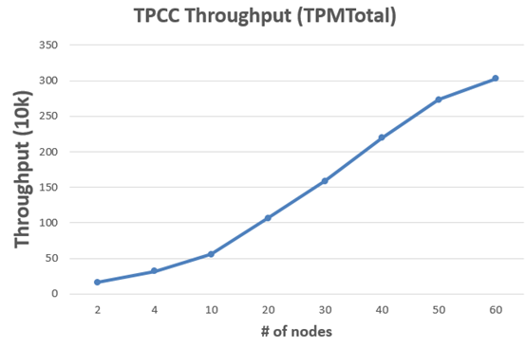
TBase TPC-DS performance test
TPC-DS Test 3 times of performance
Through the scale of cluster,TPCC has a linear growth 10 million
TPCC Throughput （TPMTotal）
350
300
250
Throughput （10k）
200
150
100
50
0
2
4
10
20
30
40
50
60
# of nodes

Slide 48
TDSQL Architecture
zookeeper
Console
LVS/HAProxy
Data collection
proxy
monitor
mysql
API &OSS
agent
mysql
mysql
scheduler
agent
agent
hadoop
xtrabackup/binlog/slowlog/errlog
kafka
SQLAudit/mulit-source sync

Slide 49
TDSQL Scale out
Hash
Logic tables/Physical tables
Logic tables
Physical tables
p0
p1
p2
p3
pn
Traits
Limitations
It supports global order by, group by, and limit operations;
It supports aggregate functions, including sum, count, avg, min, and max (but not other aggregate functions)
It supports cross-set joins and subqueries
It supports global unique fields and sequence
It supports distributed transactions
It supports two-level partitioning
It provides specific SQL statements for querying configuration and status of the entire cluster
Custom functions, events, and table spaces
Views, stored procedures, triggers, and cursors
Foreign keys, self-built partitions, and temporary tables
Compound statements such as BEGIN END, LOOP, and UNION
SQL statements related to master/slave synchronization
SQL statements related to authorization(do it on the web console)

Slide 50
Scale out and rebalance
Switch the route
1
2
3
4
A
A
A
A
SQL Engine
B
SQL Engine
SQL Engine
SQL Engine
C
SQL Engine
D
SQL Engine
SQL Engine
SQL Engine
E
SQL Engine
F
SQL Engine
SQL Engine
SQL Engine
New shard G
New Shard G
G
G
1. When you scale out，The System will estimate all the workload of every machine, and find out the most busy ones.
Based on the configuration of new node G, move the data to it from the nodes mentioned before.
3. you can write and read the old node except the time of verifying data between A and G
4. In the end ,switch route and delete data.

Slide 51
Tencent Payment Business
Inner request
Outer request
Outer request
Inner request
Shenzhen
Shanghai
GSLB
nginx
nginx
nginx
nginx
Route of different business
TSM
Midas门户
nginx/cgi
nginx/cgi
Access Layer
Configure
NCS
boss
portal
mp
boss
portal
mp
Logic Layer
drm
drm
Ncs services
account
channel
account
channel
NCS
tdsql API
hold API
tdsql API
hold API
More than 100 million order a day
Billions of payment
More than 2000 node
Across the AZ and Region
tdsql proxy
hold agent
tdsql proxy
hold agent
storage layer
Account
Order
Account
Order
S
M
M
S
sync
Notes:
1、API路由控制
2、offerid/业务代码转发
3、NCS下发
Marketing system

Slide 52
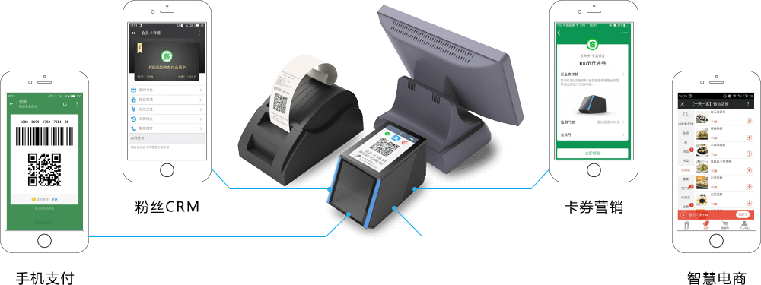
SWIFTPASS The Most Popular Wechat Payment Channel
Store
Outlet
Shop…
Store their kernel data in TDQL
30+ million order every day
Strong consistency data
Group shard architecture
2 instances，with 8 shards for them
12.8TB data
1500 TPS
Store the data in TDSLQ 450 days.
The firewall
The firewall
The firewall
The firewall
Risk Control
Risk Control
Risk Control
CGI
CGI
CGI
Logic Server
Logic Server
Logic Server
TDSQL
TDSQL

Slide 53
Key differentiated features
Redis 4.0 Cluster
Tcaplus
Multidimensional scale
R/W Splitting
A K-V Store stem from Tencent Game
Shard capacity
32 4
proxy
3 128
shard2
replica2
Shard number
shard1
Replica 3
分片2 2
5 0
Replica number
More than 10 millions QPS for the cluster and 4TB data in memory
Scale in 3 dimensions
Scale without disconnection
Coroutine +Multithread
Cache --LRU-→ SSD
memory use rate increase by 20+%
Availability :99.99%

Slide 54
DTS
Metadata
1.DTS configure
2.execution plan
3.Mission dispatch
4.Controlling command
5.Status information
DTS Master
Load Controller
Heartbeat
Heartbeat
Load Controller
Dumper
Loader
Controller
Controller
First
Extractor
source
Filter
Store
Rewriter
Importer
destination
increment
export
Notes:
DTS管理组件（DTSMaster）：
管理整个DTS的执行周期，保存以下信息：
1、DTS配置信息：包括源目的数据库类型，地址，库表信息
2、执行计划：分析迁移库表类型、主键信息，指定迁移计划
3、任务调度：DTS任务会被调度到一台中转机运行，调度算法会根据源实例数据量，中转机正则运行的任务数、磁盘容量来选取负载最小的中转机
4、控制命令：根据Dumper、Loader上报的状态信息，下发相关控制命令（流控，暂停等）
5、状态信息：保存DTS迁移任务详情（库表迁移进度、备份对应的log位点等）
监控（Monitor）：
监控源、目的实例的负载情况，上报给DTSMaster
全量导出（Extractor）：
对源库存量数据进行多线程并发导出
数据转换（Rewriter）：
根据用户配置对库、表、列进行转换
数据导入（Importer）：
将UTL格式的日志转换成目标语句导入到目标数据库
负载控制：
Monitor周期采集源、目标实例的状态值，上报给DTSMaster；
DTSMaster判断是否超过用户设置的阈值，如果超过则降低QPS，避免影响业务；

Slide 55
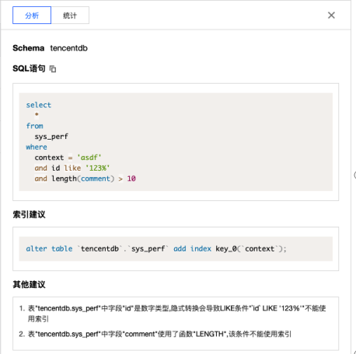
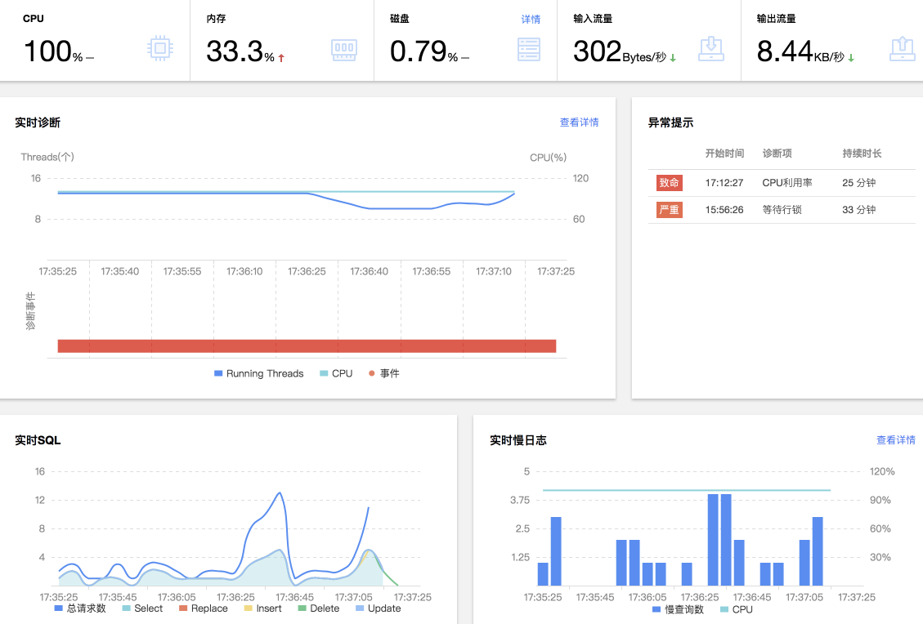
DBBrain-DB operations
7*24 diagnosis
All log analysis
slow log statistics
Daily patrol report
01

Slide 56
DBbrain framework
console
Mini program (wechat)
Error log
Special problem
CDB Tuning
training
Suggestion
output
Session Ana
feature data
Diagnosis pattern
algorithm
anomaly
SQL Check
Performance data
pattern
relevance
Health report
trend
Real time diagnosis
stream computing
SQL OPT
EX
EX
EX
Resul feedback
TDB connector
message queue
Transaction ana
Dead lock
Machine Monitor
Net Monitor
DB
Monitor
Agent
Audit log
Slow log
MySQL
Redis
MongoDB
PostgreSQL
SQLServer
TDSQL
01

Slide 57
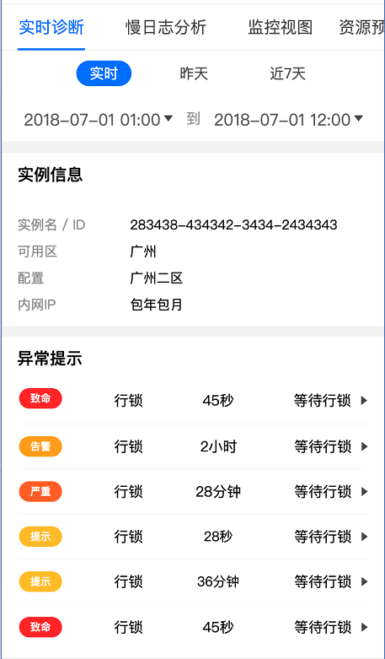
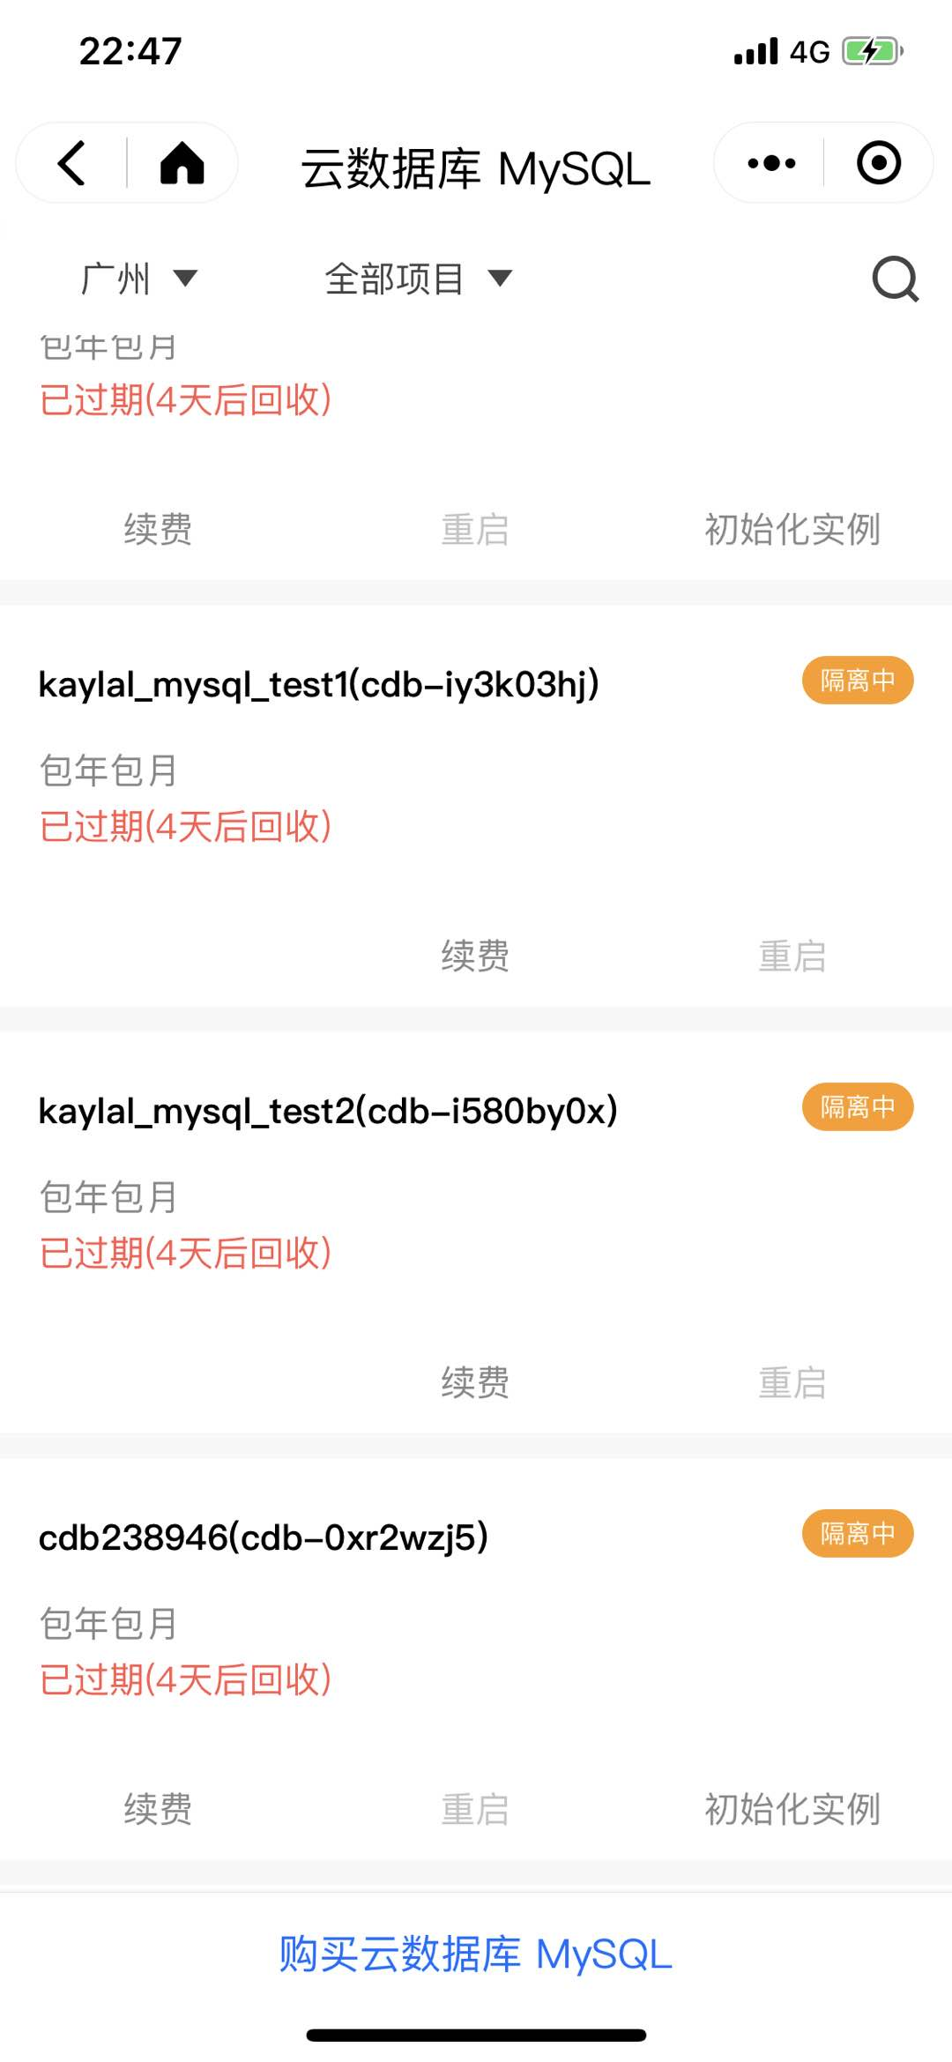
Operations in your hand
Health report
Realtime diagnosis
Database Management
01

Slide 58
04 Some of our plan

Slide 59
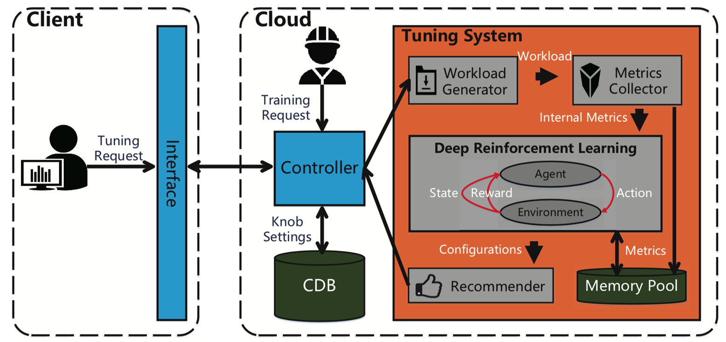
DBBrain
CDBTune
多种数据库类型插件式嵌入
前端展示
接口层
MySQL
Diagnosis
Redis
Mongo
Other
01

Slide 60
Redis hyprid storage
Cost
Storage
Redis
Tendis
Serverless
Hot data
Cold data
Memory:Redis
SSD (RocksDB)
All data
Easy to use

Slide 61
The architecture of TDSQL V3.0
client
SQL
TDSQL3.0
Thread pool coroutines
Based on MySQL 8.0
Share nothing
Separate the computing layer and storage layer
Not just grammer ,but also function Stored procedure and trigger
SQLEngine
Control
GTM
Control
Range hash
P0
P0
P0
PA0
PB0
PB1
P1
P1
P1
PA1
PA2
PB2
P2
P2
P2
P3
PA3
PB3
P3
P3
P4
P4
PA4
PB4
P4
Notes:
Proxy的线程池模型需要优化成协程模型
Proxy的SQL兼容性工作量还非常大，需要寻找更好的方案
基于shard key的对于开发人员来说存在一些负担，而且不利于olap的场景
在去IOE的形势下，经过几年的培育，客户已经对分布式数据库产品形态非常认可，在具体的数据扩容方面会觉得能自动的数据迁移看起来更cool一点，而咱们的设计看起来更为保守，噱头不够。
3.0架构的目标
因此接下来一方面需要继续对2.0的进行投入，以巩固我们目前的优势，另外为了提高产品竞争力，需要开启新一轮架构优化3.0，以解决上述问题，更好地服务好我们的客户。对于3.0，希望咱们的产品特色如下：
分布式share nothing的架构，计算层和存储层分离，每层可以独自伸缩
数据高一致性，健壮的分布式事务处理机制
单个集群规模的容量可以做到PB,EB级别
所有的节点支持多写，提供更好的性能
100%兼容MySQL的SQL语法功能，包括存储过程，函数，触发器等高级特性，降低从Oracle等传统数据库迁移到分布式数据库的门槛
普通的硬件配置，物理机，虚拟机，公有云，专有云都支持
两地三中心，跨中心多活等
行列混存，除了oltp之外，更好地支持ap场景
适用场景广泛，核心的交易场景，如支付，交易，订单等；hbase的场景；时序数据库的场景等
冷热数据分离
多租户支持
3.0的架构
为了解决2.0的不足，但是又保持良好的扩展性，所以会继续坚定地走Google Spanner这种技术架构，只是将各层的技术实现做一些改造，核心的架构图如下所示，外观看起来跟2.0是比较类似的。
具体的实现层面会有不少差异，主要体现在以下的方面：
Proxy层升级为SQLEngine层，基于MySQL8.0的SQL层进行改造，将原来的多线程框架换成协程框架，将底层的InnoDB引擎层换成分布式的存储引擎，移除各种有状态的信息，如锁，binlog性能优化，本地的表结构等信息。需要持续优化的是分布式的查询计划处理，下推逻辑，路由逻辑，与分布式引擎交互的逻辑等。
调度模块新增一个GTM功能，负责提供全局时钟服务，目前基本开发完成，在32逻辑cpu的情况下，通过raft构成的3节点组能提供200w/s的tps.
分布式引擎不再采用基于hash的多实例的MySQL+Innodb，而是去掉事务和SQL信息，用基于rocksdb实现一个自动range分裂的纯分布式的存储引擎。在这里需要实现基于raft协议的数据一致性同步，基于版本号的并发读写，增减节点自动进行容量伸缩，流量调度等特性。

Slide 62
THANK YOU!

Slide 63
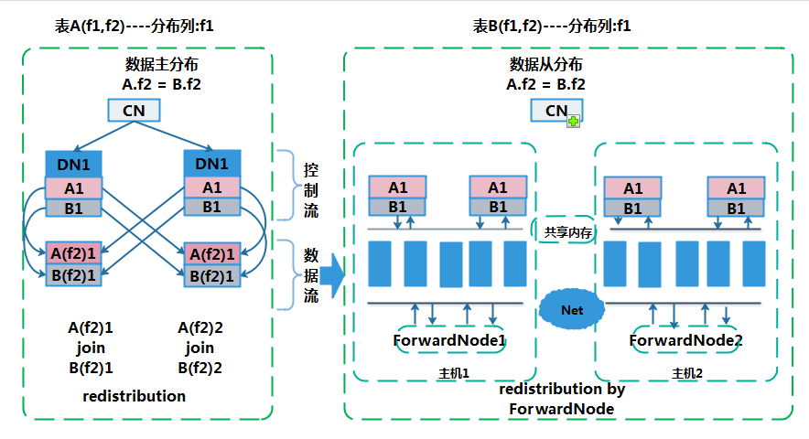
Error log
training
feature data
anomaly
algorithm
Performance data
pattern
relevance
trend
stream computing
parallel OLAP executer
Notes:
1.其他MPP数据库的做法是DN 与 DN 之间是需要相互创建连接来完成数据重分布，根据本地存储的shardmap把需要进行join的数据拉到内存.我们以 200 台 DN ，100 并发查询，简单的计算一下单节点对外创建的连接数 为 （200 -1 ） * 100 = 2W 连接.这只是对外的连接，算上其它节点连进来的话，就会有 4W 个连接。 2.增加了 FN 专门用于网络转发，连接数降低了，扩张性和并发度自然也就提高了。 3.简单的理解就是：之前只能扩展到200台，是因为之前的数据重分布在这个规模的集群会导致单节点连接数很高，现在我们把数据重分布的单机和单节点的连接数降低了，所以，就可以横向扩展了

Slide 64
超大规模集群支持
Notes:
1.其他MPP数据库的做法是DN 与 DN 之间是需要相互创建连接来完成数据重分布，根据本地存储的shardmap把需要进行join的数据拉到内存.我们以 200 台 DN ，100 并发查询，简单的计算一下单节点对外创建的连接数 为 （200 -1 ） * 100 = 2W 连接.这只是对外的连接，算上其它节点连进来的话，就会有 4W 个连接。 2.增加了 FN 专门用于网络转发，连接数降低了，扩张性和并发度自然也就提高了。 3.简单的理解就是：之前只能扩展到200台，是因为之前的数据重分布在这个规模的集群会导致单节点连接数很高，现在我们把数据重分布的单机和单节点的连接数降低了，所以，就可以横向扩展了

Slide 65
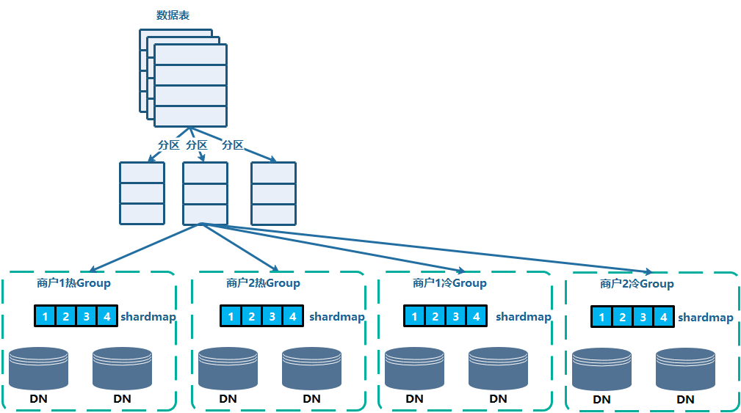
强大的数据治理方案---数据分片与分区

Slide 66
DBbrain核心功能-性能优化
遵循编译优化器规则
计算代价和成本
遵循各类引擎规则
索引+重写 相结合
融合各种优化经验
SQL自身不够优质，相同逻辑重写
SQL优化
资源配置
参数调优
不只有SQL优化
资源配置最优化组合
数据库参数智能调优
01

Slide 67
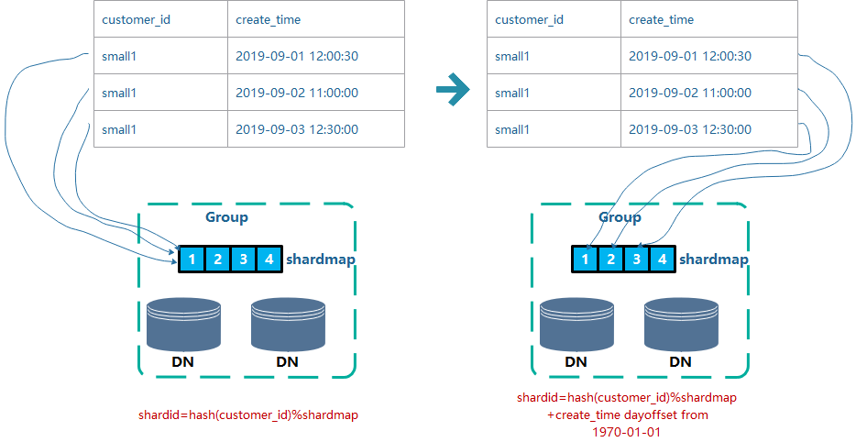
强大的数据治理方案---数据防倾斜方案

Slide 68
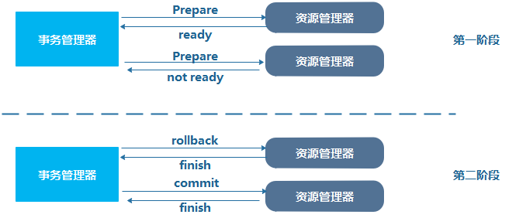
分布式事务支持---2PC
第一阶段：事务管理器要求每个涉及到事务的数据库节点预提交(precommit)，并反馈是否可以提交。
第二阶段：事务管理器要求每个涉及的数据库节点要么提交数据，要么回滚数据。
需要解决的问题:
资源阻塞问题：残留的存在prepare状态的两阶段事务仍然持有一些资源锁，这将会阻塞之后对部分数据的访问和更新操作。
数据不一致问题：数据不一致问题集中体现在第二阶段的故障场景中。当两阶段提交事务出现了部分commit部分prepare，那么更新数据在部分commit的节点可见；当两阶段提交事务出现了部分commit部分rollback，那么数据在所有节点出现了不可恢复的不一致状态。
参与节点宕机问题：当出现协调节点宕机的情况，即便是有做了主备倒换，产生了新的协调节点，参与节点中的异常两阶段事务将一直残留下来。
PREPARED状态 | COMMIT状态 | ROLLBACK状态 | 异常阶段及原因 | 动作
有 | 有 | 无 | commit阶段异常 参与节点故障 | COMMIT剩余事务
有 | 无 | 有 | prepare阶段异常 参与节点宕机 | ROLLBACK剩余事务
有 | 无 | 无 | prepare阶段异常发起节点宕机 | ROLLBACK剩余事务
Notes:
(1)内核处理机制上：这个部分我们做了两件事，第一，在两阶段事务执行过程中记录信息，用于恢复残留两阶段事务；第二， 避免进入“Commit Prepared”的两阶段事务在所有参与节点回滚该事务。
（2）在异常处理上：TBase提供了一个两阶段事务的自动处理工具，在系统监测到残留的2PC事务时，运行工具来处理系统的两阶段事务，保证业务的正常运行。通过访问残留两阶段事务的信息，来判断其在各个参与节点中的状态，根据事务的全局状态，我们对其进行异常事务清理，最终使得数据恢复至全局一致状态。

Slide 69
TBase 典型场景—HTAP超融合处理系统
数据资源管理系统
元数据管理
数据量统计
BI报表
FTP文件服务器
返回5k+记录，1.3秒
TBase汇聚库
关系数据库
数据抽取6w条/s
大数据平台离线计算
实时入库效率：10w条/s
消息中间件
ETL
1亿记录关联，3秒返回
…….
操作日志写回TBase
关联查询
其它数据源
Datanode节点*24个，
存储共计150TB+
毫秒级返回
智能模型构建
实时点查询
注：原Oracle RAC支撑数据量到300亿数据，计算和查询的时候已经到达瓶颈，超时宕机的场景频发，入库速率极限值使用Oracle只能达到3000条/秒

Slide 70
Typical Industry
Retail
Bank
Securities
Bank
e-commerce
Manufacruring
Insurance
Insurance
1000+
40+
Internet Finance
Government
Public Cloud
Games
Games
On Premise
Retail
Payment

Slide 71
The first internet bank –webank
300+ sets
1800+ instance
PB level storage
Hundreds of kernel system
Peak TPS 100 thousand
360 million trading volume
INTERNET
CDN
CDN
CDN
Intercity
DZ
IDC
Online Network
DZ IDC
DMZ
DMZ
Dev
IDC
Test
IDC
Tencent network
Office network
Business system
deposit business
Clearing system
Facce recognition
Credit card
loan business
business platform
…
safety control & big data
traditional financial module
New financial module
Notes:
demilitarized zone

Slide 72
The DCN Architecture of WeBank
DCN(Data Center Node) include access ,logic, and storage layer
Every DCN in charge of fixed number of users.
Extend their business through DCN
GNS control the route of DCN
RMB deliver the messages between all DCNs
ADM summarize the data and metadata
Internet
Private network
GNS（DCN route management ）
RMB（message bus）
APP
APP
APP
APP
ACCESS
ACCESS
ACCESS
ACCESS
DBMS
DBMS
DBMS
Scale out
DBMS
ADM
DCN1
DCN2
DCNX
Notes:
什么是DCN?DCN是微众分布式架构的基础. DCN是一个自包含的单元,可以理解为是一个小型机,你可以把应用层,接入层,存储层全装在里面,但不同的是,我们的DCN是一个逻辑概念,是基于X86的平台服务器搭建. 每个DCN,我们会限定一个可承载的用户量,并根据这个用户量,来设计DCN的软硬件规模. 比如微粒贷,我们可能设置每个DCN就承载500万的用户.
那么问题来了,我怎么知道哪个用户在哪个DCN呢?所以我们需要一个全局的路由系统, 我们叫GNS,来管理DCN的路由信息.
解决了路由问题,还要解决DCN间的通信问题,所以我们还有一个RMB模块,叫可靠消息总线,来负责各DCN间的消息通信.
基于这种整体的架构,我们通过DCN能够实现很好的规模控制,以及很好的水平扩展的问题,所以我们在数据库层,就采用了TDSQL no shard的架构,避免了使用tdsql shard架构带来的一些额外的改造成本.

Slide 73
The Architecture2
DCN Master
DCN Master
DCN Master
APP
APP
APP
APP
LB
LB
LB
LB
1 Master 3 Slaves
Sync to 2 slaves and async to 1 slave
inner city IDC ,RPO=0,RTO in several seconds
More than 99.99% availability
Access
Access
Access
Access
SLAVE1
MASTER
SLAVE2
MASTER
SLAVE
TDSQL
SET1
sync
sync
async
MASTER
SLAVE1
sync
SLAVE2
MASTER
SLAVE
TDSQL
SET2
sync
async
Inner city IDC1
Inner city IDC2
Inner city IDC3
Intercity IDC

Slide 74
Digital Guangdong
Mini program on WeChat
The First 100 days after released
6000+ encryption tables
266 kind of services
3.48 million users
100 kinds of certifications
Ana
LB
Online office
personal
corporation
public
Handicap service
Data
synchronization
Tax
ETL
certification
…
…
Trade and Industry
Internet
Multi source data)
Government network
Office platform

Slide 75
Some to the key differentiated features

Slide 76
Performance
Index update：70k/s
The reason of High Performance
select：440k/s
Hardware
Customized Physical Machine with the latest inexpensive hardware
Physical Machine :Codename ts85(x86，24 cores(48 hyper-threading cores)，512G Mem ,6T PCIE-SSD)
Or Sh02
Software
Kernel optimization , thread pool …
LTS (Logical Timestamp Service) 11 million QPS
Master
Slave
Slave

Slide 77
The Diagnosis of Performance
Redundant index
Dead lock
uncommited trx
Request trx processlist
Innodb lock waits
Long session
Slow sql
Resource
Connect usage
CPU usage
Data space usage
Table data distribution
…
Engine
abstraction of SQL
first appeared time
last appeared time
count
query time max/min/avg
lock_time max/min/avg
rows examined
...

Slide 78
SQL-Engine

Slide 79
Audit
Audit Log
Audit Strategy
Audit Rule
Check the log
Combine the instance
regular expression
……
Action
Let it go
Alarm
……
Include
Not include
Equal/unequal to
Client Ip
Execution time
Users…

Slide 80
Scale out
Hash
Logic tables/Physical tables
Logic tables
Physical tables
p0
p1
p2
p3
pn
Traits
Limitations
It supports global order by, group by, and limit operations;
It supports aggregate functions, including sum, count, avg, min, and max (but not other aggregate functions)
It supports cross-set joins and subqueries
It supports global unique fields and sequence
It supports distributed transactions
It supports two-level partitioning
It provides specific SQL statements for querying configuration and status of the entire cluster
Custom functions, events, and table spaces
Views, stored procedures, triggers, and cursors
Foreign keys, self-built partitions, and temporary tables
Compound statements such as BEGIN END, LOOP, and UNION
SQL statements related to master/slave synchronization
SQL statements related to authorization(do it on the web console)

Slide 81
Scale out and rebalance
Switch the route
1
2
3
4
A
A
A
A
SQL Engine
B
SQL Engine
SQL Engine
SQL Engine
C
SQL Engine
D
SQL Engine
SQL Engine
SQL Engine
E
SQL Engine
F
SQL Engine
SQL Engine
SQL Engine
New shard G
New Shard G
G
G
1. When you scale out，The System will estimate all the workload of every machine, and find out the most busy ones.
Based on the configuration of new node G, move the data to it from the nodes mentioned before.
3. you can write and read the old node except the time of verifying data between A and G
4. In the end ,switch route and delete data.
Notes:
（预计2017年6月份公有云前台可支持）

Slide 82
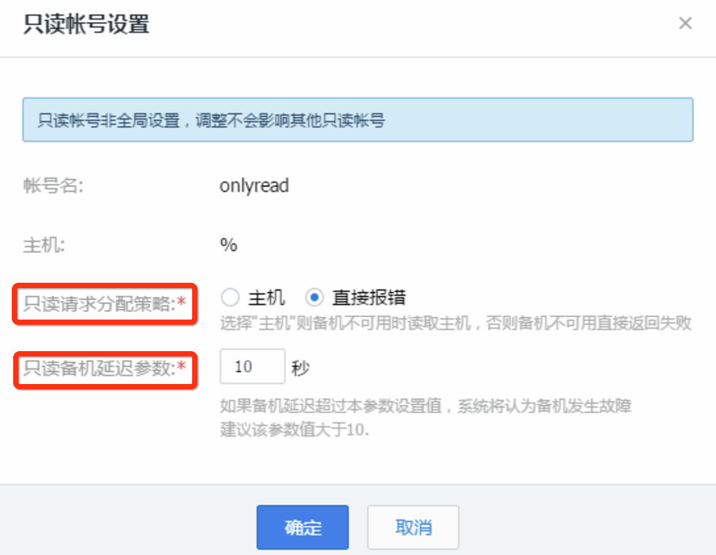
The Separation of Read and Write
Based on user
Based on analyzing of transanction
Based on comments
Notes:
1.业务代码不用修改
2.灵活的功能，同时能满足客户的时延承诺，不要提供错误的服务

Slide 83
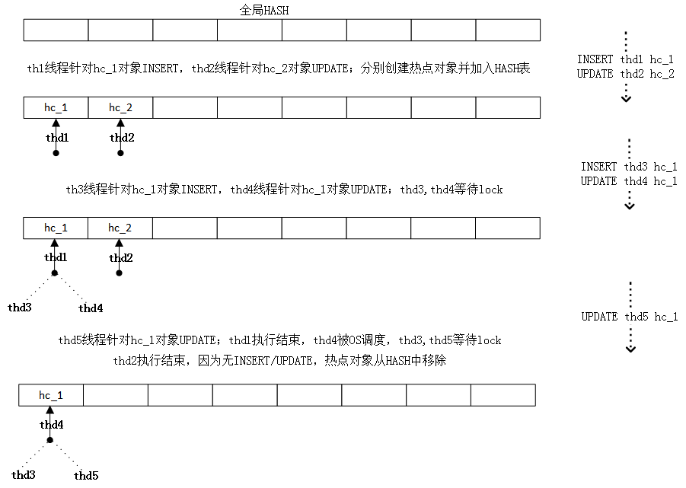
Hot data update （just in noshard mode）
Set lock status
Lock granularity check
Page lock check
Wait check
Transaction status check
LOCK_MAX_N_STEPS check
Lock sacrifice

Slide 84
Other ways about hot account
Kernel problem
Scattered Lock
Multi-account
Combine the account every day
1 lock and wait
2 deadlock check
3 single core operation
Hot data
Delayed account
Just have every log ,and check the Account everyday
Other DBMS
Scale your CPU/Mem
Memory DBMS

Slide 85
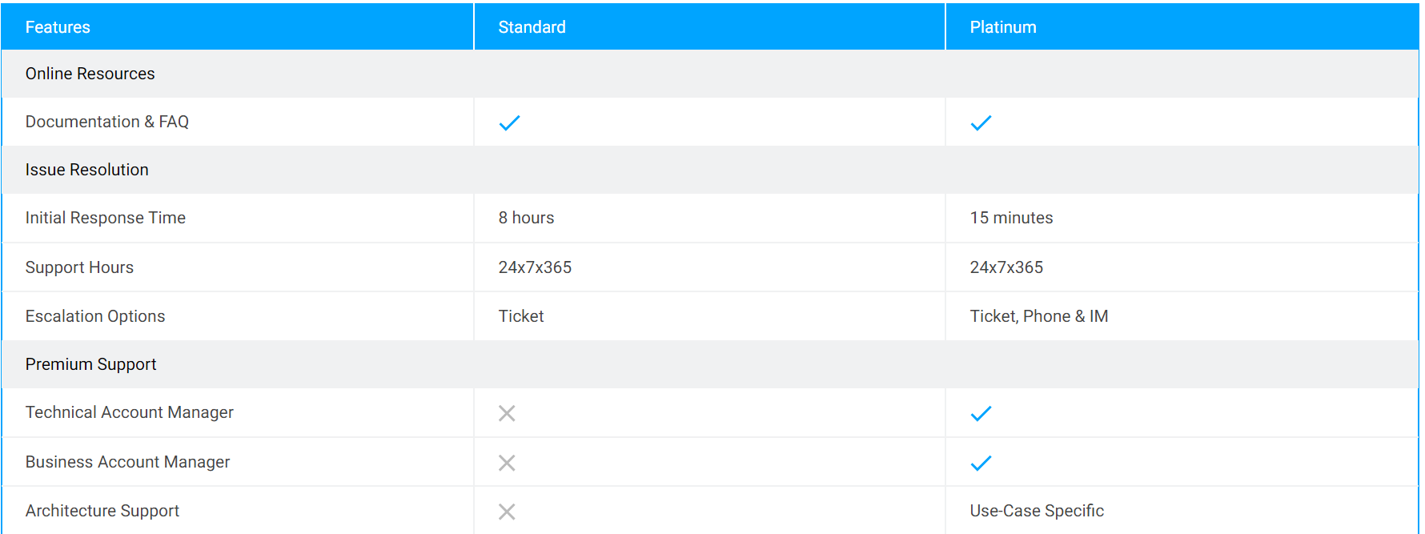
Services and support
Hong Kong (China) | +852 800-964-163 (Toll Free)
United States | +1 888-652-2736 (Toll Free)
Others | +86 4009-100-100
Sales Support
Technical Support
After-Sales Support Plans
Standard
Platinum
submit a ticket.

Slide 86
Product strategy
Performance
Reliability
RDMA ,FPGA,SPDK ,
kernel optimization
Data insurance
unsupervised learning for data deletion
Easy to use
Availability
AI tuning ,AI diagnose ,AI
heterogeneous migration
scale forecast
TencentDB
RTO RPO choice
any Anomaly detect
Security
Cost
AEP
Storage density
Serverless
Security policy
AI in Audit

Slide 87
TBase产品特性
接口友好
用户数据安全保护
完整兼容SQL2003
兼容ORACLE语法
基于三权分立的安全体系
矩阵式行列权限控制
透明数据加密脱敏能力
HTAP能力
金融级数据可靠性
单实例行列混合存储
OLTP，OLAP双引擎
多主多活多副本金融级数据可靠性保护
提供99.99%以上的数据可靠性
完整分布式事务能力
多硬件平台支持
业务无感知的分布式事务处理
支持RR,RC,SSI三个事务隔离级别
支持多种硬件平台，包括：X86,ARM,POWER,IBM S390等主流硬件平台

Slide 88
领先的技术和丰富的经验是成功的关键
王牌业务支持
稳定性保证
Wechat Pay
QQ Mail
Tencent Map
2014年上线，经过内外业务的长时间验证，稳定性保证
SUCCESS
技术领先
客户见证
团队拥有数据库领域的众多核心专利，技术领先
服务外部客户超过50家，包括银行、保险、公安、消防、税务、政务、烟草、医疗等

Slide 89
The DCN Architecture of WeBank
DCN(Data Center Node) include access ,logic, and storage layer
Every DCN in charge of fixed number of users.
Extend their business through DCN
GNS control the route of DCN
RMB deliver the messages between all DCNs
ADM summarize the data and metadata
Internet
Private network
GNS（DCN route management ）
RMB（message bus）
APP
APP
APP
APP
ACCESS
ACCESS
ACCESS
ACCESS
DBMS
DBMS
DBMS
Scale out
DBMS
ADM
DCN1
DCN2
DCNX
Notes:
什么是DCN?DCN是微众分布式架构的基础. DCN是一个自包含的单元,可以理解为是一个小型机,你可以把应用层,接入层,存储层全装在里面,但不同的是,我们的DCN是一个逻辑概念,是基于X86的平台服务器搭建. 每个DCN,我们会限定一个可承载的用户量,并根据这个用户量,来设计DCN的软硬件规模. 比如微粒贷,我们可能设置每个DCN就承载500万的用户.
那么问题来了,我怎么知道哪个用户在哪个DCN呢?所以我们需要一个全局的路由系统, 我们叫GNS,来管理DCN的路由信息.
解决了路由问题,还要解决DCN间的通信问题,所以我们还有一个RMB模块,叫可靠消息总线,来负责各DCN间的消息通信.
基于这种整体的架构,我们通过DCN能够实现很好的规模控制,以及很好的水平扩展的问题,所以我们在数据库层,就采用了TDSQL no shard的架构,避免了使用tdsql shard架构带来的一些额外的改造成本.

Slide 90
TBase—WeChatPay Vender System
CLB
CN
CN
CN
CN
CN
From 2016 ,TBASE supports WeChatpay 5million to 1billion transactions a day
Divide big and small vender to prevent the data skew
DZ:across region and AZ
Small Vendor hot data GROUP
Big Vendor hot data GROUP
Small Vendor cold data GROUP
Big Vendor cold data GROUP
DN1
DN2
DN6
DN7
DN12
DN13
DN18
DN19
DN3
DN4
DN8
DN9
DN14
DN15
DN20
DN21
DN4
DN5
DN10
DN11
DN16
DN17
DN22
DN23
latest 4 months data
High IO device for performance
the data before 4 months
Normal devices for costs

