Slide 1

Tencent Cloud Enterprise
Overview
TCE Architect Team

Slide 2
What is TCE ?
TCE Product Portfolio
Deep Dive into TCE
Disaster Recovery Solution
Agenda

Slide 3
What is Tencent Cloud Enterprise?
01

Slide 4
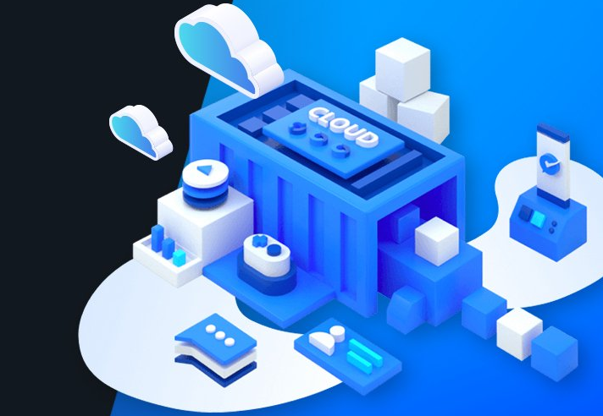
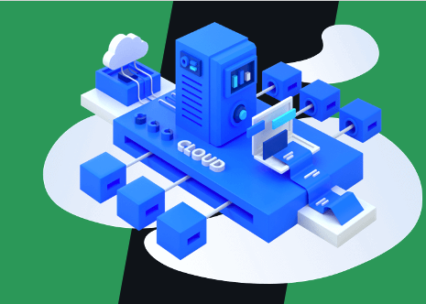

What is TCE (Tencent Cloud Enterprise) ?
Enterprise-Level, Full-Stack Cloud Solution
for customers that require Hybrid or Private cloud solution.
Stable and Efficient
Comprehensive
Safe and Reliable
Based on the same distributed architecture as Tencent Cloud public cloud.
Includes a broad range of cloud services, including IaaS & PaaS services.
Integrated intelligent security management services to keep cloud platform safe.

Slide 5
A Brief History of (Tencent Cloud Enterprise)
Internationalization, IPv6 supported.
50+ cloud services provided including IaaS, PaaS, Security and DevOps.
Complete IaaS services and more PaaS services, such as Storage, Message Quere, Cache Service.
Webank built its own private cloud by using tencent cloud services.
TCE Initiation
TCE 1.0
TCE 2.0
TCE 3.0
TCE 3.6
TCE 3.8
2014.12
2016.12
2017.08
2018.06
2020.06
2021.01
Basic IaaS Services and database service, such as Virtual Machine, Load Balancer, MySQL.
Comprehensive cloud services based on virtual network, released brand new cloud native services.
More cloud native services provided, such as logging, big data, blockchain and cloud firewall.

Slide 6






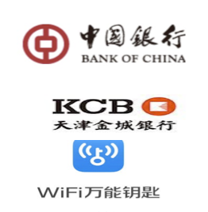

A Brief History of (Tencent Cloud Enterprise)
Internationalization, IPv6 supported.
50+ cloud services provided including IaaS, PaaS, Security and DevOps.
Complete IaaS services and more PaaS services, such as Storage, Message Quere, Cache Service.
Webank built its own private cloud by using tencent cloud services.
TCE Initiation
TCE 1.0
TCE 2.0
TCE 3.0
TCE 3.6
TCE 3.8
2014.12
2016.12
2017.08
2018.06
2020.06
2021.01
Basic IaaS Services and database service, such as Virtual Machine, Load Balancer, MySQL.
Comprehensive cloud services based on virtual network, released brand new cloud native services.
More cloud native services provided, such as logging, big data, blockchain and cloud firewall.

Slide 7

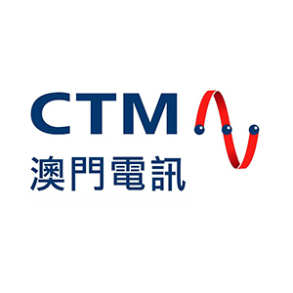

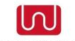


















Tencent Cloud Enterprise Customers by Industries
  Education &
  Government
  Media & Telecom
TCE Customers
  Financial Services
  Retail & Estate
  Automotive & Manufacturing

Slide 8



Tencent Cloud Enterprise Use Cases
  Private/Hybrid Cloud
  Industry-Specific Cloud
  Hosted Cloud
Deployed on premises for government and enterprise customers. Provides enterprises with a consistent hybrid cloud experience.
Specialized cloud applications and services that address specific industry needs.
Deployed on Tencent Cloud’s datacenter for enterprise customers.

Slide 9
Tencent Cloud Enterprise Product Portfolio
02

Slide 10
Tencent Cloud Enterprise Product Portfolio
Web Portal for Tenant
Web Portal for Manager
Cloud API
Security
TCenter
Cloud Manager
Web Application Firewall
Management
Operation Support Platform
(Billing, Documentation, Account)
Management Platform
(Cloud Monitor, CMDB, DCOS)
Cloud Workload Protection
Productivity
Development
Tencent Kubernetes Engine
API Gateway
Tencent Service Framework
Message Queue CKafka
Security Operations Center
Platform as a Service
CODING DevOps
Key Management Service
Database
TDSQL for MySQL
TDSQL for PostgreSQL
CTSDB
Redis
MongoDB
Compute
Storage
Network
Network Traffic Analysis
Cloud Virtual Machine
Cloud Block Storage
Virtual Private Cloud
Network Intrusion Prevention System
Bare Metal Server
Cloud Object Storage
Cloud Load Balancer
Infrastructure as a Service
Auto Scaling
Cloud File Storage
Direct Connect
Secrets Manager
Full Virtualization
Software Defined Storage
Software Defined Network
Cloud Audit
Data Center
Physical Servers (Intel x86, ARM, GPU)
Physical Network (Switches, Firewall, AAA )

Slide 11


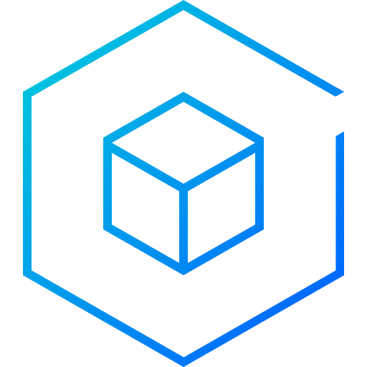
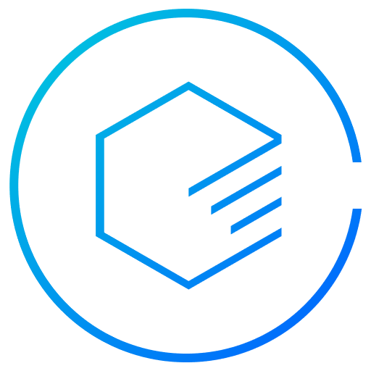
TCE IaaS available on-premises
Compute
Networking
Storage
Data Center Oprating System
Cloud Virtual Machine
GPU Cloud Computing
Bare Metal Server
CVM Dedicated Host
Auto Scaling
Virtual Private Cloud
NAT Gateway
Direct Connect
Cloud Load Balancer
Peering Connection
Cloud Block Storage
Cloud File Storage
Cloud Object Storage
Cloud Log Service
A management system that enables lifecycle management of physical servers and network switches.
Beyond traditional virtualization

Slide 12

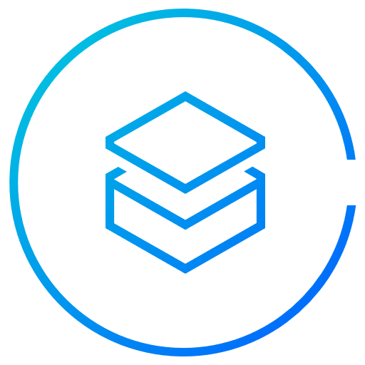

TCE Compute Service Portfolio
Cloud Virtual Machine
GPU Cloud Computing
CVM Dedicated Host
Bare Metal Service
Auto Scaling
Based on KVM Virtualization;
Flexiable Configuration;
High Stability and Reliability;
Easy Management;
Secure Network;
Service Integration;
Provides GPU computing by VM;
Excellent Performance via PCIe passthrough;
Provides physical machine-grade exclusive resources;
Inherent CVM Features;
Provides physical server resources for users;
Integration with VPC network, Load Balancer, and other tencent cloud services.
Automatically creates and removes CVM instances based on business load;
Allows users to schedule scaling;
Fault-tolerant

Slide 13
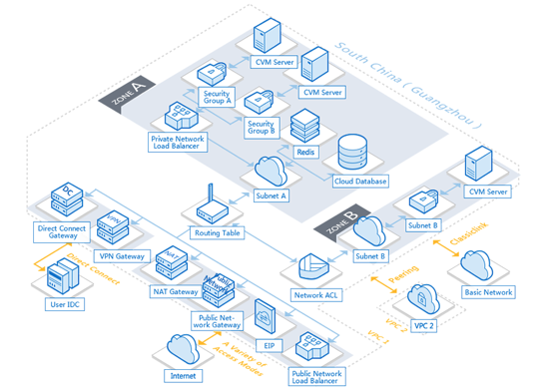





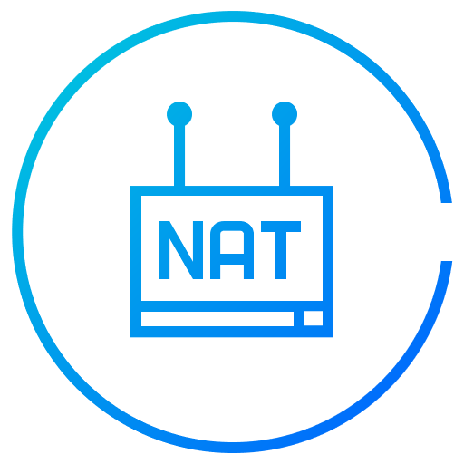
TCE Network Service Portfolio
Virtual Private Cloud
- Isolation
Direct Connect
- Connectivity
Peering Connection
- Connectivity
Cloud Load Balancer
- Distribution
Elastic IP
- Distribution
NAT Gateway
- Distribution

Slide 14
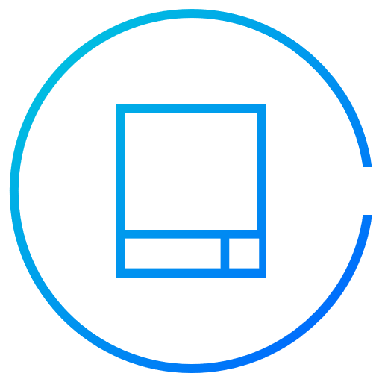


TCE Storage Service Portfolio
Cloud Block Storage
Cloud File Storage
Cloud Object Storage
Cloud Log Service
Elastic Scalability: one single cloud disk can store up to 16 TB of data;
Multiple Storage Types: premium cloud disk, SSD cloud disk;
Snapshot Backup;
High Stability and Reliability
Supports NFS v3.0/4.0 protocols and POSIX APIs;
Elastic Capacity and Performance;
Permission Management;
Object Management
Supports a variety methods for conducting batch operations on storage objects.
Real-time Collection: LogListener Collection, API/SDK Collection;
Real-time Indexing, Powerful Query Engine, Flexible Queries

Slide 15

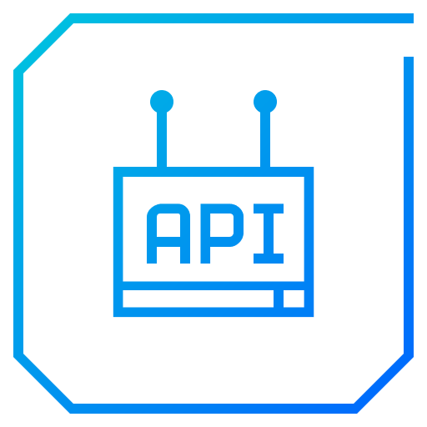
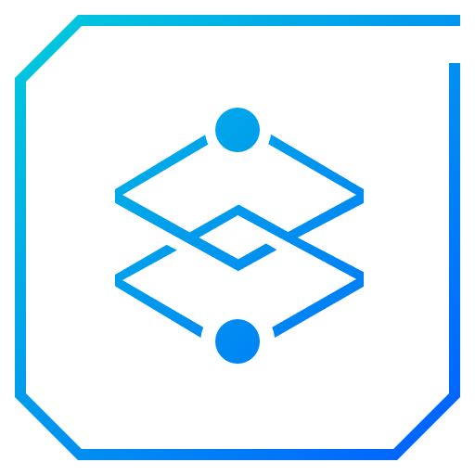


TCE PaaS available on-premises
Tencent Kubernetes Engine
API Gateway
Tencent Service Framework
Message Queue Ckafka
CODING DevOps
Container management, with TKE support for Docker and Kubernetes.
API hosting service that enables full lifecycle management of APIs.
Application management platform for microservices, supported Spring Cloud, Service Mesh.
Distributed, high-throughput and highly scalable messaging system that compatible with Apache Kafka API.
Enable companies to more rapidly and reliably build and deliver products using DevOps practices.
High productivity development

Slide 16
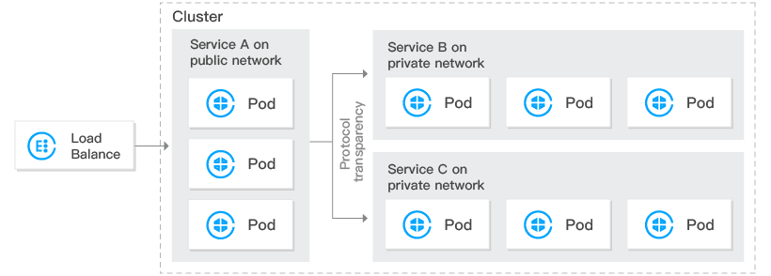
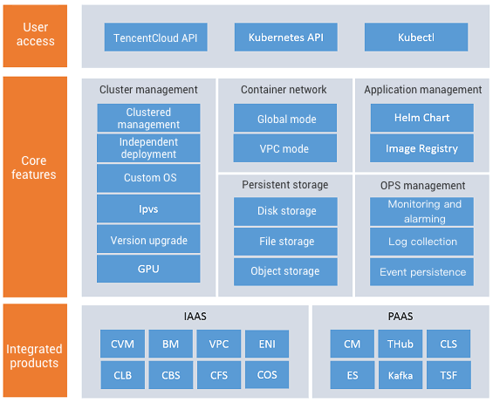
Container Service – TKE (Tencent Kubernetes Engine)
Security and Reliability: TKE resides in a dedicated Cloud Virtual Machine(CVM) instance with computing resources exclusive to the tenant.
Ecosystem and Openness: TKE is fully compatible with the entire range of Kubernetes capabilities and has been adapted to Tencent Cloud’s fundamental IaaS capabilities such as CVM, CBS and CLB.

Slide 17

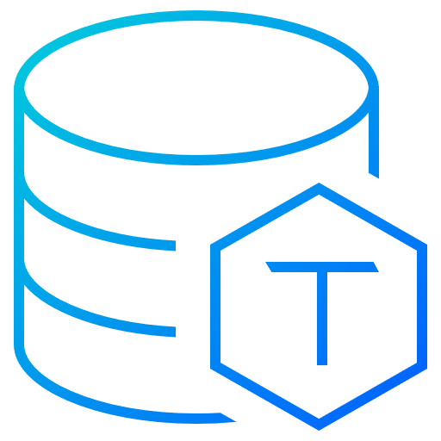
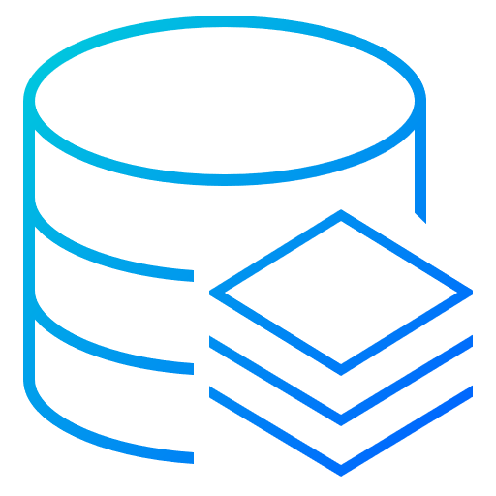
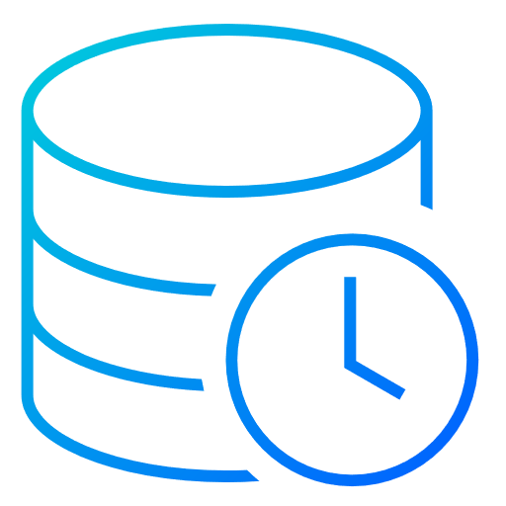
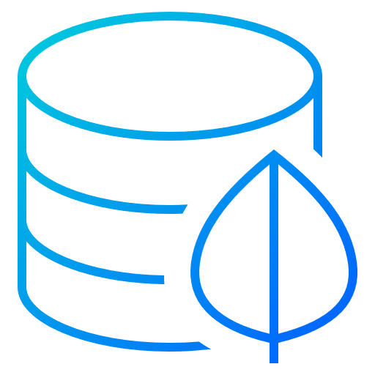
TCE PaaS available on-premises
TDSQL for MySQL
TDSQL for PostgreSQL
TencentDB for Redis
TencentDB for CTSDB
TencentDB for MongoDB
A high performing shard-enabled distributed database highly compatible with MySQL and MariaDB.
A powerful database ideal for handling complex SQL processing in OLTP wordloads.
A Redis-compatible elastic caching and storage service.
A stable, reliable, and cost-effective online high-performance time series database service.
A stable, secure and high-performance document database compatible with MongoDB.
High performance database services

Slide 18
TCE Security Services available on-premises
On-premises:
Web Application Firewall
Cloud Workload Protection
Network Threat Analysis
Network Intrusion Prevention System
Vulnerability Scanning System
Database Auditing
Security Operations Center
VPN Service
SaaS on Public Cloud:
Anti-DDoS
Consulting & Expert Services:
Compliance Consulting Service
Penetration and Emergency Response Services

Slide 19
Deep Dive into
Tencent Cloud Enterprise
03

Slide 20
System Architecture of TCE
Cloud Service Layer
Compute
Storage
Networking
Database
Middleware
Security
Control Layer for Cloud Service and Cloud Platform
Authentication, Authorization System for Tenant
Authentication, Authorization System for Manager
Web Portal
Deployed to Kubernetes
Operation Support System
for Cloud Service
Management System for Underlay Service
Resource Management
(Orchestration, Scheduling)
Persistent Storage Layer
Underlay Service Layer
TDSQl for MySQL
Message
Queue
Redis
DCOS
Out-of-band Management
NTP
ZooKeeper
ElasticSearch
Object Storage
DNS
Monitoring Service
YUM
Physical Device Layer: Data Center, Physical Server, Physical Network

Slide 21
VPC
Based on Host Overlay;
GRE tunnel encapsulation;
Multi-tenant isolation;
Various network features;
CLB
Multi-protocol Forwarding: supports requests from Layer-4(TCP, UDP) and Layer-7(HTTP, HTTPS);
Supports weight configuration, session persistence, health checks, cross-az disaster recovery;
DC
Enables users to interconnect among multiple local IDCs;
TCE Software Defined Network

Slide 22
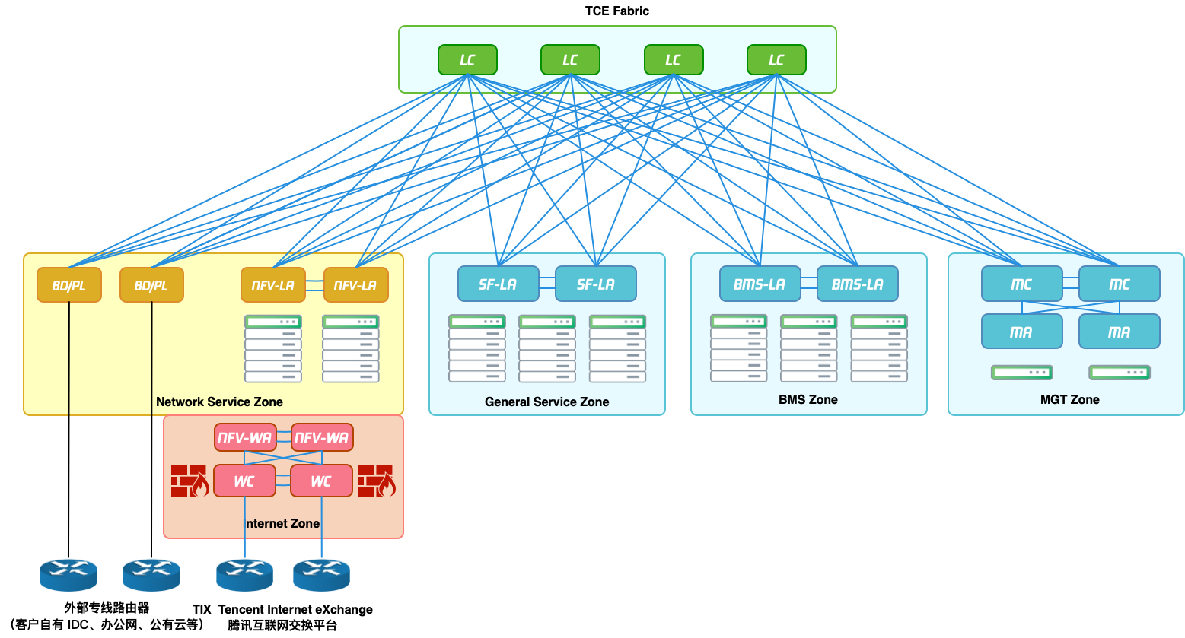
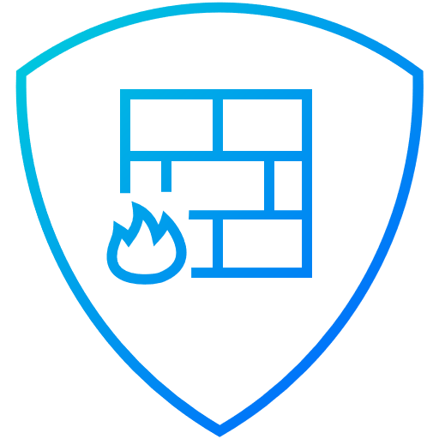
TCE Physical(Underlay) Network Architecture in Logical Sections
Internet Access
Intranet Access
Internet
Firewall
Private Link
Data Exchange Module
General Service
Zone
Bare Metal
Service Zone
Network Service
Zone
Out-of-band Management Zone: Provides access to network devices via console port, to physical servers via iLo, and is uplinked to core switch LC.
TCenter, VM
Physical Server for Bare Metal
Load Balancer
Database…
VPC, DC, NAT…
Out-of-band Management Zone
Data Exchange Module: Core Switch to connect each Zone
Internet Access: Provides access to Internet Service Providers(ISPs) or user’s own backbone networks.
Intranet Access: Access to user’s internal backbone networks, including access to Virtual Private Cloud(VPC) by using leased lines.
General Service Zone: Provides access to Cloud Virtual Machine(CVM), Database, Middleware and is uplinked with core switch LC.
Bare Metal Server Zone: Provides access to Bare Metal Service(BMS) and is uplinked to core switch LC.
Network Device
Management
Physical Server
Management
Network Service Zone: Provides access to SDN network nodes, such as VPCGW, TGW, NATGW, and is uplinked to core switch LC.

Slide 23




TCE Physical(Underlay) Network Architecture
LC：LAN Core
LA：LAN Access
BD/PL：Border/Private Line
MC：Mgmt Core
MA：Mgmt Access
NFVL：NFV-LAN
NFVW：NFV-WAN
WC：WAN Core
100G
Internet
40G
25G
10G
Gigabit
Intranet
Traffic Detection Zone
Mirror-TM
BFW
WC
EBGP
Network
Service
Zone
NFVW
Dedicated line access
GW
IPS
IDS
...
OSPF
ECNFW
ECNSW
Mirror-YJ
NFVL
PL
Core Switch
Data Exchange Module
EBGP
LC
EBGP
…
LA
LA
BMS-LA
MC
...
...
...
MA
...
General Service Zone
BMS Zone
OOB Mgmt Zone

Slide 24
TCenter Cloud Manager
Provides operators with cloud resource allocation management, calculation and billing, message notification, etc.
Users
Manager
Provides Maintenance personnel with system monitoring, alarms, problem processing, availability guarantee tools, etc.
Provides cloud tenants with cloud service‘s creation and operation usage and lifecycle management.
Operator
Web Portal for
Tenant Users
Management
Platform
Operation Support Platform
Web Portal for
Manager

Slide 25
Authentication, Authorization System

Slide 26
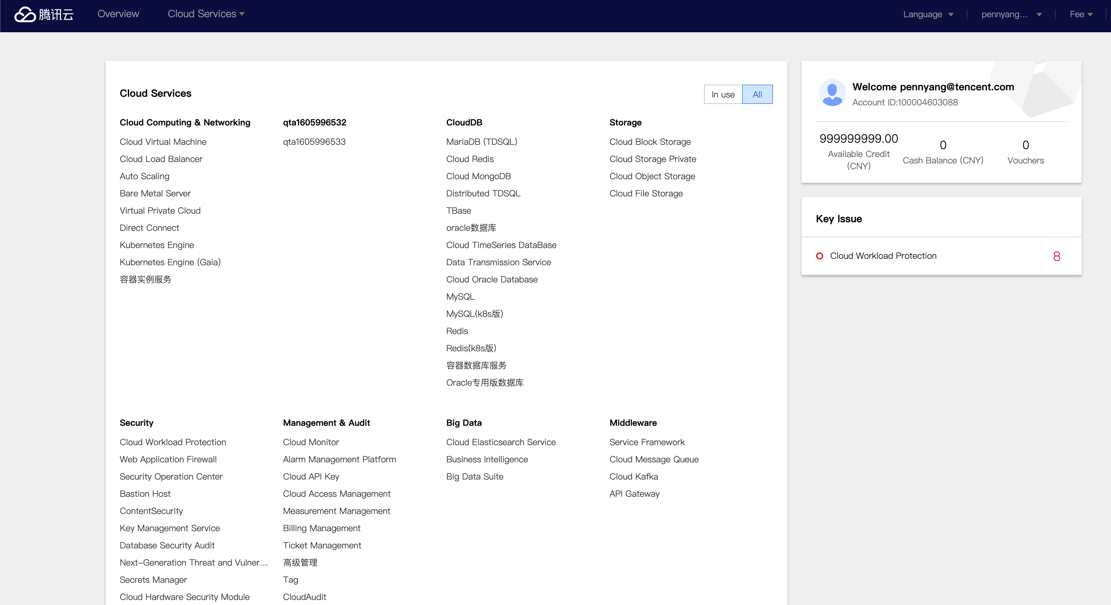
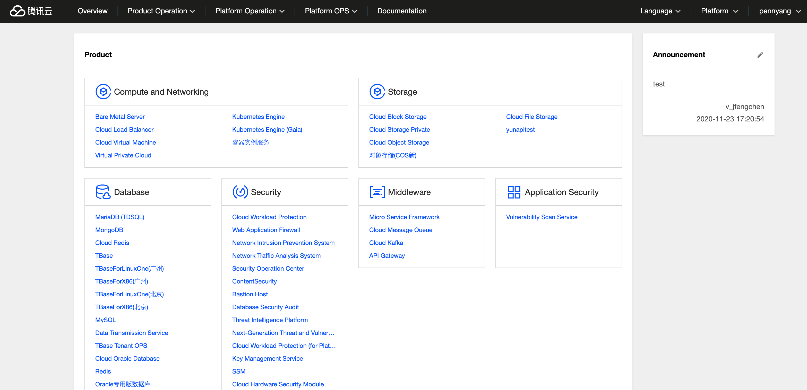
TCenter Cloud Manager – Web Portal Screenshots
Web portal for Tenant
Web portal for manager

Slide 27
04
Disaster Recovery Solution

Slide 28
Architecting disaster recovery

Slide 29
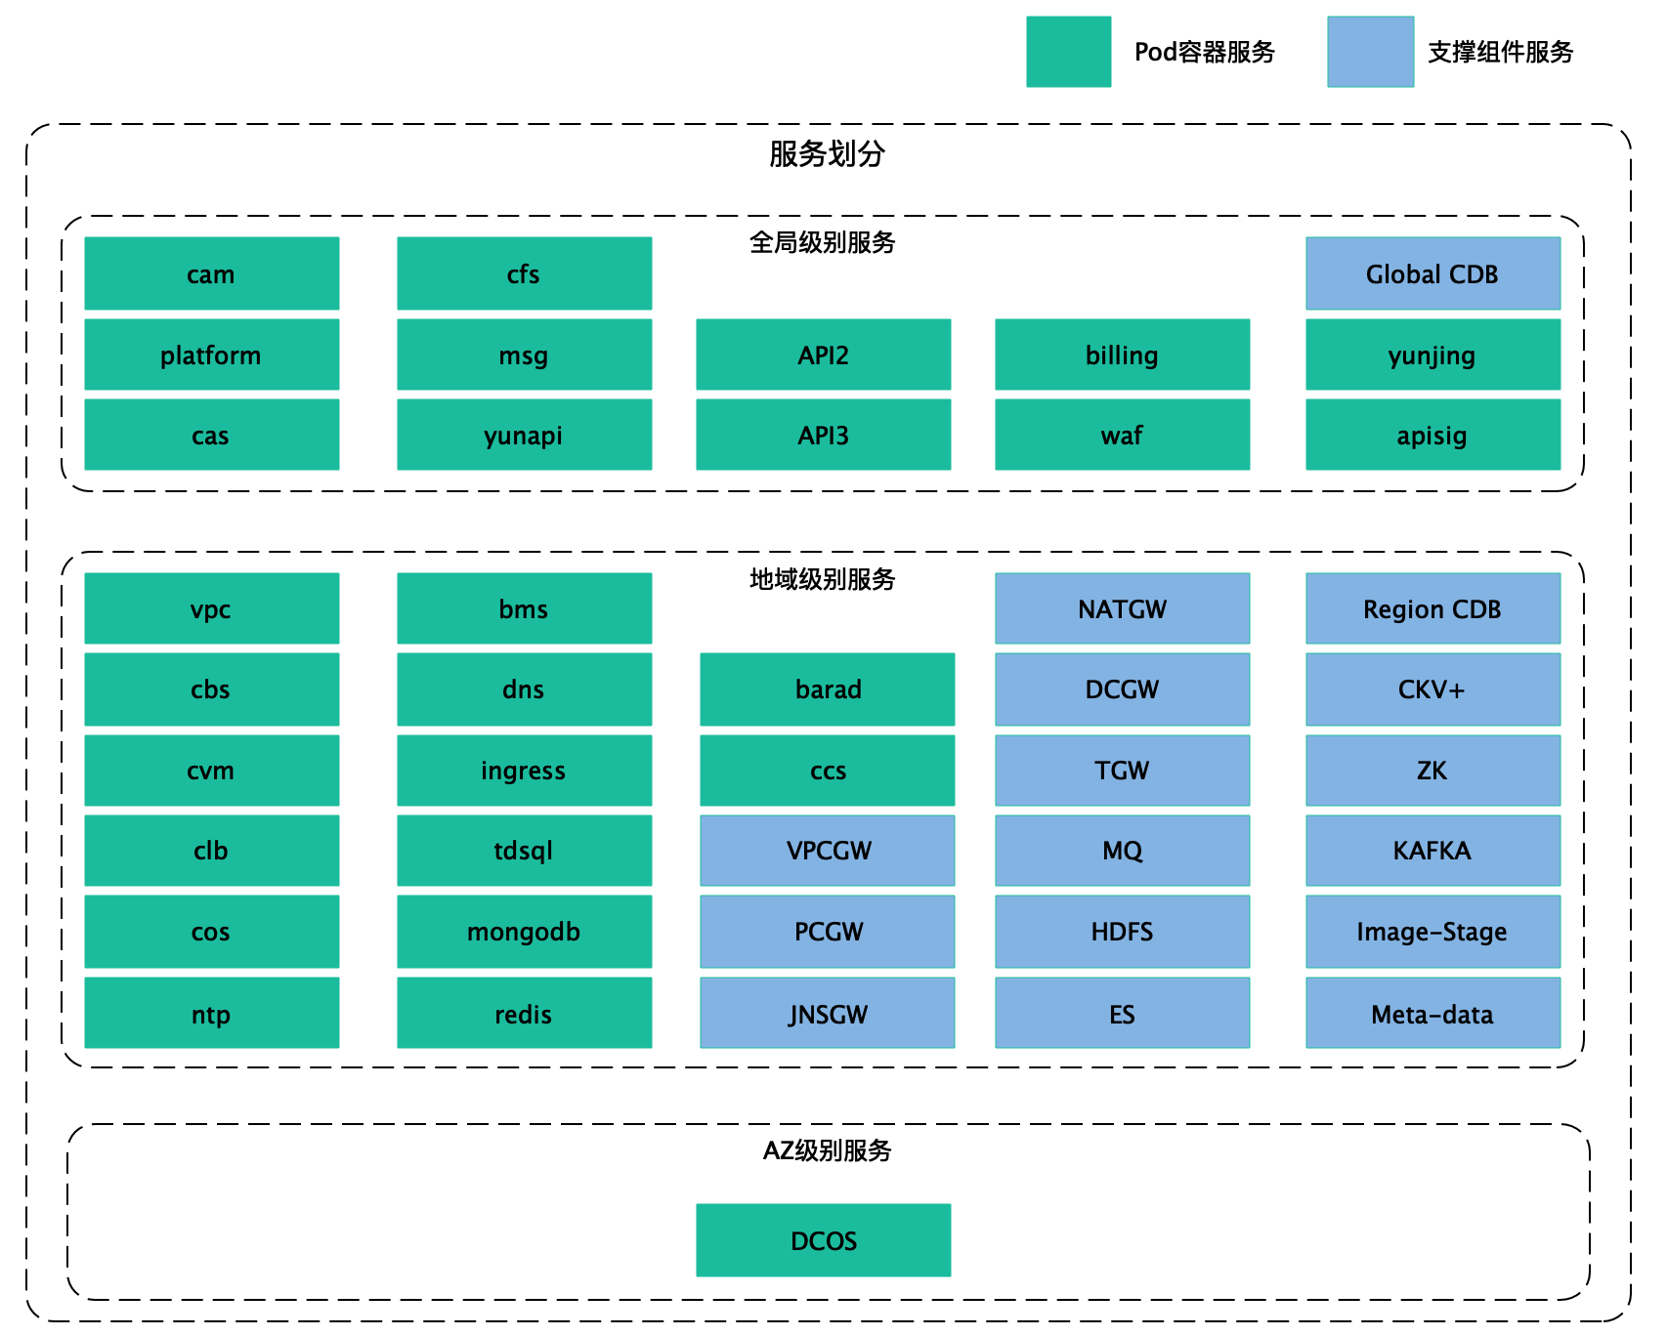
Divided services for disaster recovery
The HA solution of control components depends on the design and implementation of the high availability scheme of internal 200+ components
The services provided by these components are divided into three categories, defined as follows:
Service Level | Failure Domain | Description
Global Services | Global | Service exceptions will affect the stability of global functions. Such as account service, CAM authentication service, cloud API service, message service, etc.
Regional Services | Region | Services are deployed at the region level. Such as : VPC、CLB、CSP、TDSQL , which have HA capability in same region.
Zonal Services | Available Zone | Such as DCOS, which have HA capability in same AZ.

Slide 30
Disaster Recovery Solution

Slide 31
Q&A

Slide 32
THANK YOU!
感谢聆听！

